Slide 1
“Energy saving through the use of phase change materials (PCM)”
23th^{th} International Expert Meeting
Power Engineering 2014
Stephan Thaler, MSc

Slide 2

Content
Motivation
Idea
Introduction
Target
Experimental Setup
Measurement
Results
Conclusion

Slide 3

Motivation
Increased occurrence of regenerative energy.
Temporally fluctuating and non-controllable power profile of the energy sources sun and wind.
Need for grid smoothing.
Cost-effective energy storage will be more important in future.
http://www.dena.de/themen/erneuerbare-energien.html

Slide 4
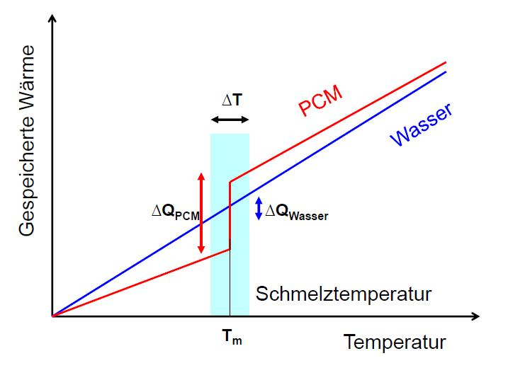
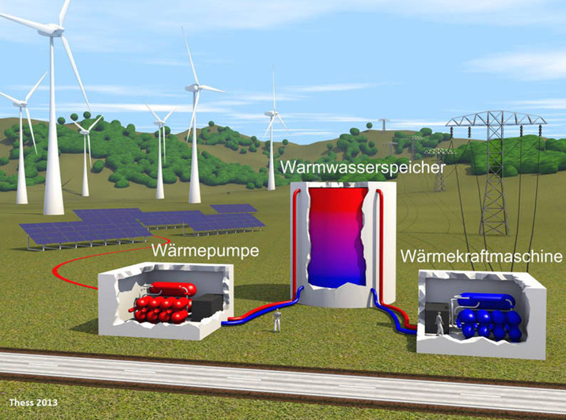
Idea
Convert the surplus energy into heat and store it in heat tanks to compensate the fluctuating power generation.
New storage media such as salt or paraffin mixtures in which a phase change takes place for more efficient heat storage.
Integrate suitable PCM-tanks into an existing heat pump system for a more economically use of the heating pump.
http://www.elektroniknet.de/power/energiespeicher/artikel/100949/

Slide 5

Target
Service for the grid
Efficient energy/heat storage.
Achieve an economically meaningful operation of the heat pump (Energy Save).
The significant parameter is the charging and discharging time.

Slide 6

Introduction
Integrate potential latent heat storage tanks into a heat pump system.
Store the surplus energy and use it in the private heating system.
The expected results should provide innovative heat storage methods to overcome the new challenges.

Slide 7
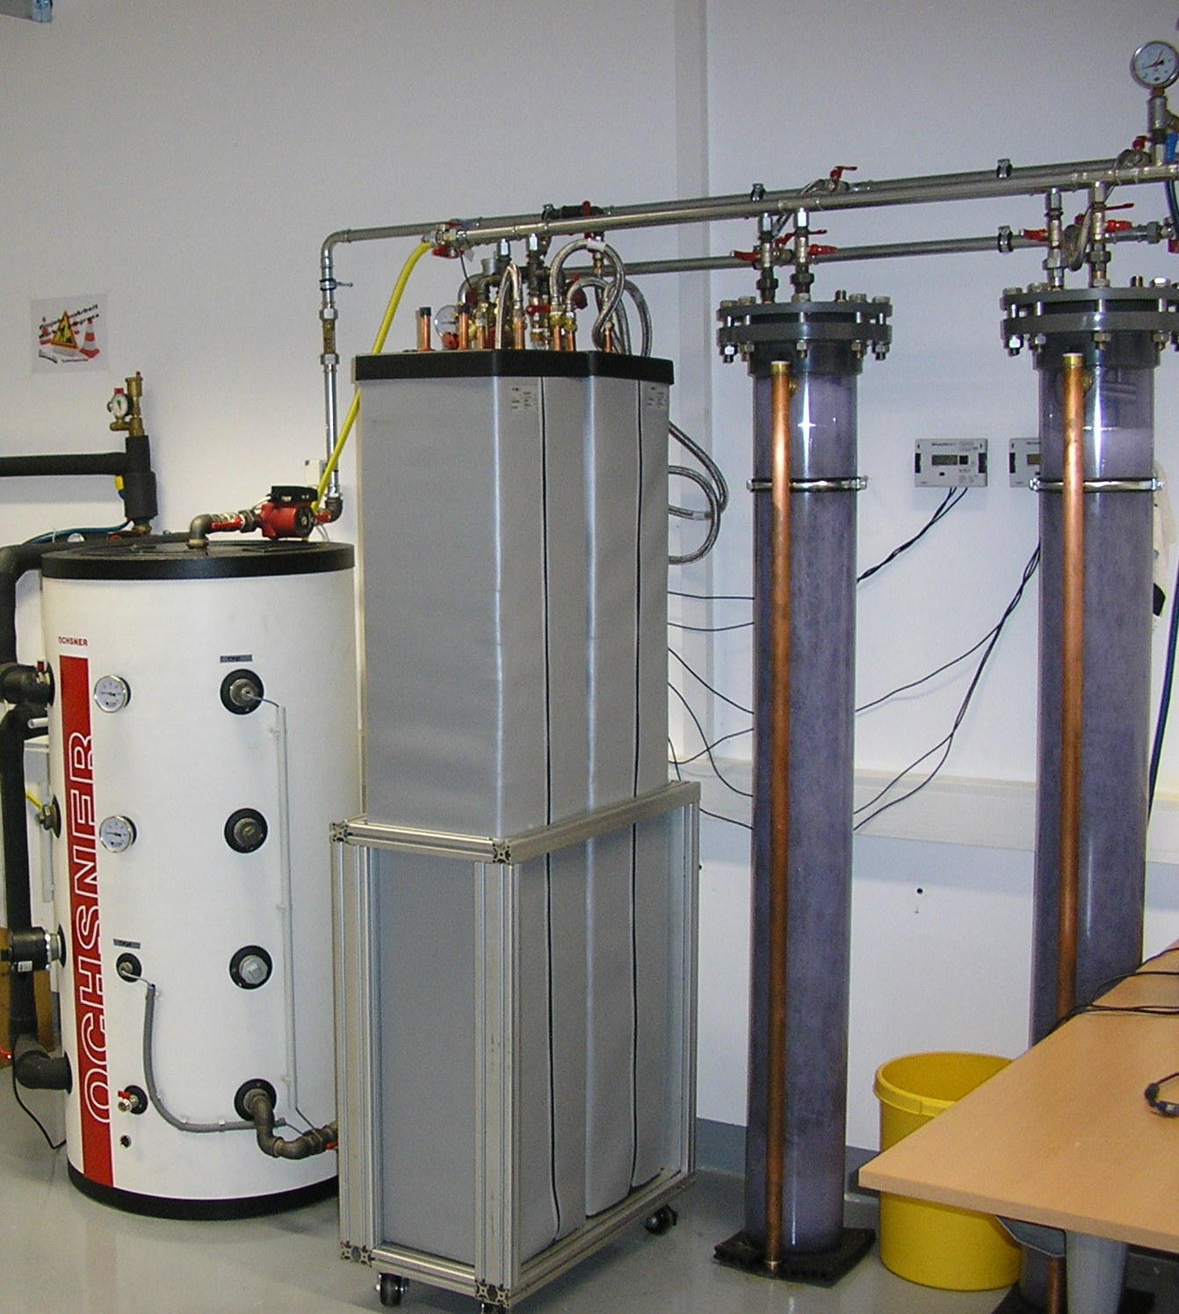
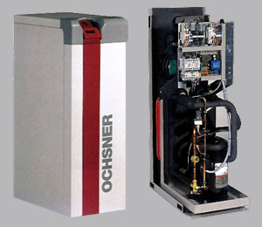
Experimental Setup
Heat pump unit - established in the laboratory
(provide implementation of latent heat storage tanks)
Different latent storage tanks – will be tested
(using appropriate test setups)
(evaluated their possible fields of application)

Slide 8
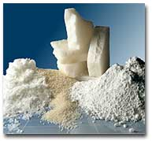
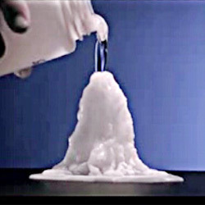
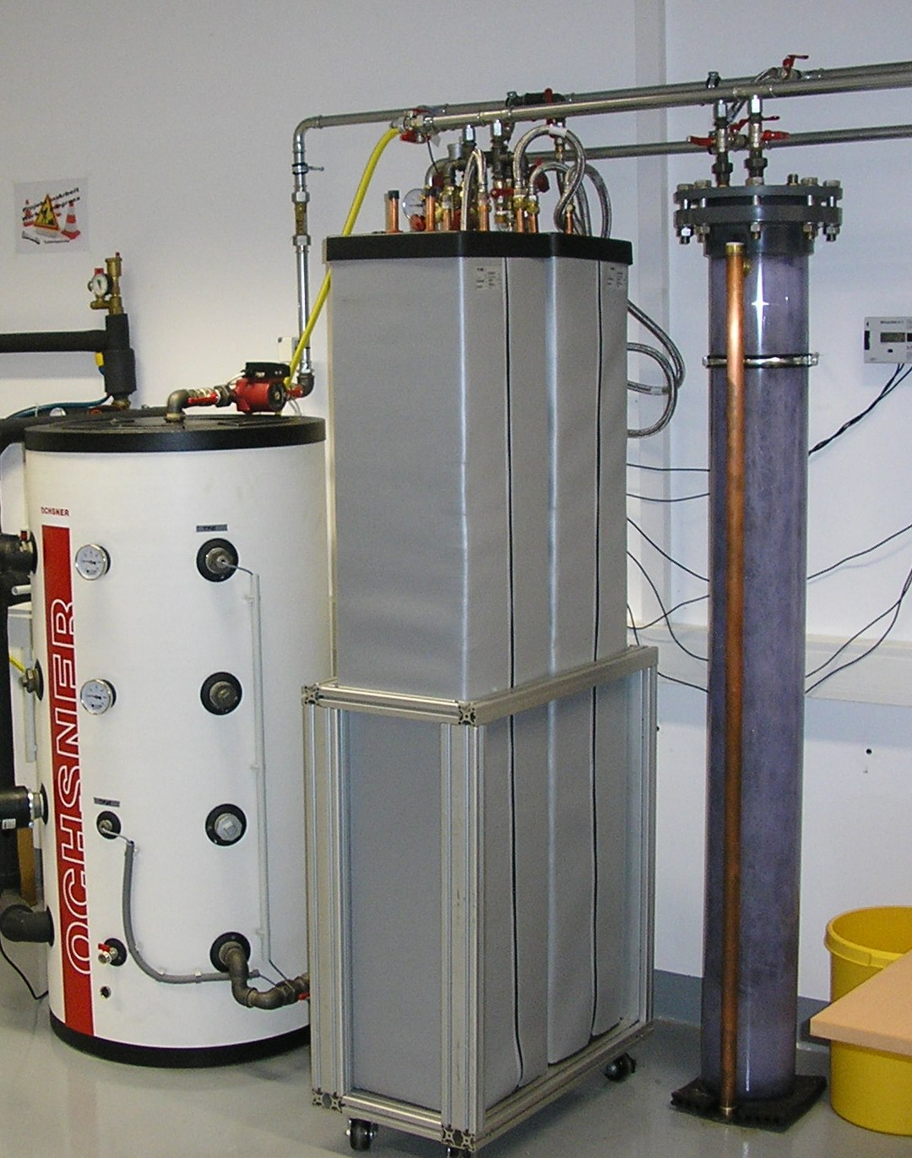
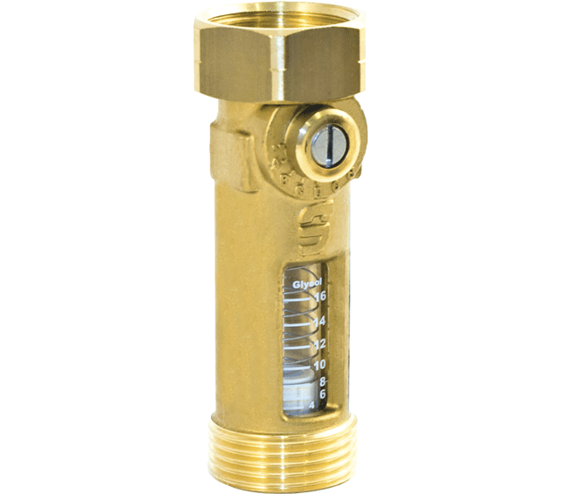
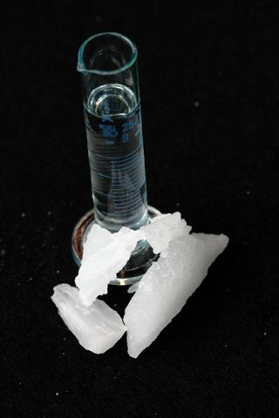

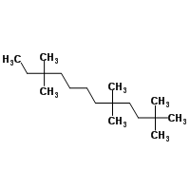
Experimental Setup
Various storage media
H2O, Na(CH₃COO).3H₂O, C₁₈H₃₈
Control & Measurement tools

Slide 9
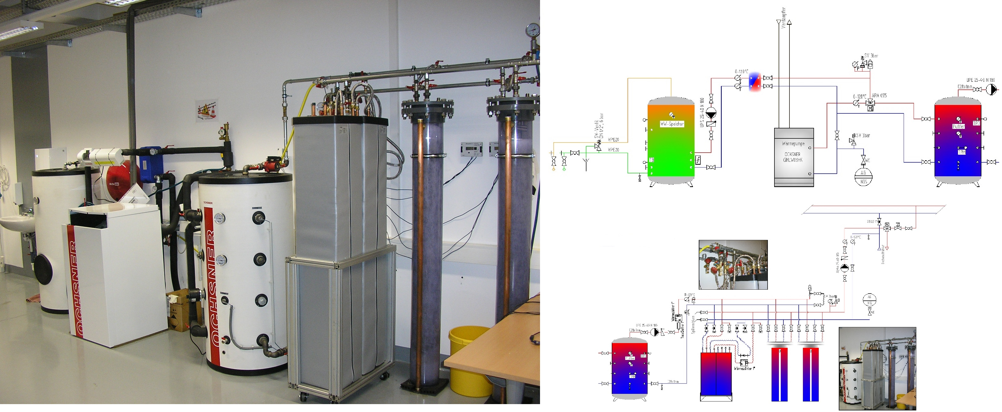
Experimental Setup

Slide 10
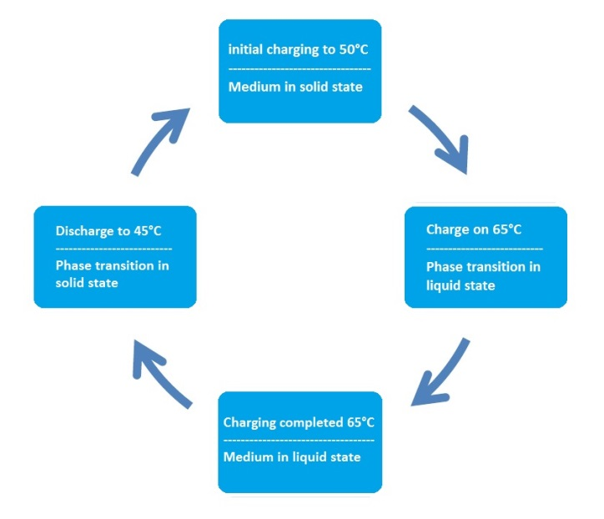
Experimental Setup
Experimental sequence
Initial charging
  (Salthydrate 50°C, Paraffin 30°C)
Phase transition
  (Salthydrate 65°C, Paraffin 50°C)
Full charge
Discharge
Na

Slide 11
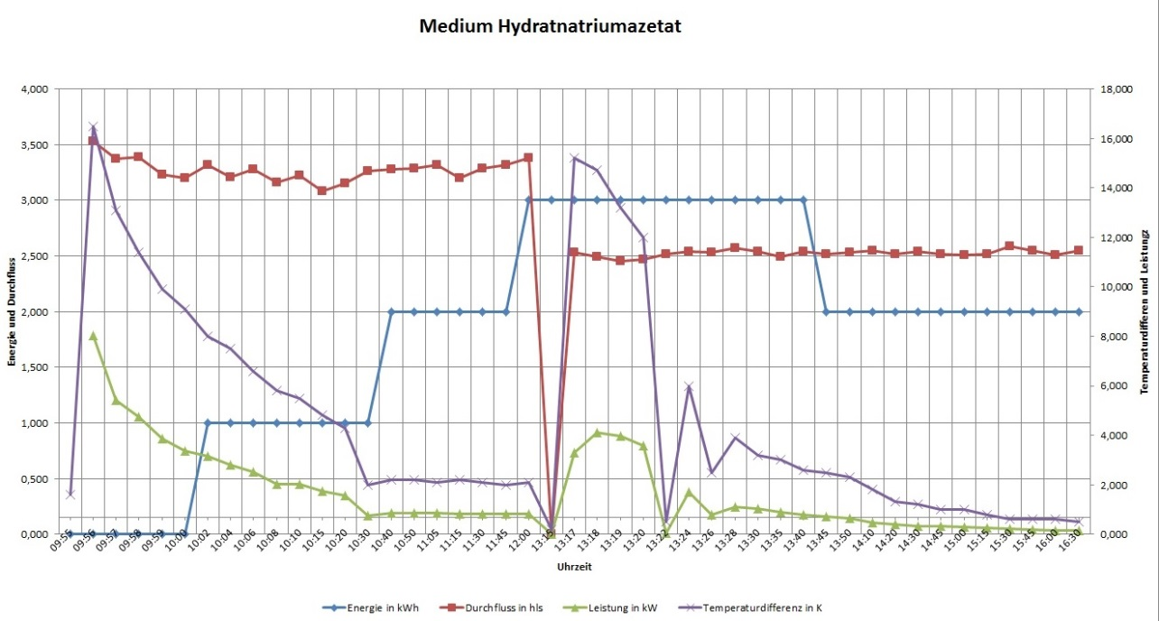
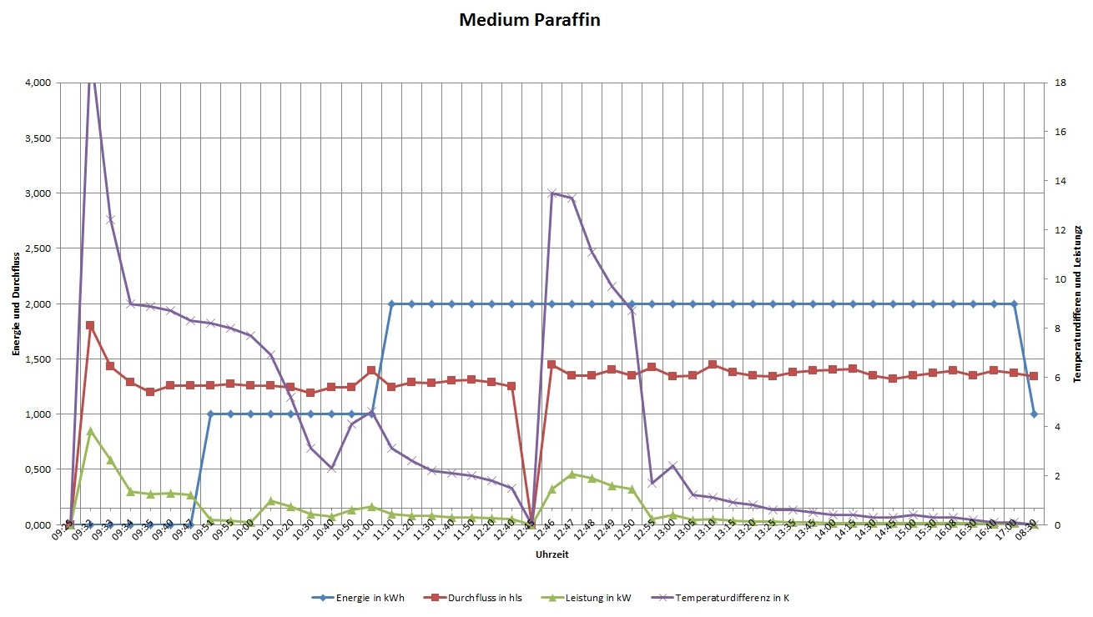
Measurement
Different measurement setups with
data acquisition
(energy, power, flow rate, temperature)
  Test setup buffer (reference)
  Test setup salt-hydrate tank
  Test setup paraffin tank

Slide 12

Results
Salt-hydrate tank
Charge: 3 kWh – Discharge: 1 kWh
Paraffin Tank
Charge: 2 kWh – Discharge: 1 kWh
Energy could not be totally released!

Slide 13
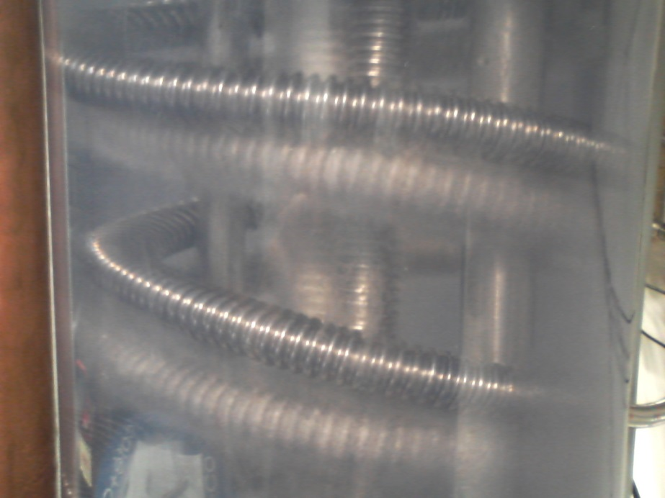
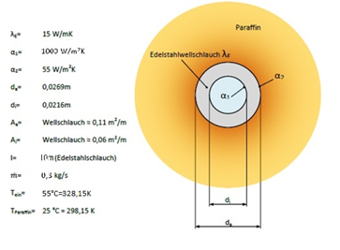
Results
Reason:
A too rapid discharge (energy removing) or at too high temperature difference of storage medium and heat exchanger starts the phase transition in the extraction region.
An insulating layer around the heat exchanger prevents further heat exchange.
Betrachtung unterschiedlicher Wärmepumpenheizsysteme und Möglichkeiten der Energieversorgung,
Dorian Münzer, FH Kärnten, 2013

Slide 14

Conclusion
Advanced latent heat storage materials of saline or paraffin base are produced for various applications and are available for nearly all temperature ranges. The needed temperature range depends on the type of heat generation as well as the employed heat dissipation system. Very important is that the return temperature is not significantly below the phase transition temperature. Otherwise it results in the formation of an insulating layer because of the storage medium solidification at the heat exchanger.
This effect can be avoided by the use of a traditional buffer or by a corresponding return temperature rising.
ADVANTAGES:
Heat pump:
extension of the heating phase by expanding the storage volume.
Storage Tank:
much longer discharge cycle
(energy storage expansion because of the phase transition)

