Slide 1
SOLAR POWER PLANT „STUDENTSKI RESTORAN VARAŽDIN”
Dunja Srpak, dipl.ing.el.
mr.sc. Ivan Šumiga dipl.ing.el.
Sandra Stijačić ing.el.

Slide 2
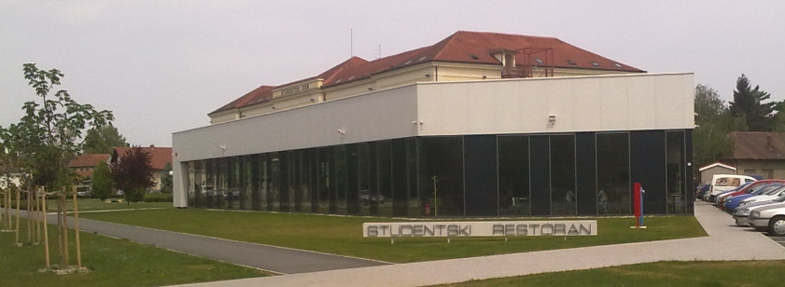
SPP “ STUDENTSKI RESTORAN VARAŽDIN”
- Designed and built in 2014 – total Power 68 kW
- Produced energy for consumption in restaurant, surplus into the network

Slide 3
INVERTERS ON THE SOLAR POWER PLANT
inverters with low frequency transformer (LF)
inverters with high frequency transformer (HF)
inverters without transformers (transformerless (TL) inverter).
Schematic diagram of the inverter with high-frequency transformer (efficiency 94,5%)
Schematic diagram of the inverter with low-frequency transformer (efficiency 96%)
Schematic diagram of the inverter without transformer (efficiency 98%)

Slide 4
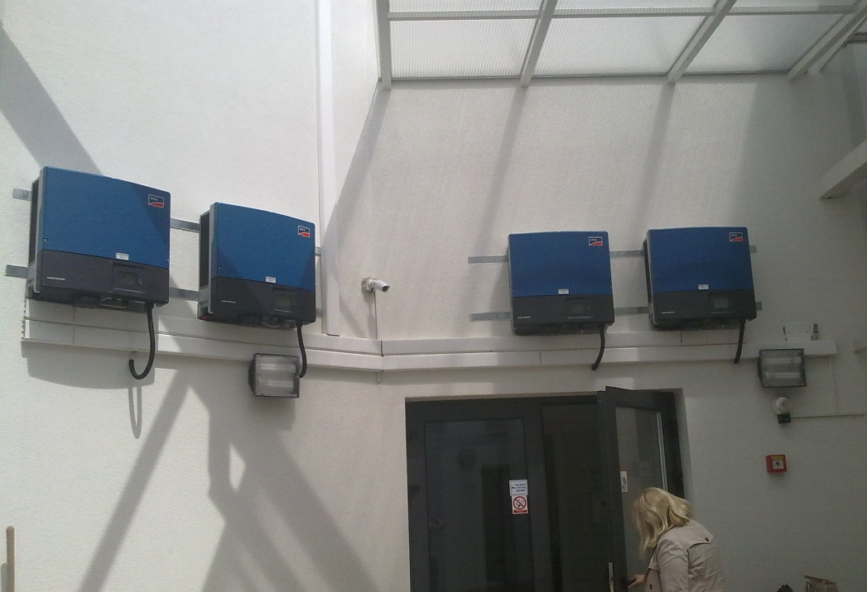

Inverters SMA Sunny Tripower 17000TL in Varaždin
P_{max-DC} (cosφ=1) 17410 W
V_{max-DC} 1000 V
I_{max-AC} 24.6 A

Slide 5
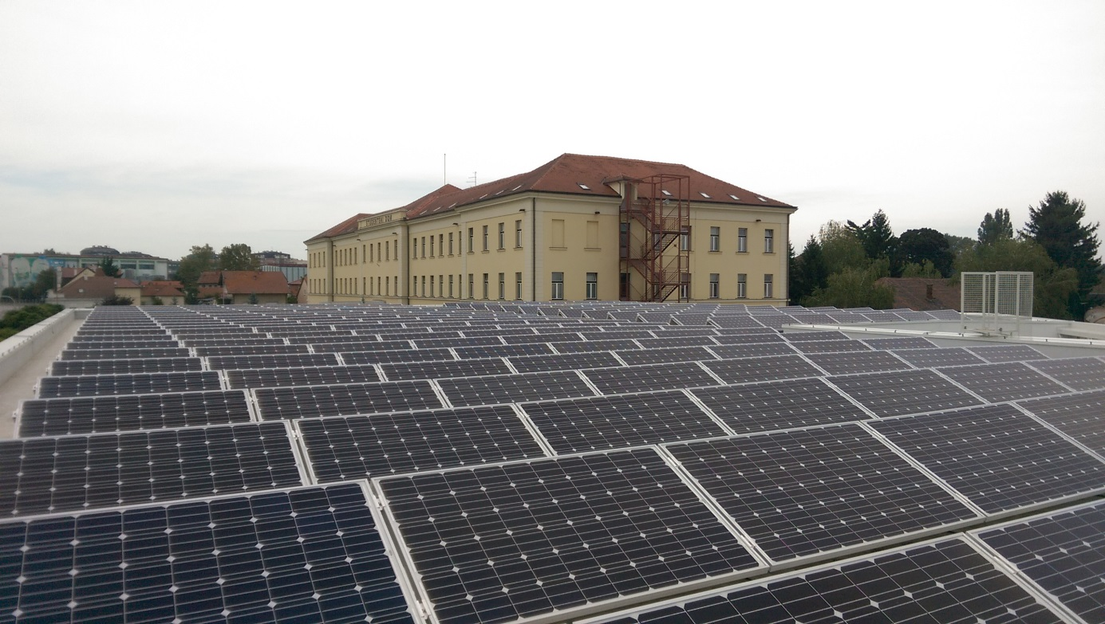
SOLAR PANELS MOUNTED ON THE ROOF
Monocrystalline PV modules 274x270W, 35.7V, 7.6A

Slide 6
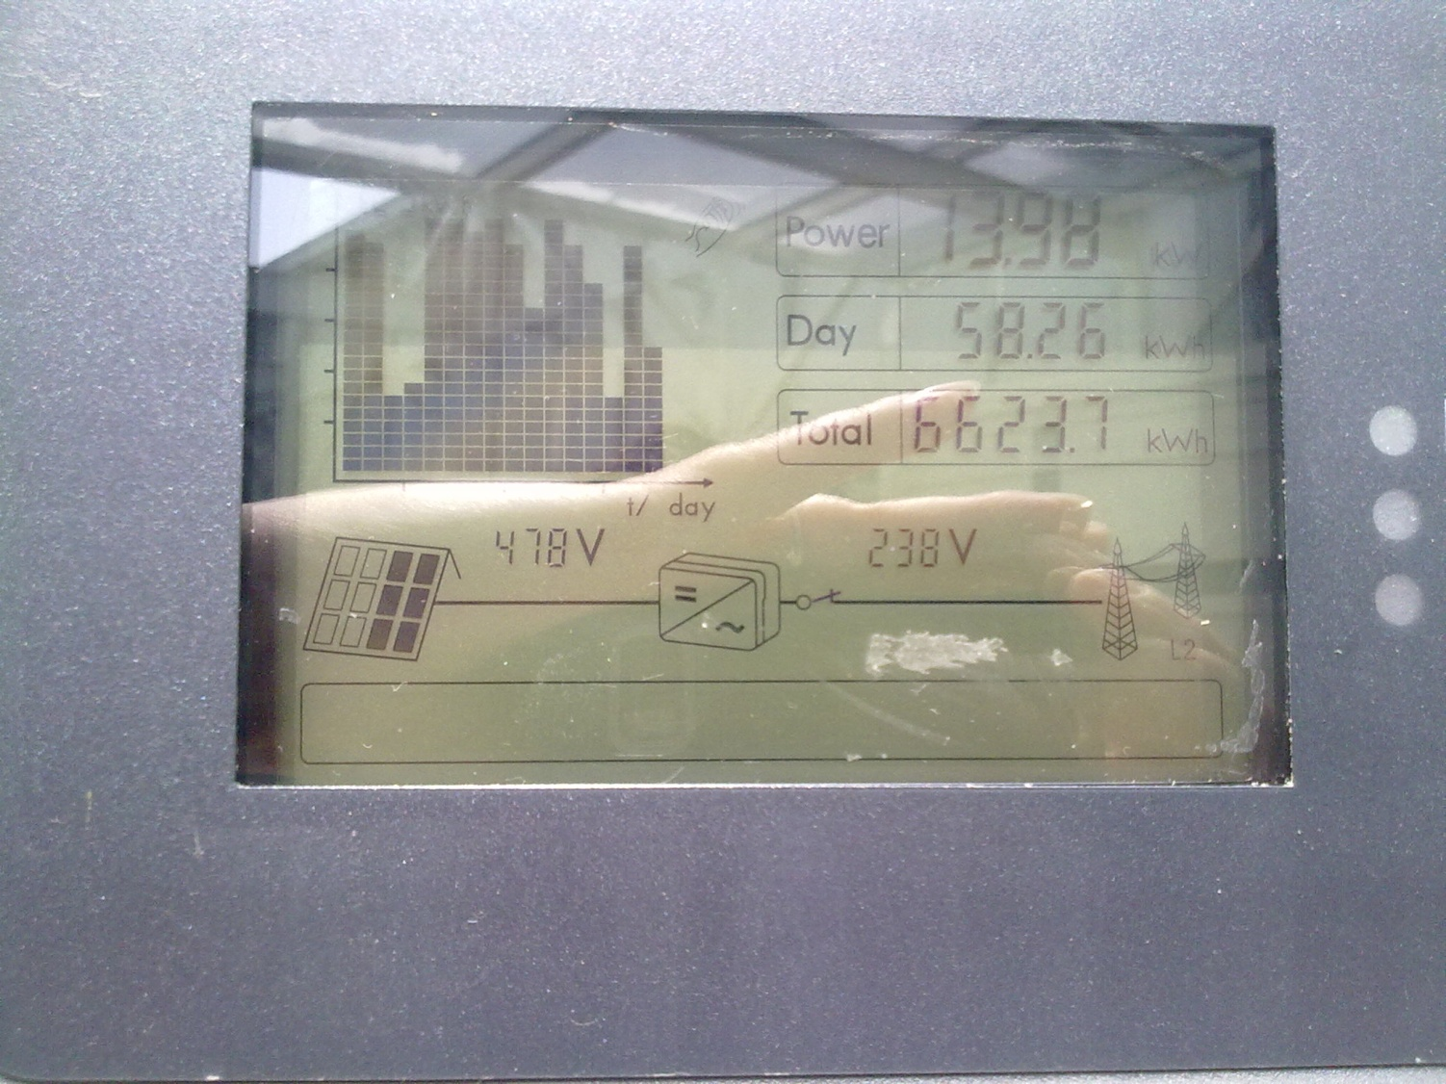
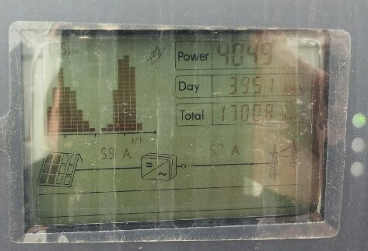
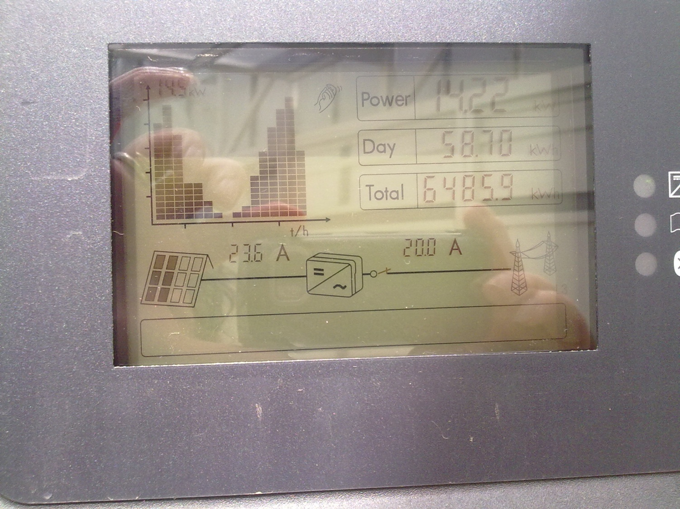
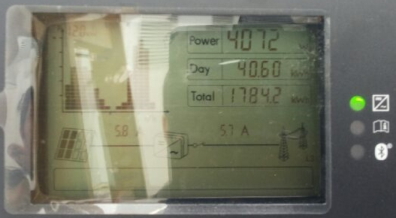
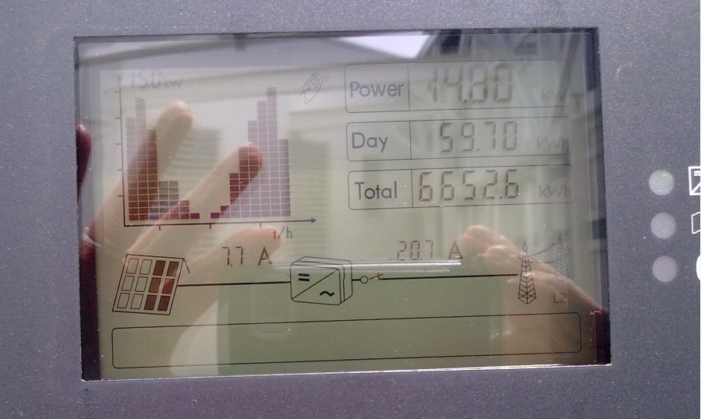
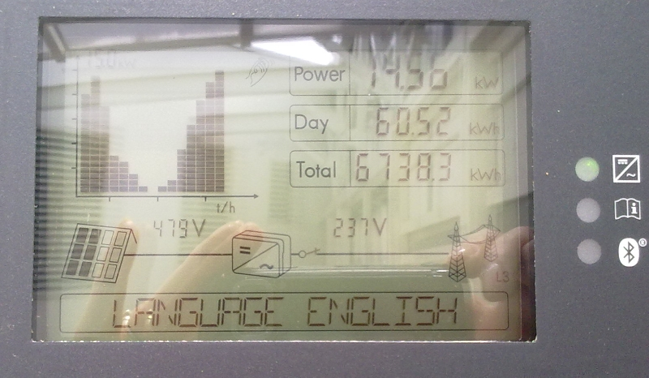
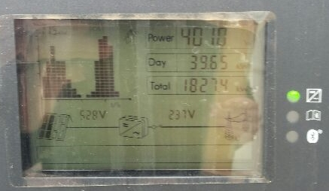
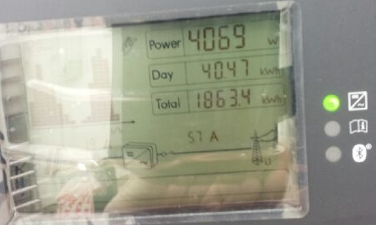
PRODUCTION IN SPP IN VARAŽDIN
Production 02/27/2015 at 12:15
Production 04/30/2015 at 12:45

Slide 8
Justifiability of the investment
Expected mean production per kW
  1150kWh/year -> 78200 kWh/year (for 68 kW)
Total production in 4 month 11/2014 – 02/2015
  7172,8 kWh (< 1/10)
Total production in 6 month 11/2014 – 04/2015
  26500,5 kWh (> 1/3)

Slide 9
Thanks for your attention

