Slide 1

Efficient Calculation of Earth Fault Currents in Compensated Networks
Univ.-Prof. Dipl.-Ing. Dr.techn. Lothar Fickert
Dipl.-Ing. Elisabeth Hufnagl
Dipl.-Ing. Dr.techn. Ernst Schmautzer
Universität Graz
Institute of Electrical Power Systems
www.ifea.tugraz.at
lothar.fickert@tugraz.at

Slide 2
AGENDA
Efficient Calculation of Fault Currents
Symmetrical components (simplifications)
Global Earthsystem
Definition
Fault current distribution
Assess
(Statik valuation of the safety of persons)
Endangering of persons
Cost Benefit Analysis, CBA

Slide 3
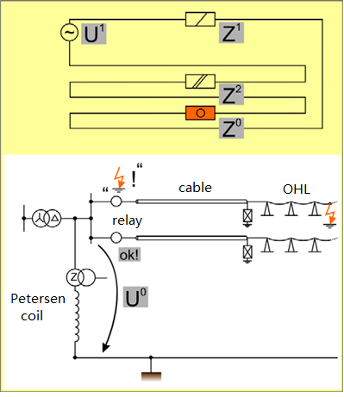
Theory and Reality of the Earth fault events

Slide 4
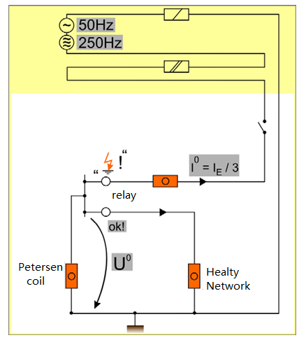
Fault calculation in symmetrical components
R_{c}⁰ = 3 • R_{c}
I⁰ = I_{E} / 3
= (I_{pet} –I_{cap}) / 3
X_{Pet}⁰ = 3 • U_{N} / I_{Pet}
X_{cap}⁰ = 3 • U_{N} / I_{cap}

Slide 5
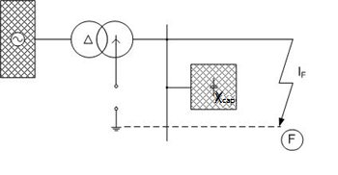
Isolated network
Circuit diagram

Slide 6
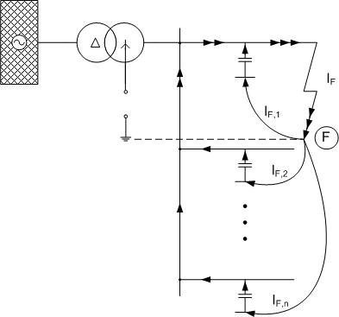
Isolated network
Circuit diagram
Starpoint
I_{F} = I_{grid,cap,e/f} = l_{cable}·i’ _{cable} + l_{OHL}·i’_{OHL}

Slide 7
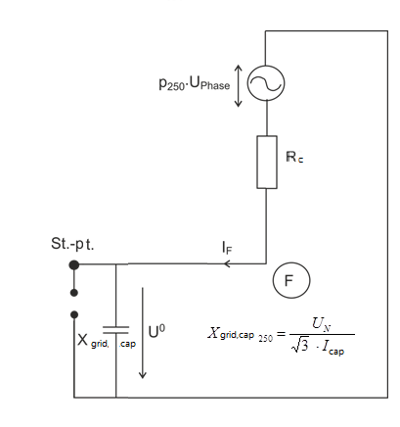
Isolated network
Equivalent circuit
I_{F} = U_{N} / √R_{c}² + X_{grid,cap}²
without factor 3

Slide 8
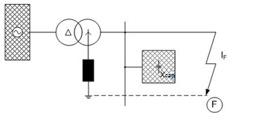
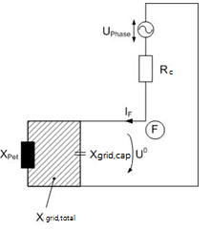
Compensated network
Equivalent circuit
Exactness, e.g. for Rc = 0:
Z₁ = (U_{N}/√3) / I_{k}
X_{grid,total} = (U_{N}/√3) / (v • I_{cap})
I_{F} = 3 * (U_{N} / √3) / (2 Z₁ + 3 • X_{grid,total})
= (U_{N} / √3) / (2/3 • Z₁ + X_{grid,total})
≈ (U_{N}/√3) / [X_{grid,total} * (1 - 2/3Z₁ / X_{grid,total})]
Δ = 2 / 3 • Z₁ / X_{grid,total} = …
Because Z₁ = U_{N} / √3 / I_{F}
respectively. X_{grid,total}= U_{N} / √3 / (v • I_{cap})
… = 2/3 • (v • I_{cap}) / I_{k}
= 2/3 • 60A / 4000A
Δ = 1%
I_{F} = U_{N}/ √R_{ü}²+ X_{grid,total}²
Whithout factor 3

Slide 9
Compensated network
Harmonic-Equivalent circuit
I_{F} = p₂₅₀ • (U_{N} / √3) / √ R_{c}² + [X_{grid,cap,,250} - (1 + k₀) • X_{L,250}]²
Whithout factor 3

Slide 10
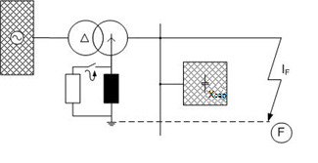
Compensated network
Electrical diagram

Slide 11
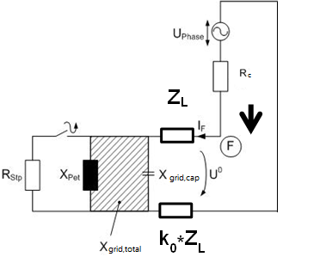
Compensated network
Equivalent circuit diagram
I_{F}= U_{Phase} / [(R_{Stp} // j·X_{grid,total}) + Z_{L} (1 + k₀) + R_{c} ]

Slide 12
Efficient Calculation of Earth Fault Currents in Compensated Networks
Univ.-Prof. Dipl.-Ing. Dr.techn. Lothar Fickert
Dipl.-Ing. Elisabeth Hufnagl
Dipl.-Ing. Dr.techn. Ernst Schmautzer
Universität Graz
Institute of Electrical Power Systems
www.ifea.tugraz.at
lothar.fickert@tugraz.at

