Slide 1
Practicality of base load renewable generation in India

Slide 2
“Energy security based on clean & reliable sources is essential for India's future…"
- Mr. Narendra Modi, Prime minister, India
2014

Slide 3
Contents
Indian electricity sector
Base load mindset
Dispatch-able and VRE
Renewable potential, India
Hybrid systems
Conclusion

Slide 4
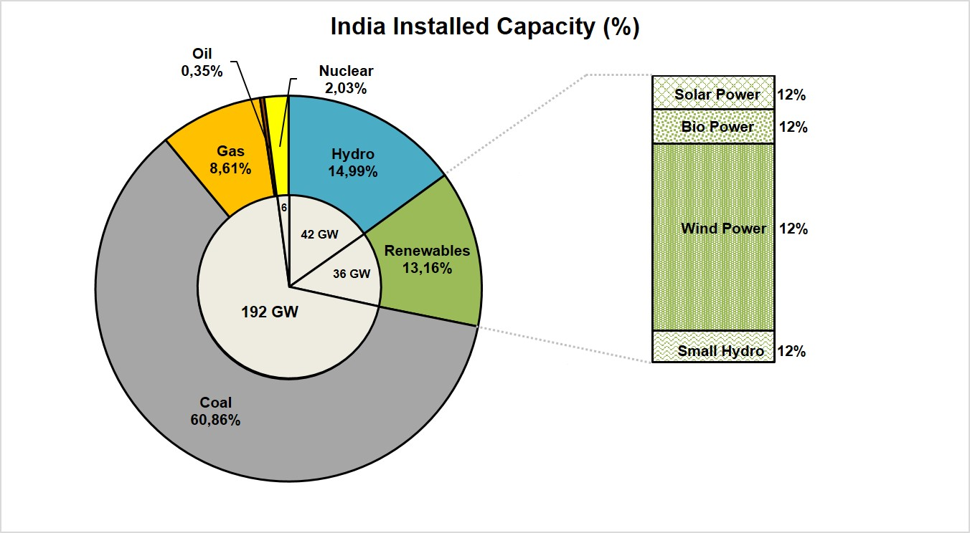
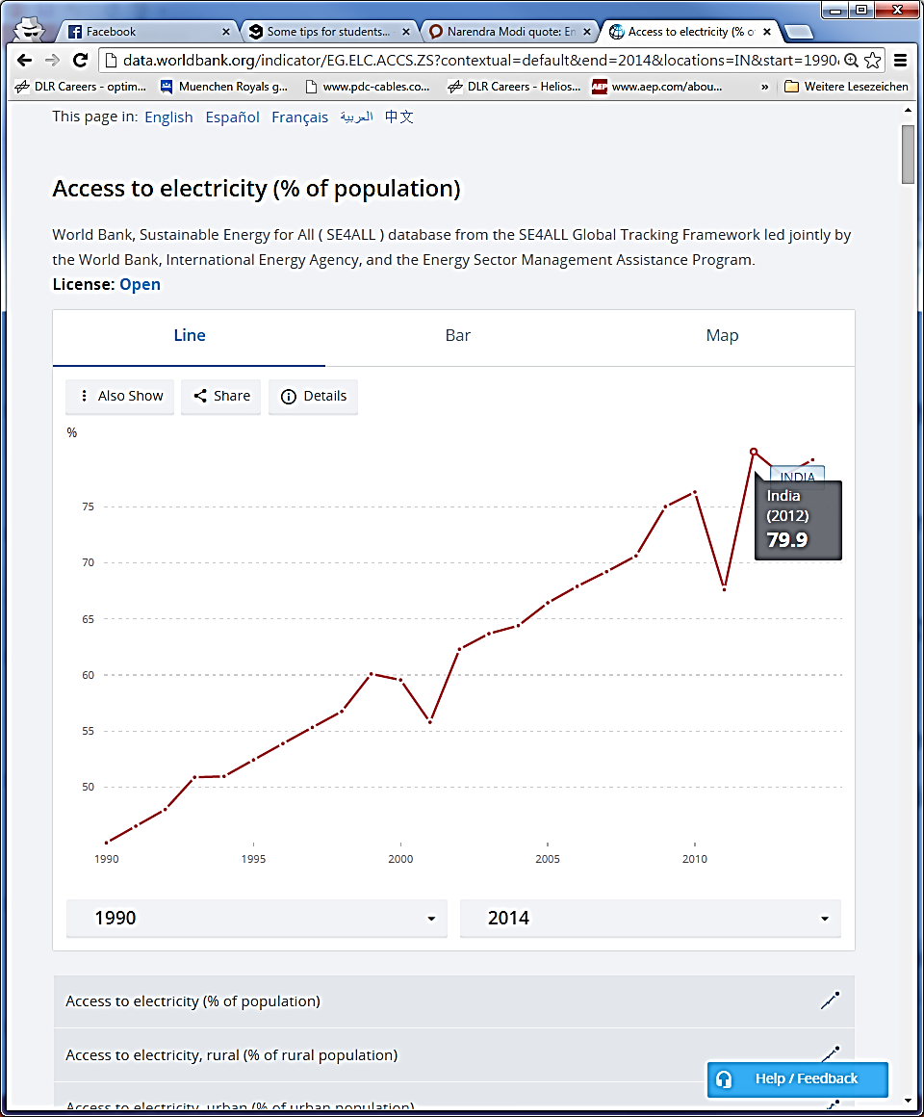
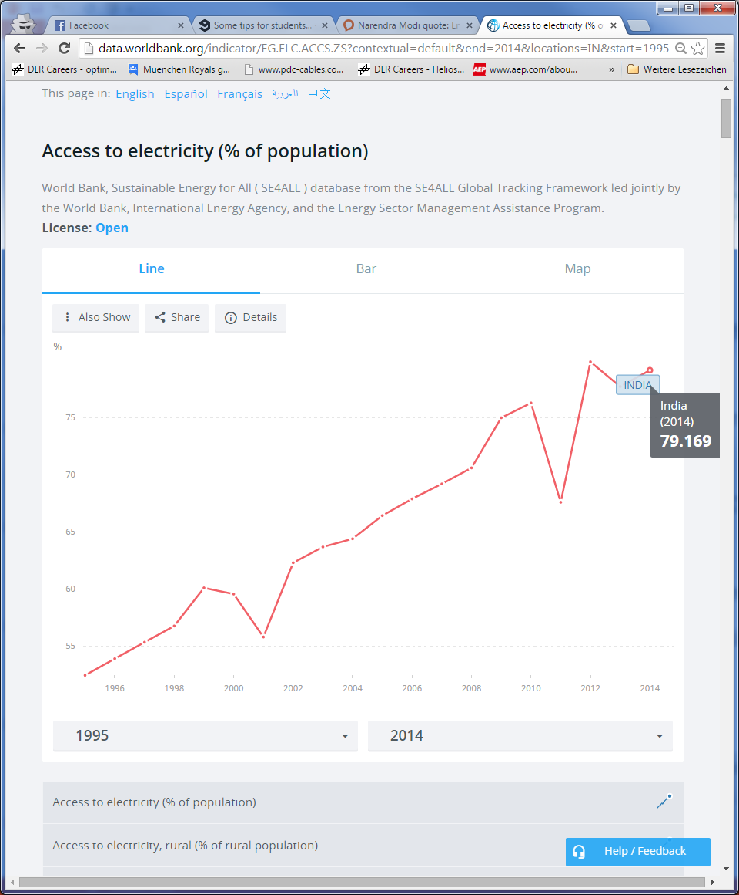
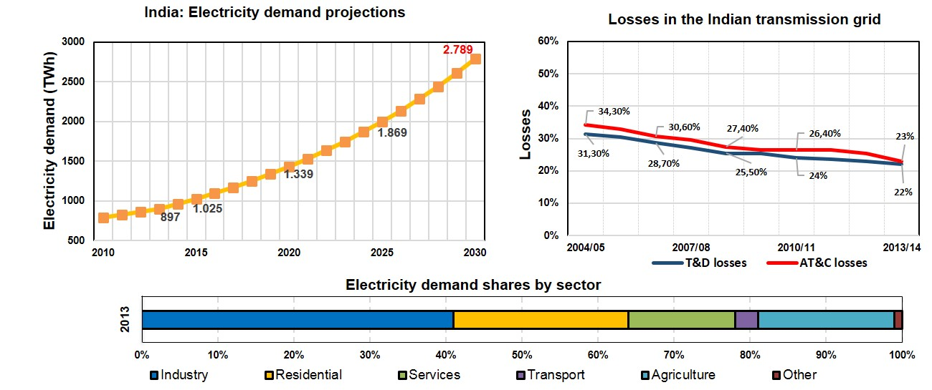
The Indian electricity sector
Source: CEA, Worldbank

Slide 5
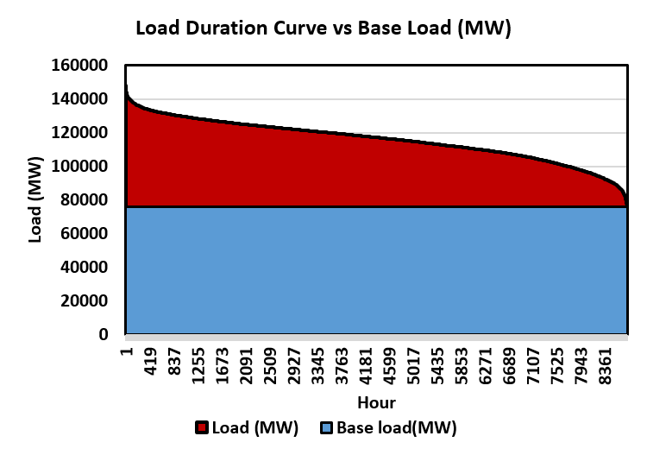
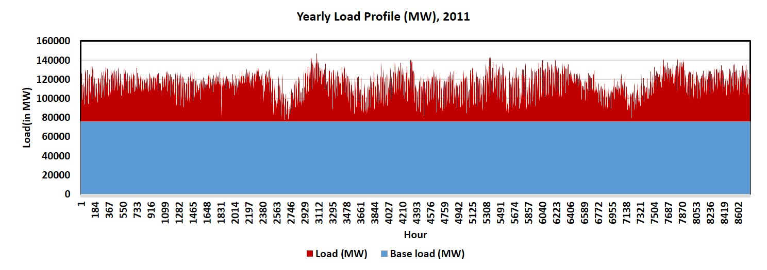
Base load :Definition and India
Base load:
Minimum electricity load observed in the year
Defines:
Energy security and sustainability
Industrial, commercial, and domestic continuously operated processes
India:
~52% of yearly peak
Source: CEA, TSOs

Slide 6
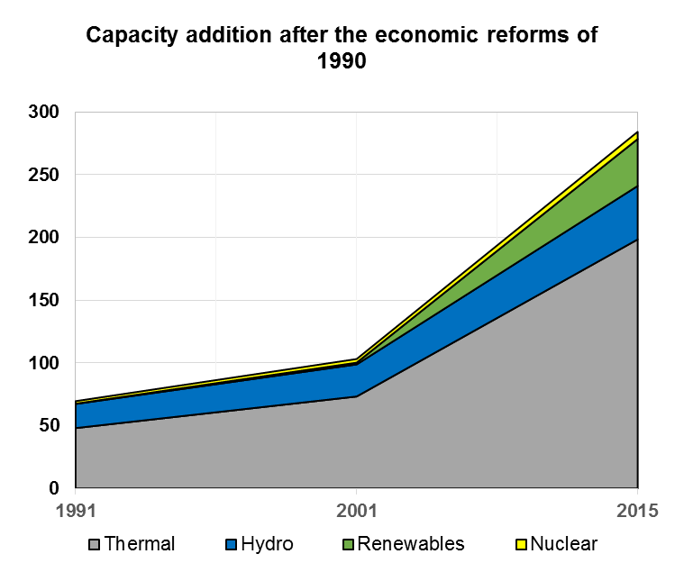
Base load mindset and implications
Base load mindset: drive to satisfy minimum energy requirements
Leads to desperate capacity addition
India: prime example, several other countries
Support only economic growth, not sustainability
Reason for high share of coal in the generation mix
Source: CEA, MoP

Slide 7
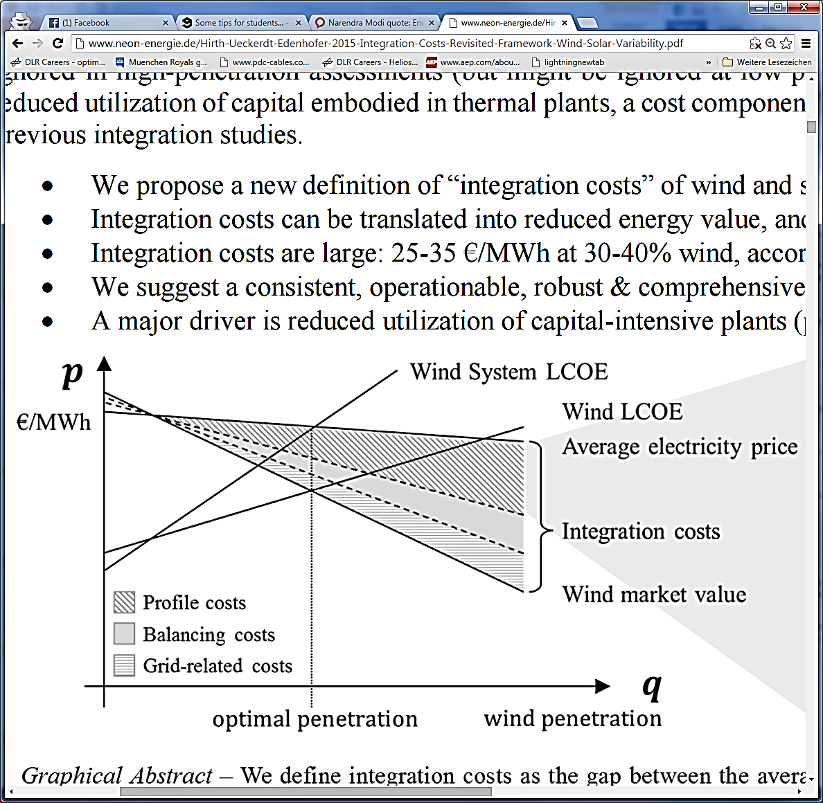
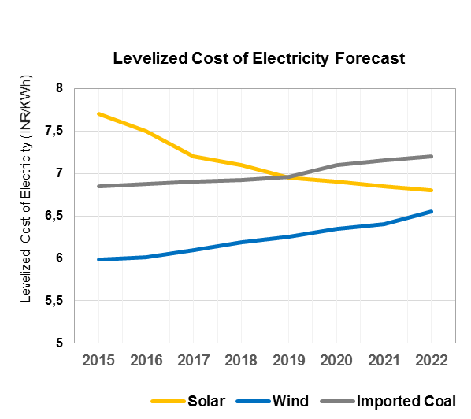
Dispatch-able and Variable Renewable Energy
Dispatch-able RE
Output: Can be ‘controlled’ to a certain level
Reliable and constant generation
No ‘integration’ costs : No problems related to balancing, grid and profiles
Variable RE
Variable and uncontrolled availability
Fluctuating generation
Integration costs tend to increase at a larger scale
Source: Neon-energie

Slide 8
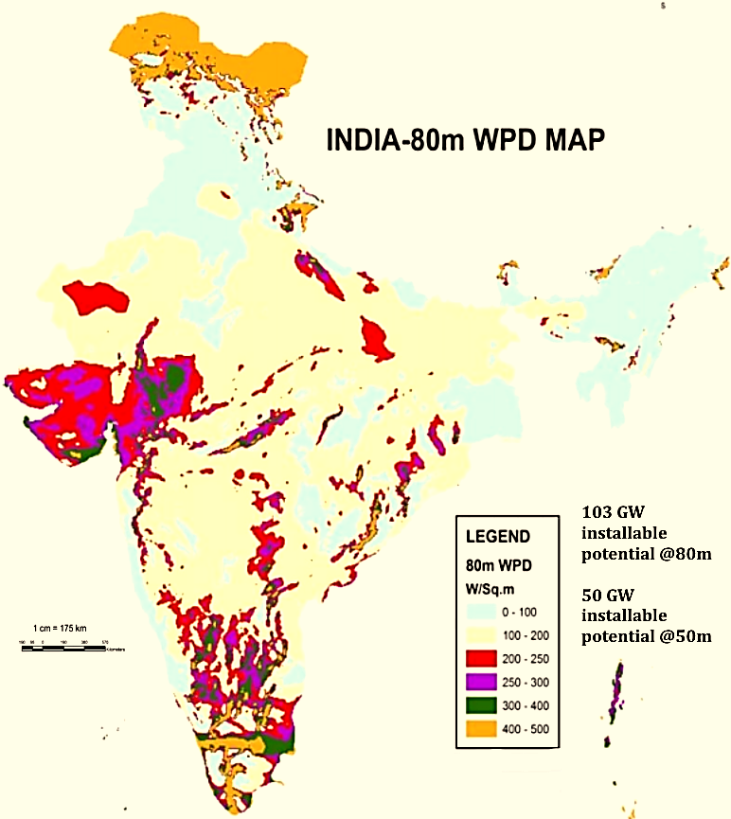
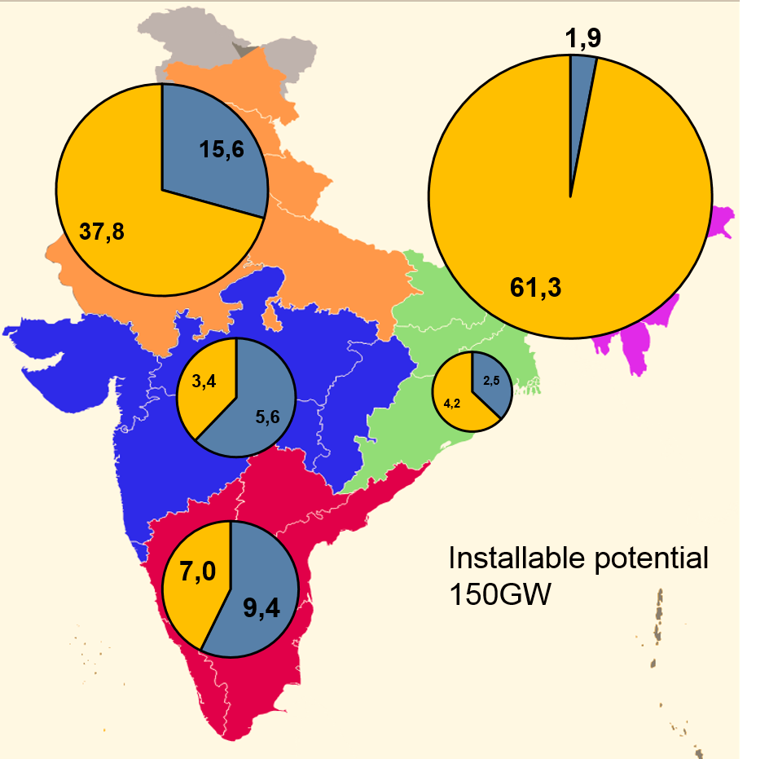
Renewable potential, India
Large renewable energy installable potential
Solar PV : 748 GW
Onshore wind: 103GW + 50GW
Hydro potential: 150GW
Source: NISE, MNRE, CEA

Slide 9
Viability of Hybrid systems
Shift focus from ‘base load generation’ to ‘full load generation’
Dispatch-able +VRE Hybrid systems : successfully implemented (ex. Brazil, Germany)
India : Financial and energy security problems
Possible Hybrid system:
Solar PV + Wind onshore + Hydro power + Gas CHP

Slide 10
Conclusions
Base load mindset: has to be changed
Full load generation using high RE penetration: possible with hybrid systems (Dispatch-able + VRE + Intermediate load PPs)
Effective measures to plan for sustainability:
  Energy efficiency and demand side management
  Responsive power transmission grid : Interplay between components
  Gas and biomass CHP: intermediate and peak load PPS
  Distributed VRE generation + Large scale Dispatchable generation
  Smart urbanization

Slide 11
Thank you for your Attention!

Slide 12
Economic aspects
Technology | Capital Cost ($/kW) | Operating Cost ($/kWh)
Coal-fired combustion turbine | $500 — $1,000 | 0.20 — 0.04
Natural gas combustion turbine | $400 — $800 | 0.04 — 0.10
Coal gasification combined-cycle (IGCC) | $1,000 — $1,500 | 0.04 — 0.08
Natural gas combined-cycle | $600 — $1,200 | 0.04 — 0.10
Wind turbine (includes offshore wind) | $1,200 — $5,000 | Less than 0.01
Nuclear | $1,200 — $5,000 | 0.02 — 0.05
Photovoltaic Solar | $4,500 and up | Less than 0.01
Hydroelectric | $1,200 — $5,000 | Less than 0.01
Source: Energy markets, Policy and Regulation

Slide 13
Flexibility of power plants
Technology | Ramp Time (To Full Capacity) | Min. Run Time
Combined-cycle combustion turbine | hours | hours to days
Nuclear | days | weeks to months
Steam cycle combustion turbine | hours | Hours to a day
Simple-cycle combustion turbine (gas/ oil/ biomass) | minutes to hours | minutes
Wind Turbine (includes offshore wind) | minutes | none
Hydroeletric (includes pumped storage) | minutes | none
Flexibility
Base load
Peak/intermediate load
Source: Energy markets, Policy and Regulation

