Slide 1
e-Vespa
The electrical crank shaft
© Alexander Elbe, BSc
Fachhochschule Kärnten
Science & Energy Labs
Europastraße 3, 9524 Villach
Tel: +43 5 90500 2118
Email: a.elbe@fh-kaernten.at

Slide 2
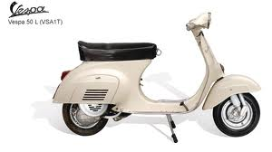
Motivation
Reconstitution of old vehicles
Refurbishment is less resource intensive than new construction
  Replacement of 2-stroke gasoline engine by electric motor
  Example vehicle:
  Piaggio Vespa V 50 N

Slide 3
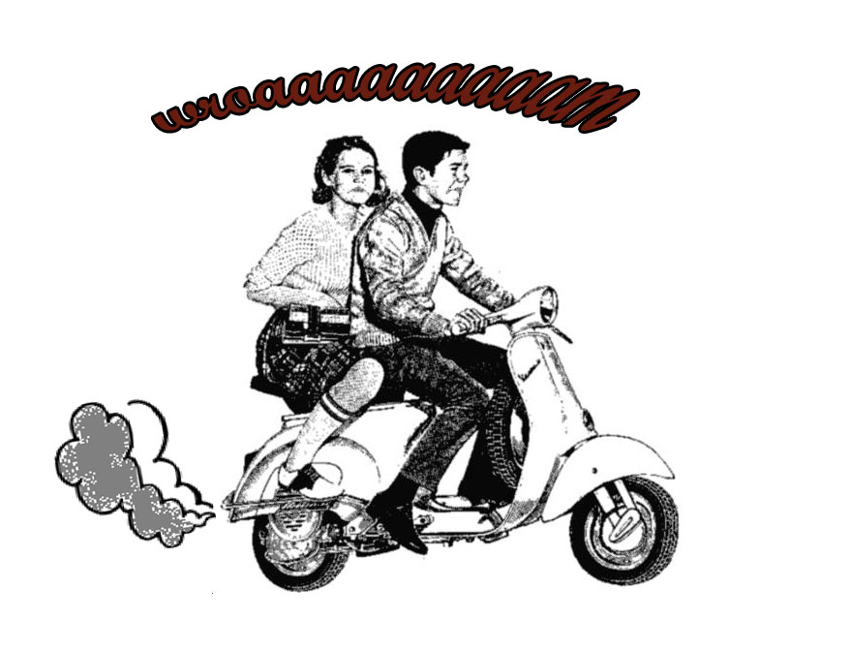
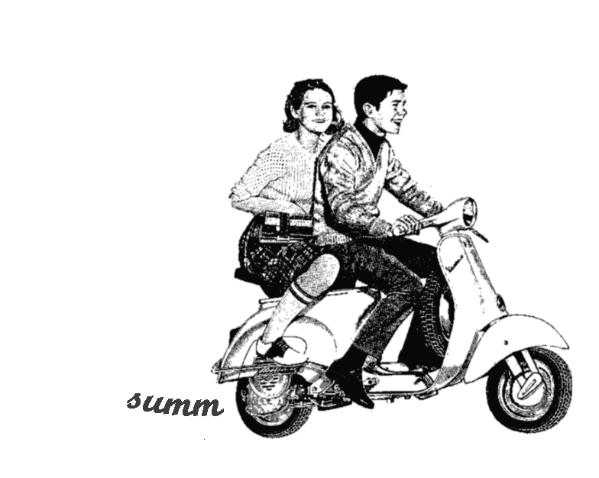
Idea
2-stroke gasoline engine
brushless DC motor

Slide 4
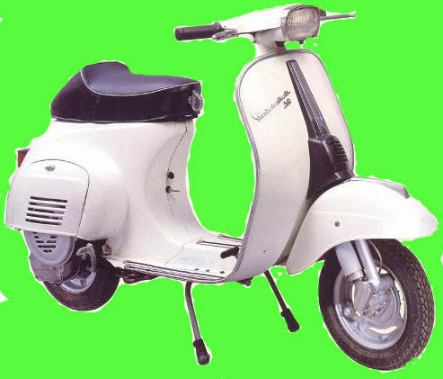
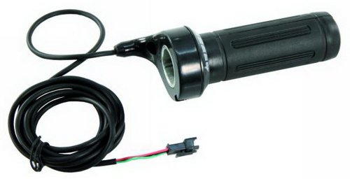
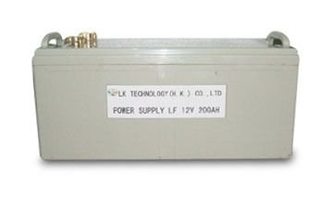
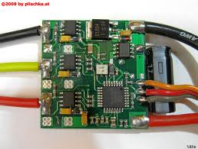
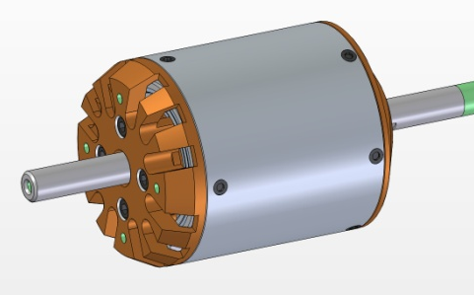
Implementation

Slide 5
System coarse draft
Throttle
µC-Unit
Power electronic
e-motor
Clutch
Gear shift
Rear wheel
Interface of gearbox

Slide 6
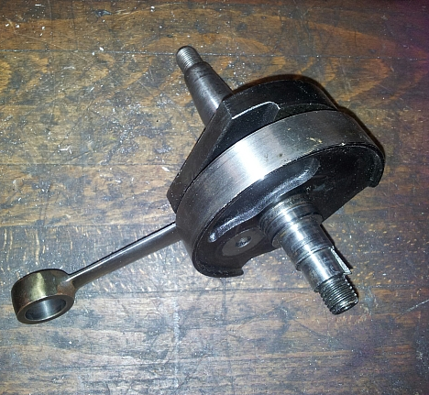
Implementation

Slide 7
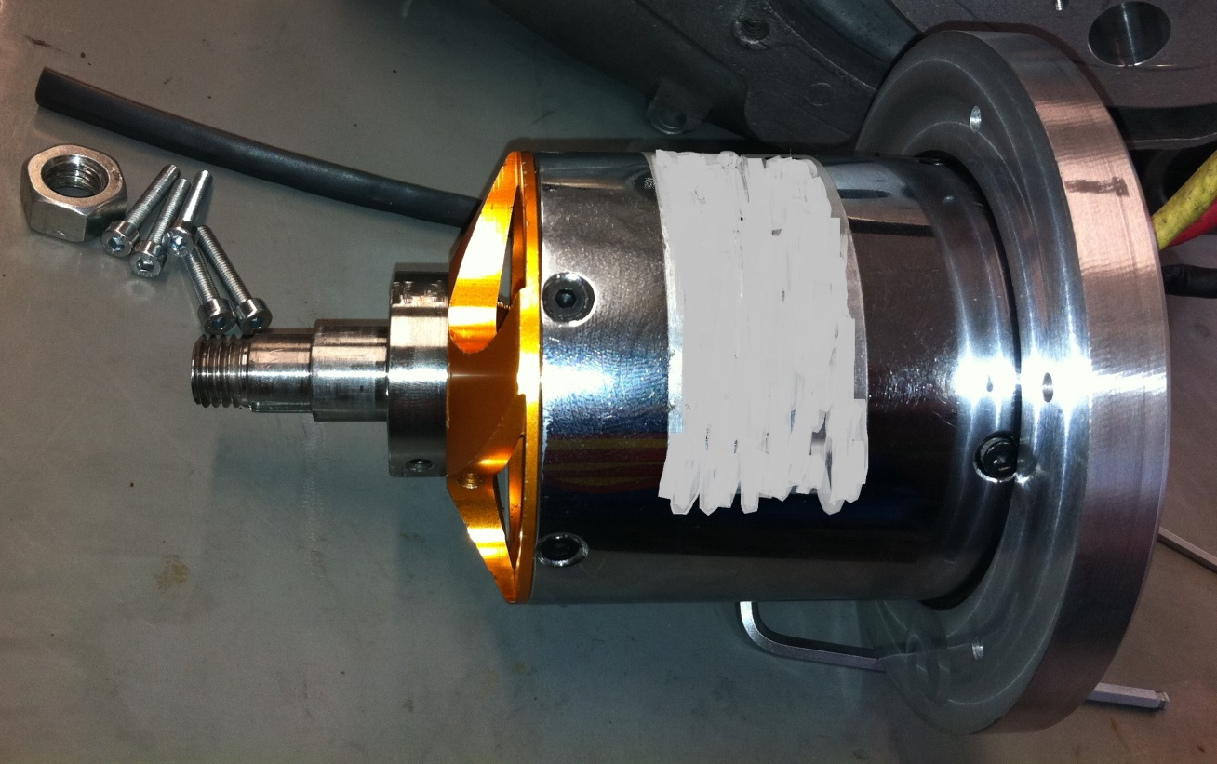
Implementation

Slide 8
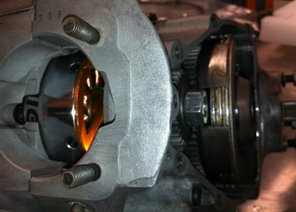
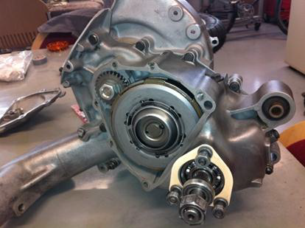
Implementation

Slide 9
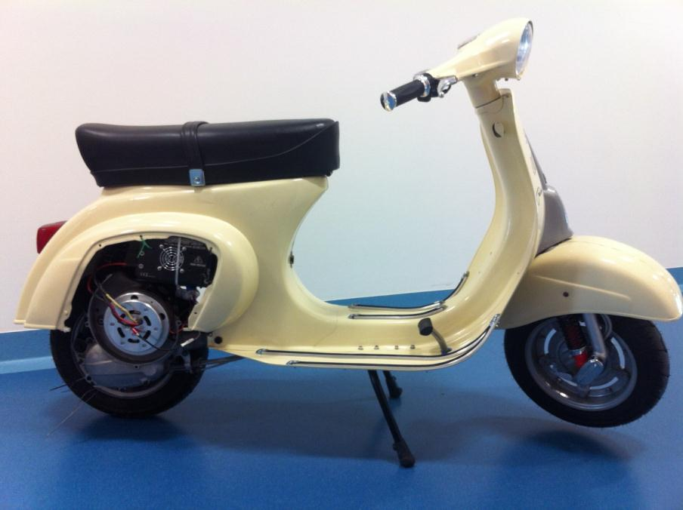
Result e-Vespa

Slide 10
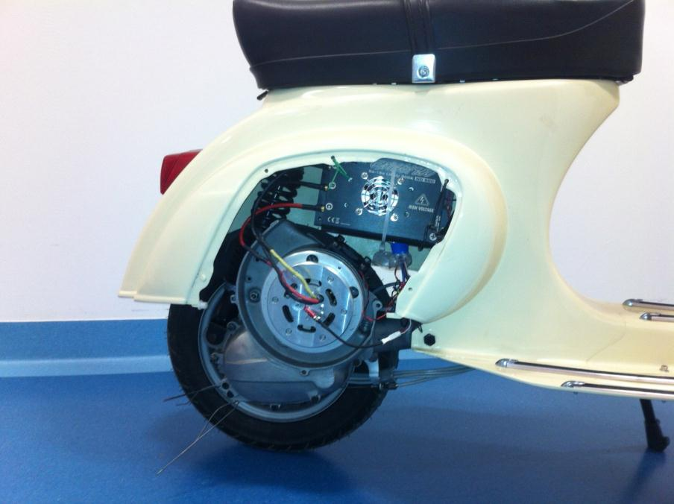
Result e-Vespa

Slide 11
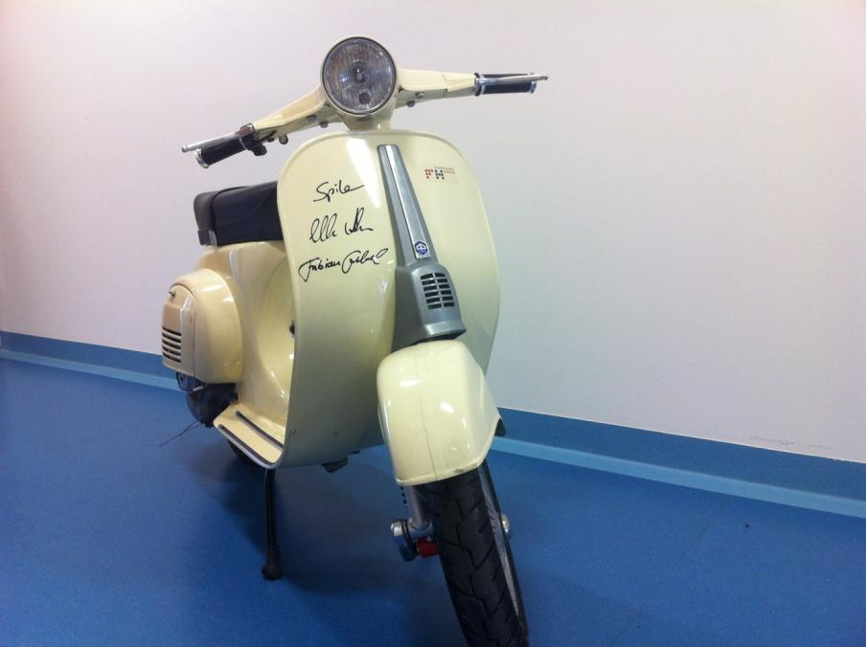
Result e-Vespa

Slide 12
Thank you for your attention
e-Vespa

