Slide 1
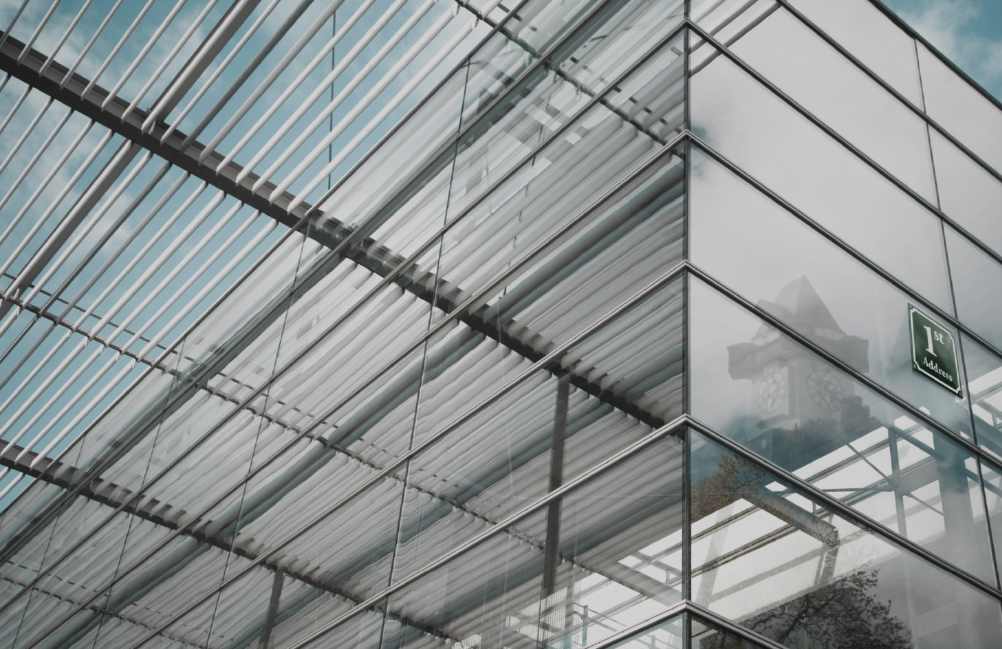





Smart City Graz
Maribor, 12.05.2015, Johann Koinegg
Eco World Styria
Notes:
Thank you for the invitation to speak at this venue.
On behalf of the projekt team from the city of Graz I have the honor to present you some facts about Graz and in particular about the Smart City Graz project.
My name: I am actually from ECO. We have a small part in this project.
In this sense I will also spend some slides at the beginning of my presentation to present you ECO – before comming to the core of the presentation.

Slide 2

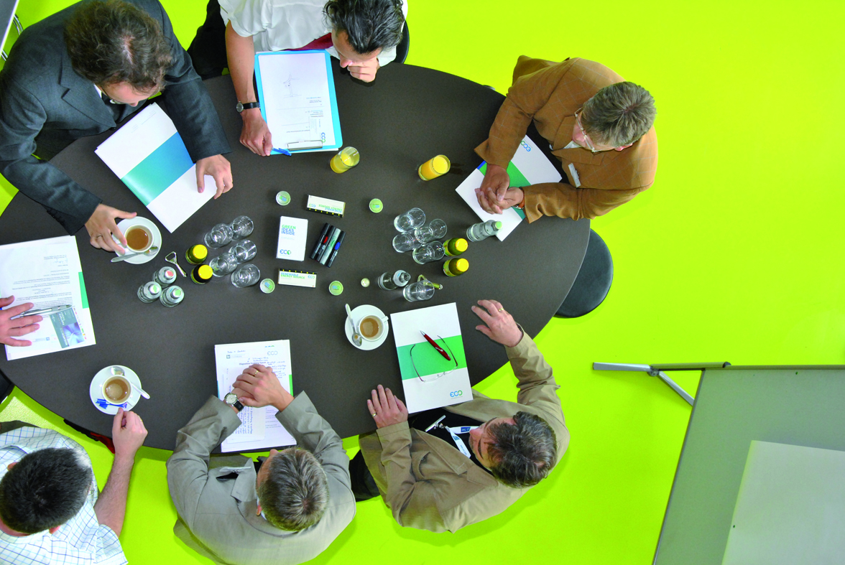



The Setup of ECO WORLD STYRIA
„Triple-Helix“Cluster
Strong bound between economy, science and public administration
170 members in the area of biomass, biofuels, solar, recycling and
hydro power
Founded 1998, staff 10 people, financed through
membership fees (750 - 5.900 €), funding and projects

Slide 3

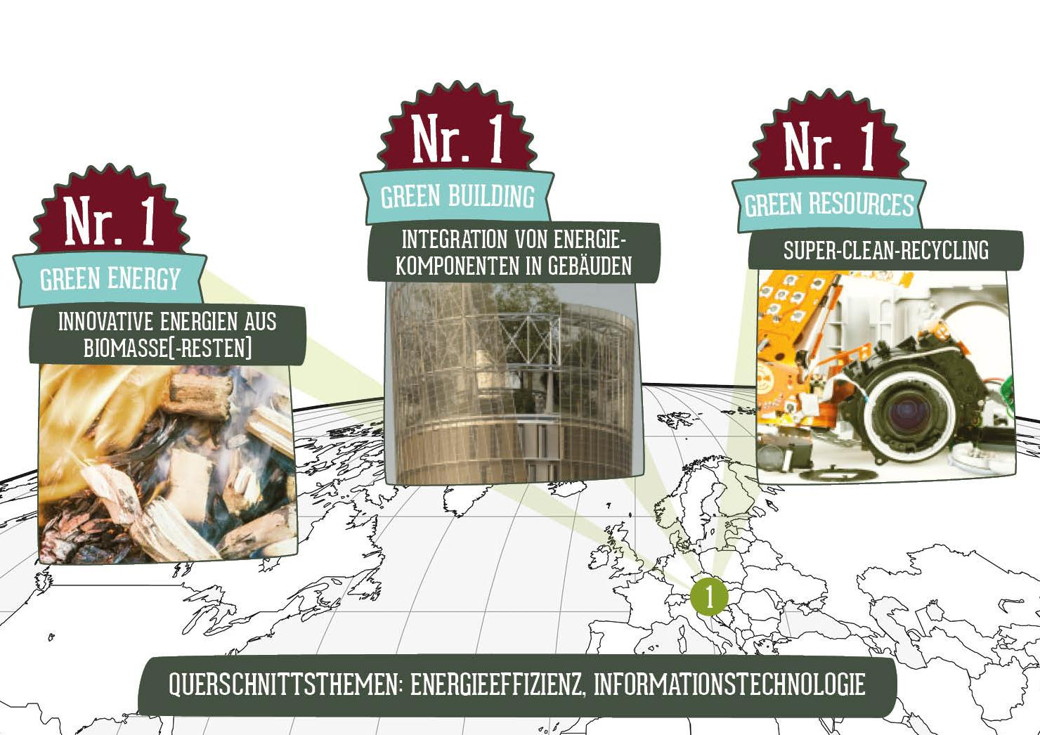
ECO STRATEGY 2015 - 2020
Notes:
Die neuen Ziele sind die Nr. 1 Positionierung in den Stärkefeldern wie Biomassenutzung, hochqualitatives Recycling sowie die Energieerzeugung in Gebäuden. Dazu will ECO 10 neue Produkte der Unternehmen mitinitiieren und 100 Innovationsprojekte auslösen mit wesentlichen Arbeitsplatzeffekten.

Slide 4
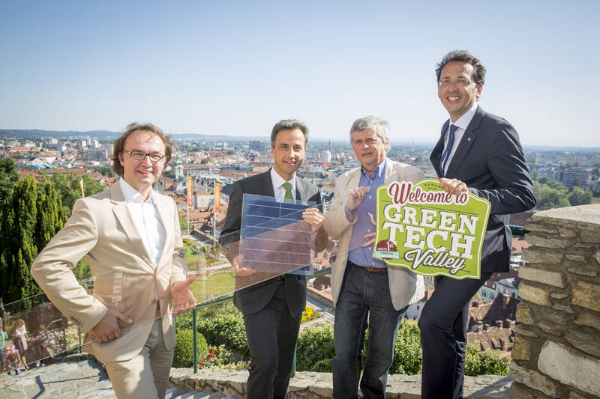

…create new products

Slide 5
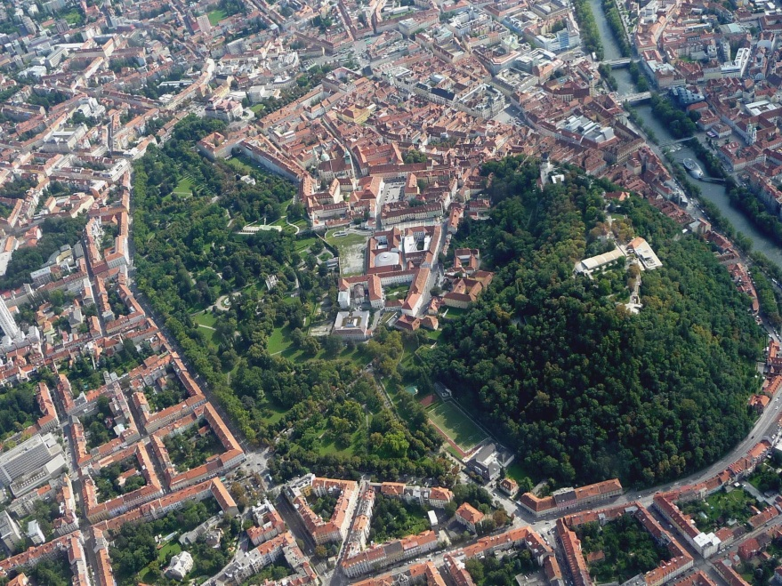


Styria – Region of Smart Growth
Styria – Region of Smart Growth.
1.2 Mio. Inhabitants in Styria
20 years of change from heavy industries to a knowledge based production society
Europe’s Top-3 R&D-quota 4.3 %
Pioneer region in recycling, hydro power, biomass and solar energy

Slide 6
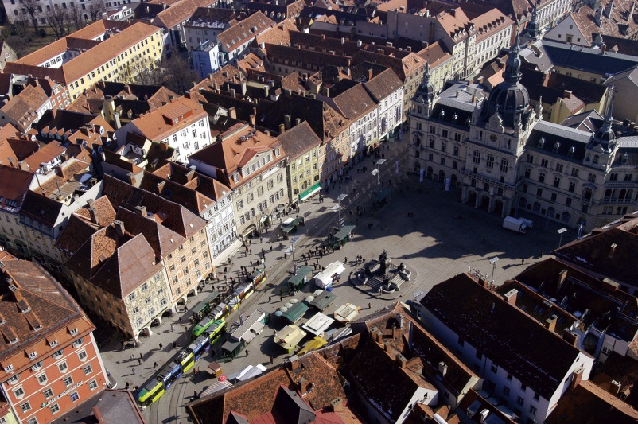
Graz in facts
269.365 inhabitants
Second largest City of Austria after Vienna
Size of 127 km²
4 universities, 2 universities of applied sciences
UNESCO World Heritage since 1999
City of Design
Cultural Capital City of Europe in 2003
Population growth
until 2020 by 2.500 inhabitants /y
from 2020 by 1.000 inhabitants/y

Slide 7
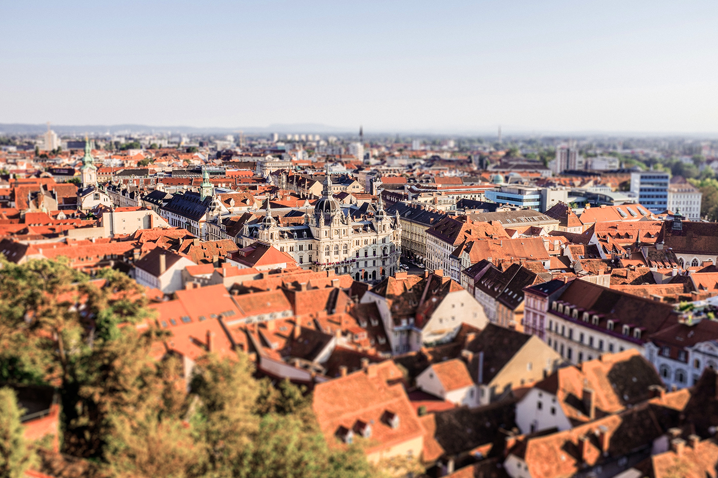


Siegfried Nagl
Mayor
GRAZ

Slide 8
Graz is a dynamic city with compact settlements construction and urban mixed usage, attractive public space and highest quality of life.
By consistent pursuit of Smart City-strategies and a broad awareness, the use of resources, energy and the related emissions led to significant reductions and key steps towards a zero emission city. The energy consumption of Graz is from 100 % renewable energy resources from the region. As a research, qualification and business location Graz sets international standards for added value by innovative urban technologies and systems.
Vision Graz 2050
Sustainable and worth living city
Notes:
Allready mentioned the population growth. From surrounding rural areas. From foreign countries. To to the 5 universities in town from students.
Therfore Graz also developed a vision towards 2050.
Smart City Graz is an international Benchmark für value creation with green Technologies (Energy, Mobility, Ressources) as well as health and design.

Slide 9
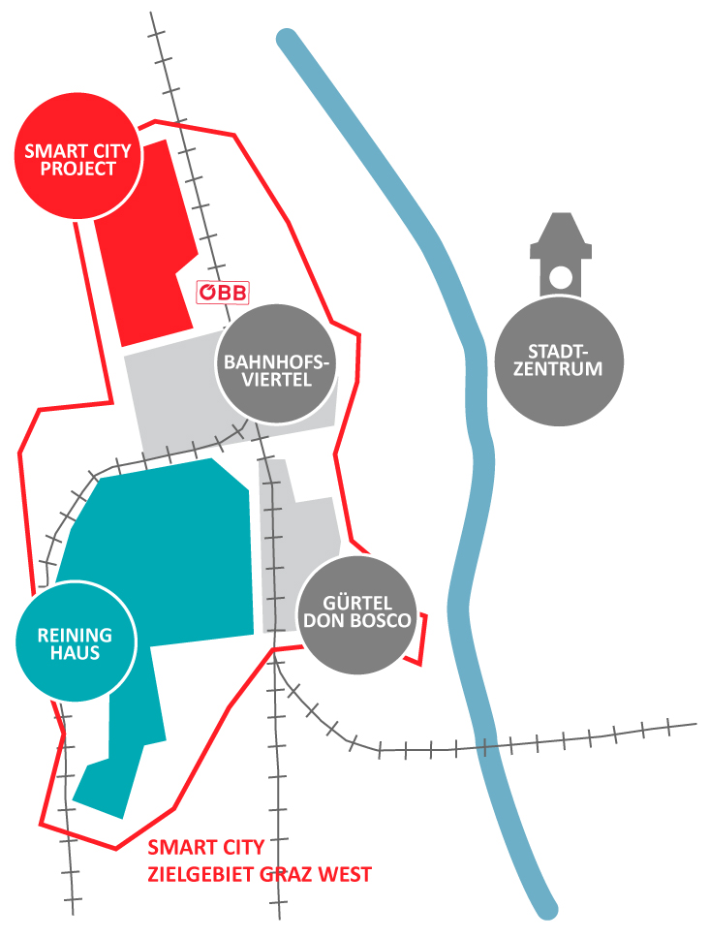
          Smart City Graz -
          Target Area Graz West
Development Areas:
Smart City Waagner-Biro: 49 ha
Reininghaus: 98 ha
Bahnhofsviertel: 57 ha
Gürtel - Don Bosco: 35 ha
Notes:
Mit dem Blickwinkel auf die Informationsgesellschaft des 21. Jahrhunderts sollte für den teils monofunktionalen Industriegürtel und die daran angrenzenden Wohngebiete im Grazer Westen der Wandel zu einem Stadtteil von neuer, zeitgemäßer und zukunftsfähiger Urbanität eingeleitet werden.
Die aktiv geförderte Einbindung der Bevölkerung in Planungs- und Entscheidungsprozesse sowie eine durch involvierte Interessensgruppen besetzte lokale Steuerungsgruppe stellten von Programmbeginn an den Interessensausgleich zwischen Ökonomie, Ökologie und sozialen Belangen sicher und konnten letztlich zu einem nachhaltigen Erfolg des Vorhabens beitragen.

Slide 10
„Smart City Project Graz“
First demonstration project
Consortium leader: City of Graz
Consortium: 13 partner
Project Value 24,0 Mio.
Funding € 4,2 Mio. (federal government)
timeframe 07.2012 – 06.2017

Slide 11
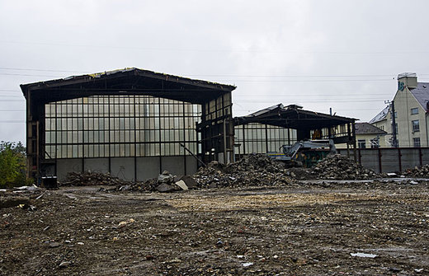
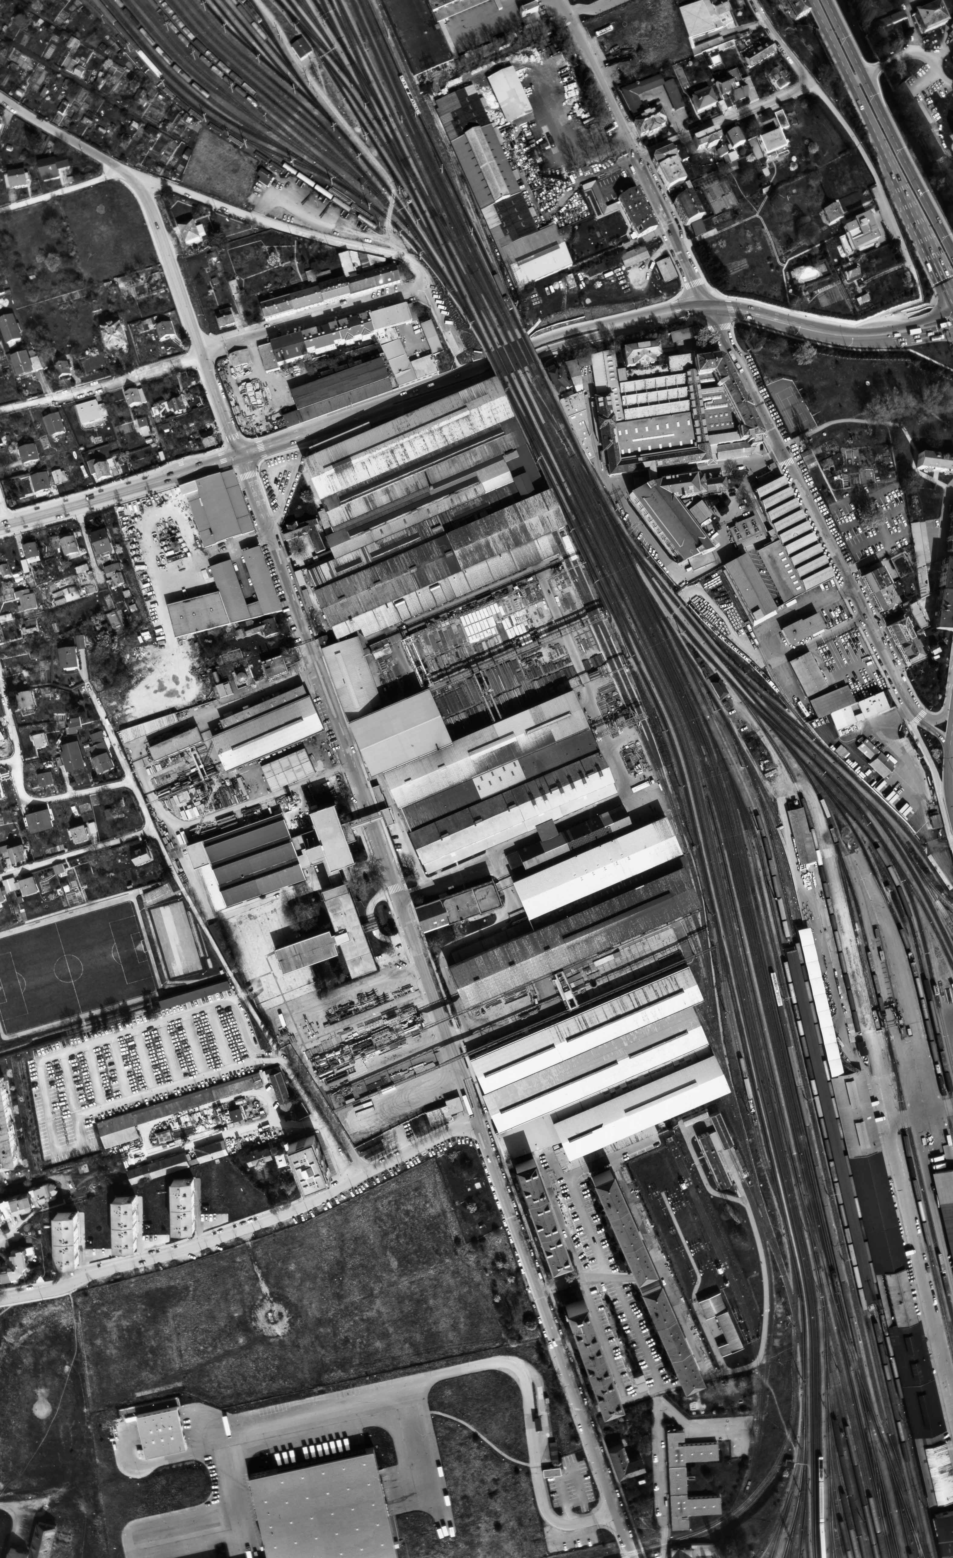
Past and current use:
Industry brownfield
Sustainable and cooperative city development
First large scale demonstration of the Grätzel PV cells
(„Science Tower“)
First establishment of a local energy grid (Energy supply centre for the city district)
First realization of multimodal mobility solutions
1989

Slide 12
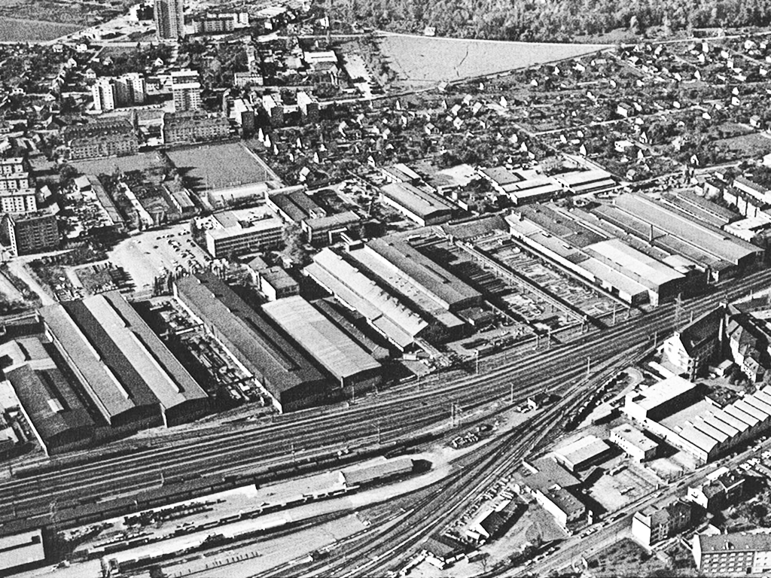
Industry
Area

Slide 13
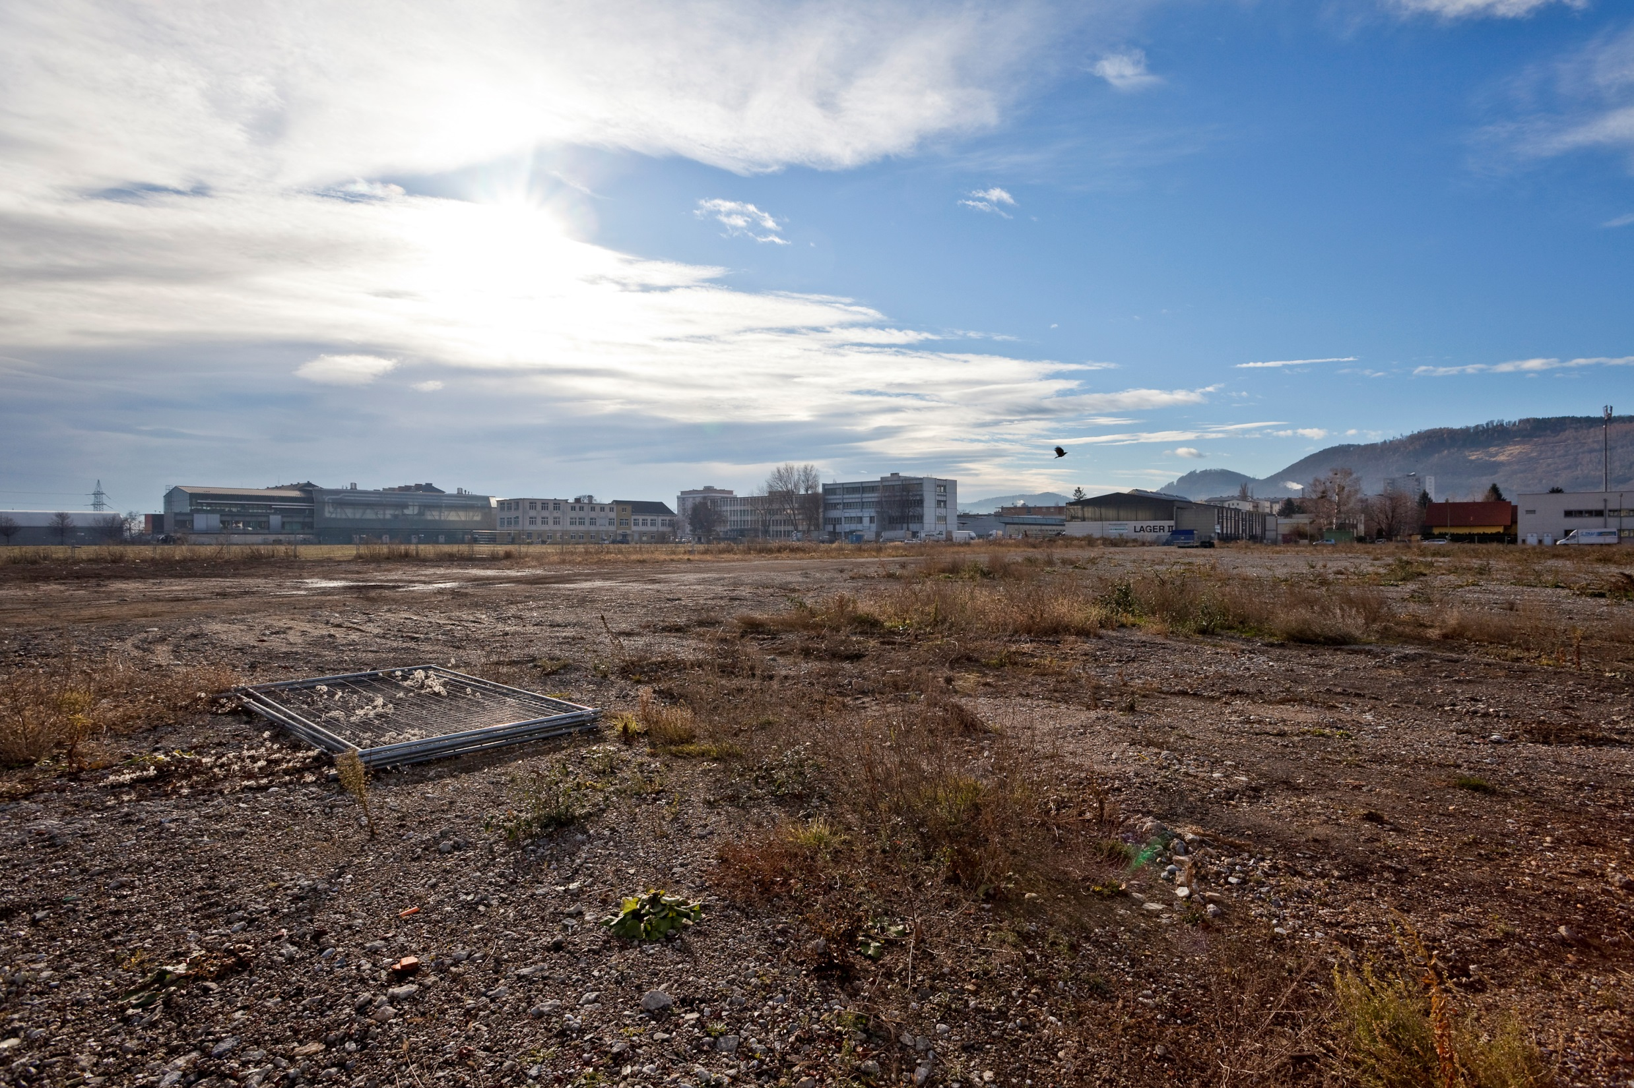
Brown-
field
Foto: Martin Grabner

Slide 14
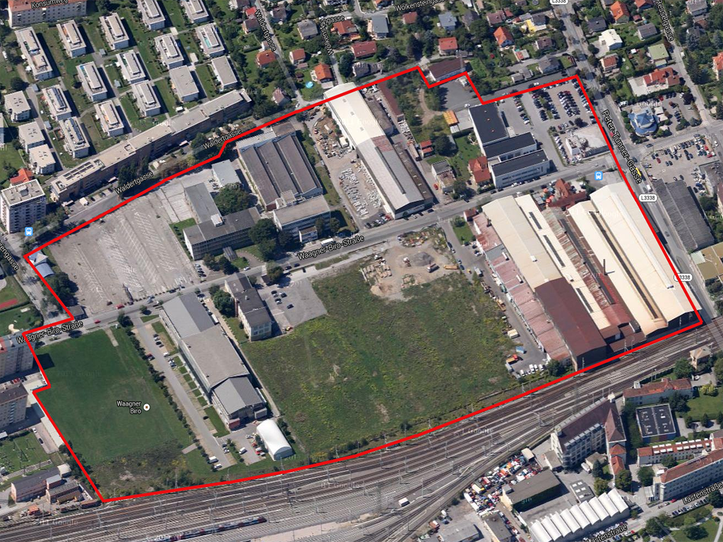
Develop
ment
area

Slide 15
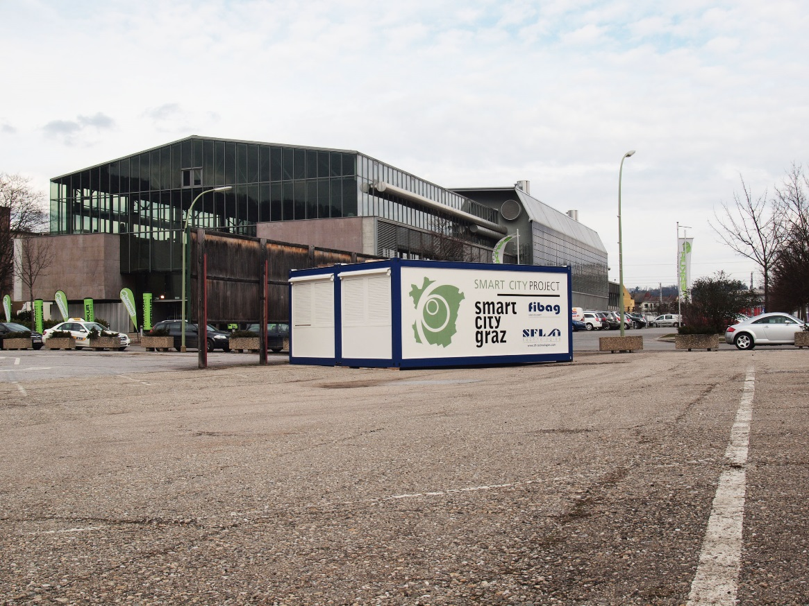

Participation meeting point „VorOrt“
Information
collect ideas
room for discussion
participation
...
Opposite Waagner-Biro Street, next to Helmut-List Halle!

Slide 16
Public Space
A shady corner
A soccer field
Cycle paths
Areas to explore and to act
A meeting point for old and young
Trees, drinking fountains, children playing area, dog meadows, …

Slide 17

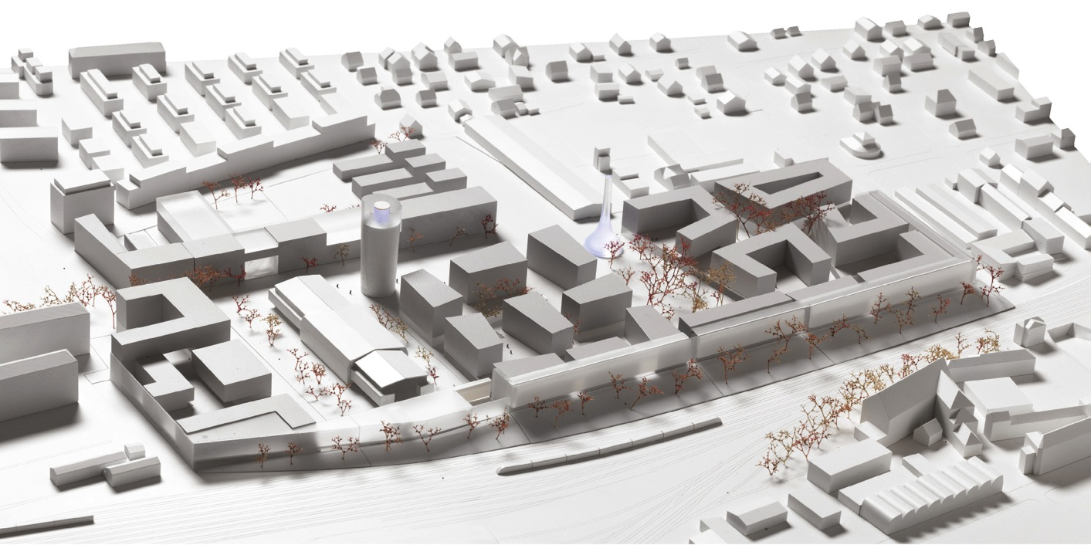
Modell: DI Markus Pernthaler Architekt ZT GmbH / Foto: Ott

Slide 18

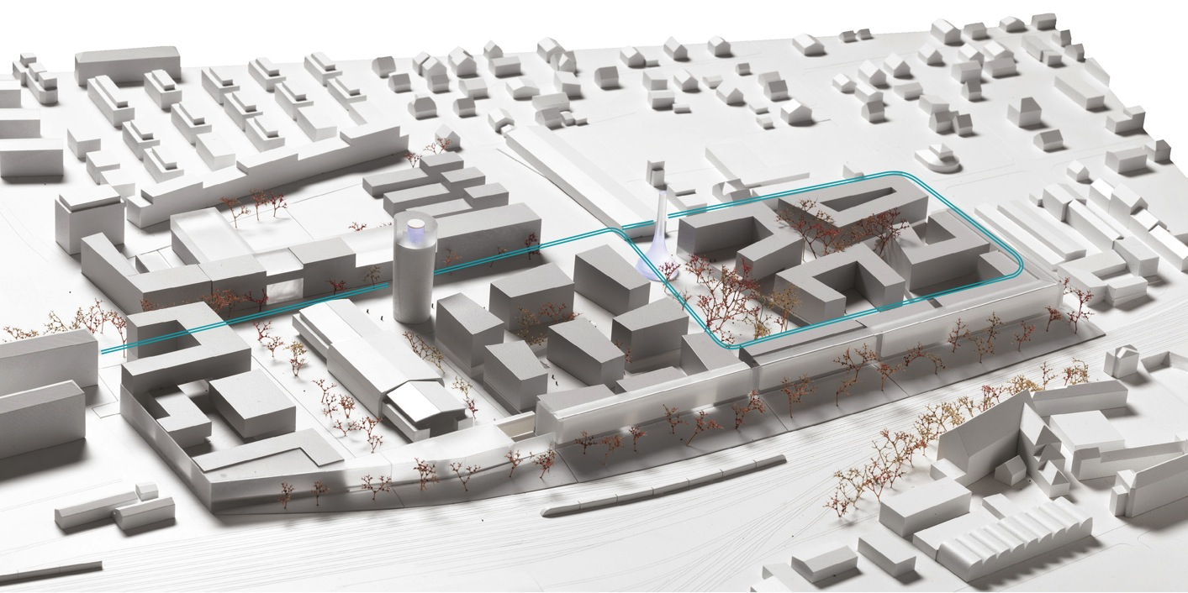
Mobility
Modell: DI Markus Pernthaler Architekt ZT GmbH / Foto: Ott

Slide 19

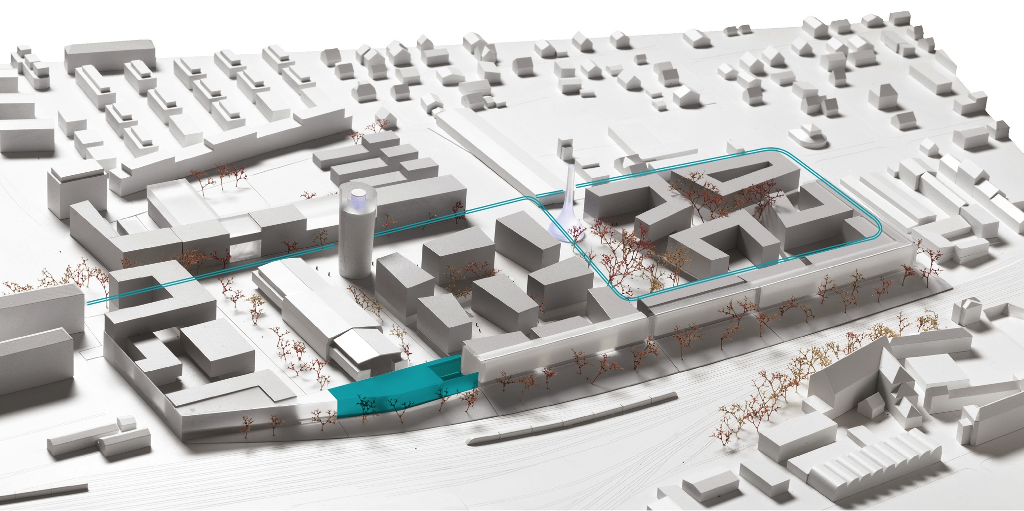
Mobility
Energy
Modell: DI Markus Pernthaler Architekt ZT GmbH / Foto: Ott

Slide 20
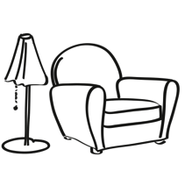
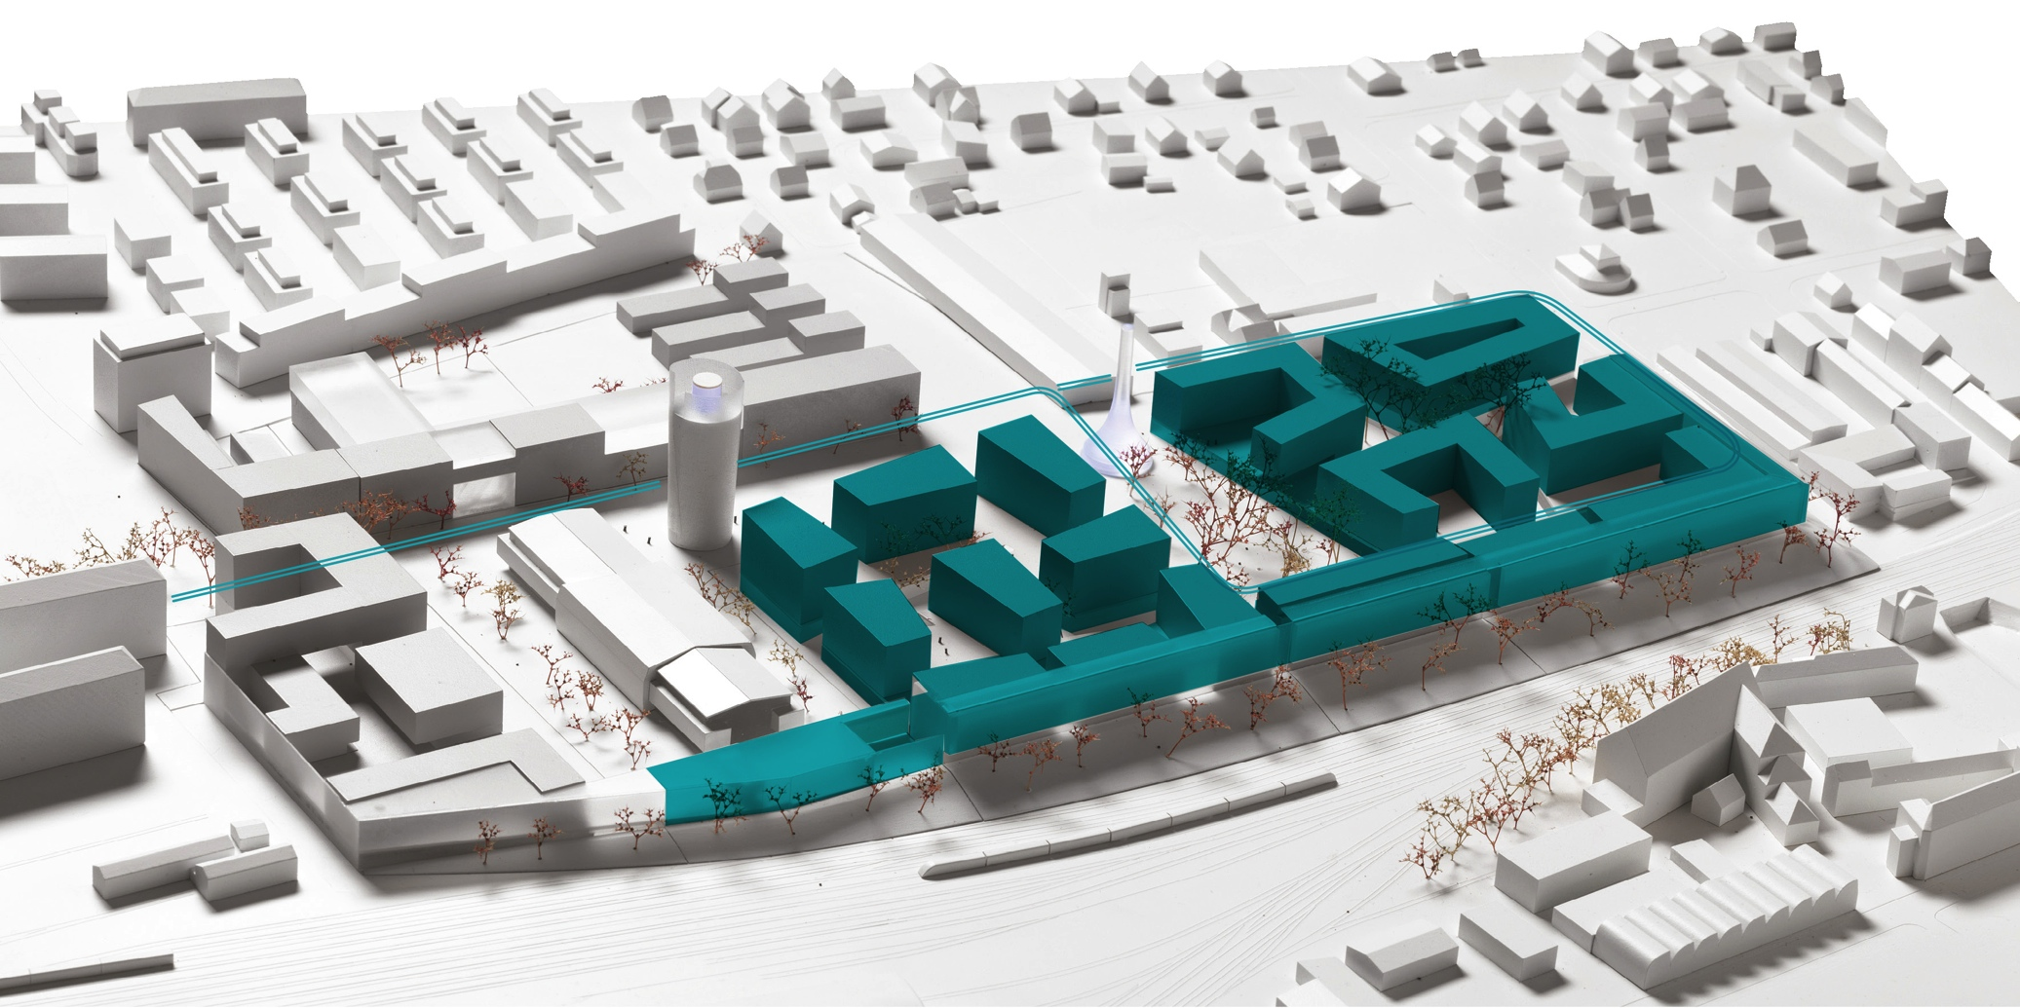
Mobility
Energy
Living
Modell: DI Markus Pernthaler Architekt ZT GmbH / Foto: Ott
Notes:
Investors and Developers

Slide 21
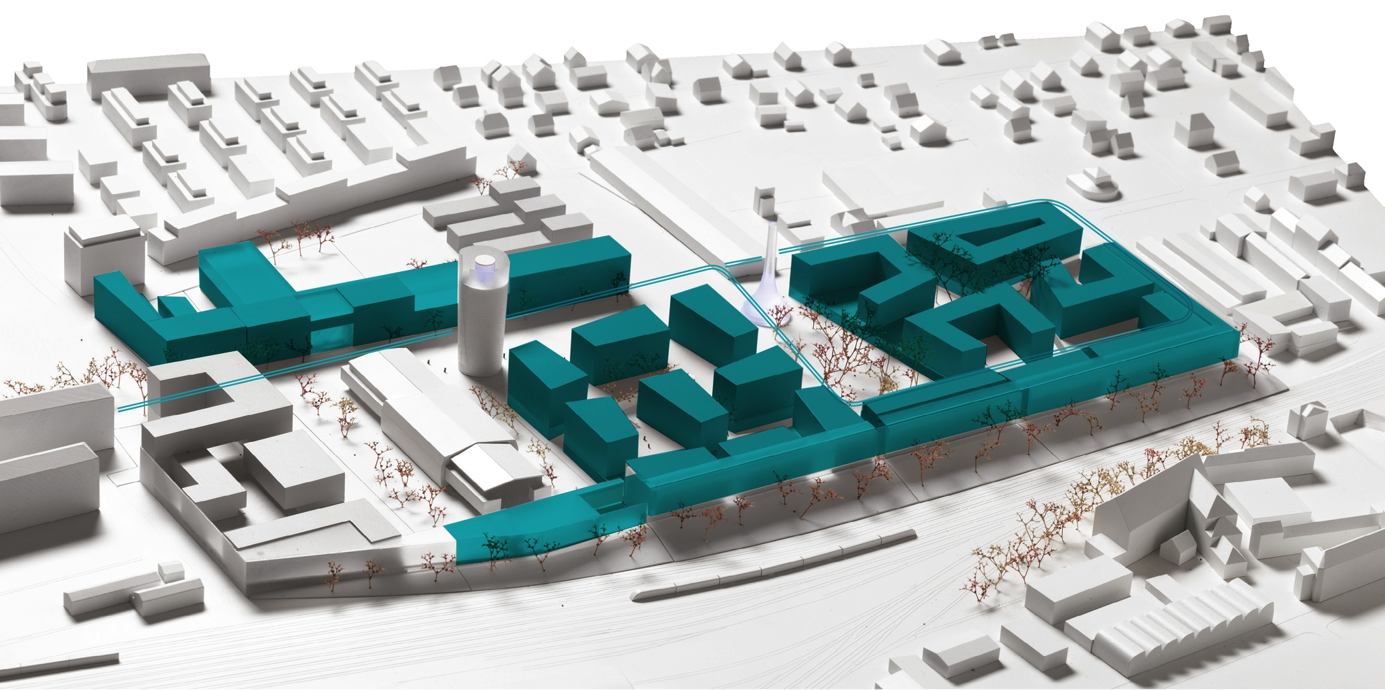

Mobility
Energy
Living
Education
Modell: DI Markus Pernthaler Architekt ZT GmbH / Foto: Ott

Slide 22
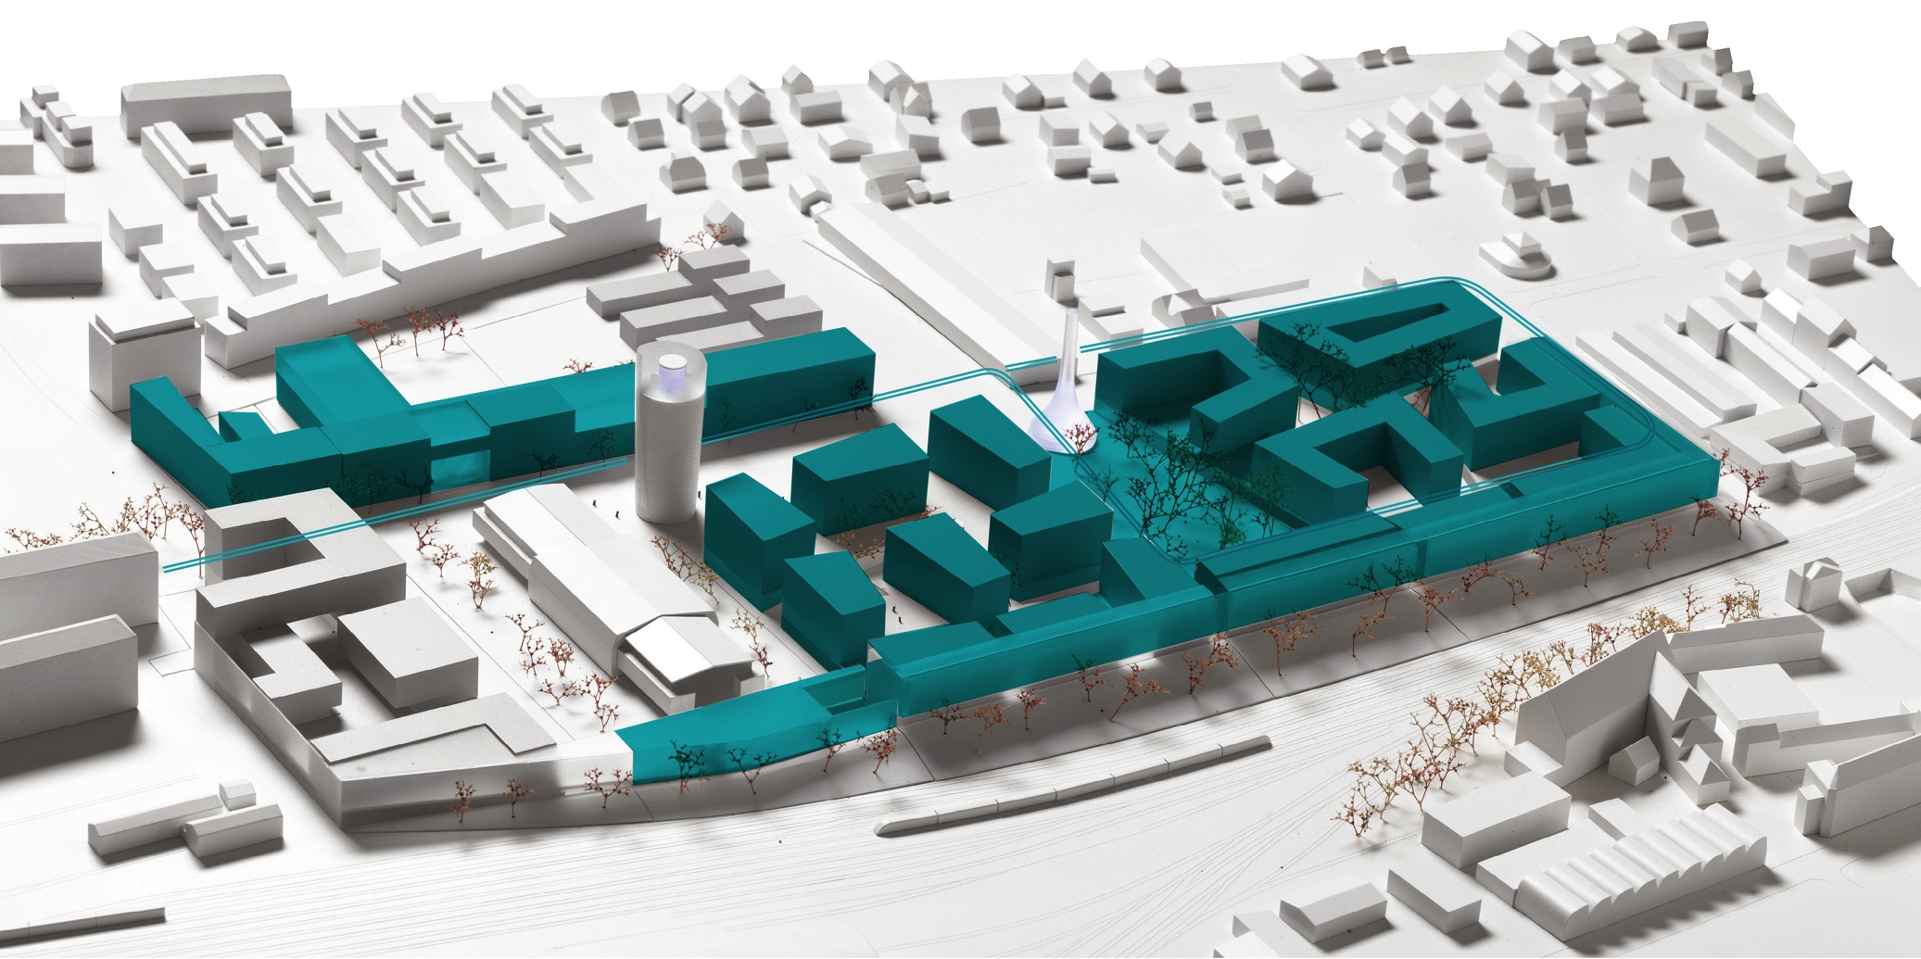

Mobility
Energy
Living
Recreation
Education
Modell: DI Markus Pernthaler Architekt ZT GmbH / Foto: Ott

Slide 23
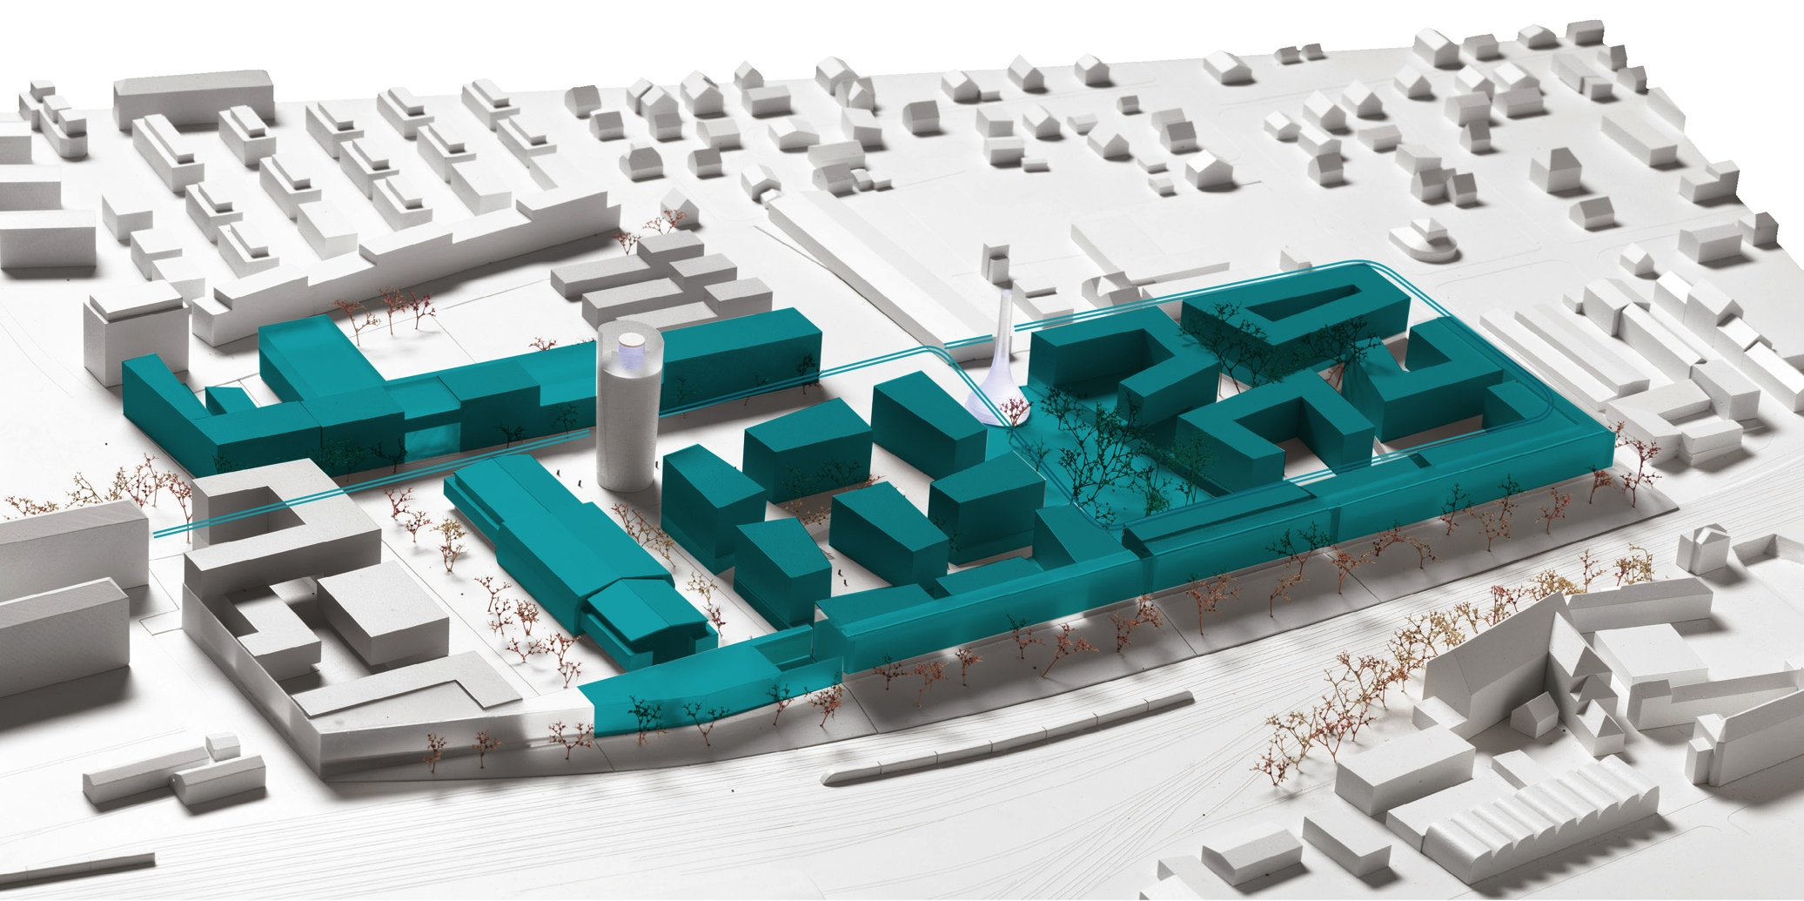
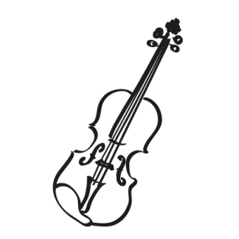


Mobility
Energy
Living
Culture
Recreation
Education
Modell: DI Markus Pernthaler Architekt ZT GmbH / Foto: Ott

Slide 24


Mobility
Energy
Living
Science
Culture
Recreation
Education
Modell: DI Markus Pernthaler Architekt ZT GmbH / Foto: Ott

Slide 25
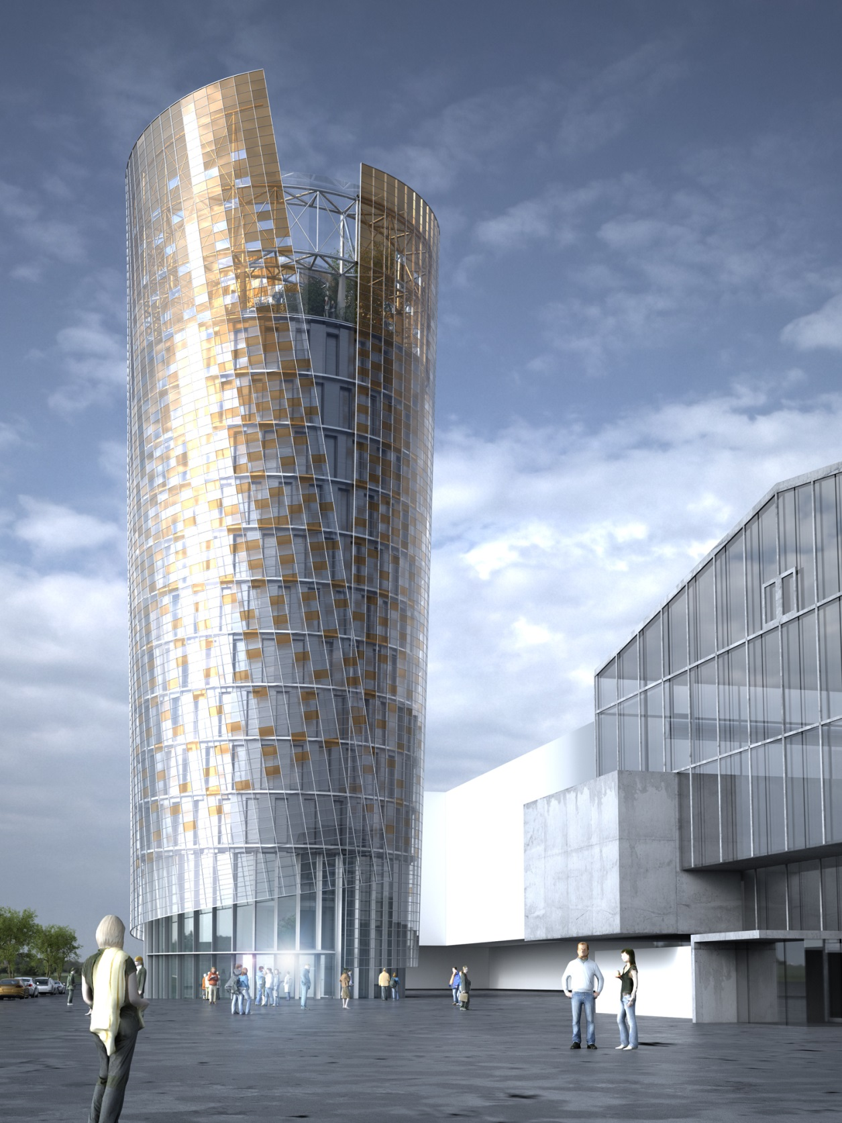
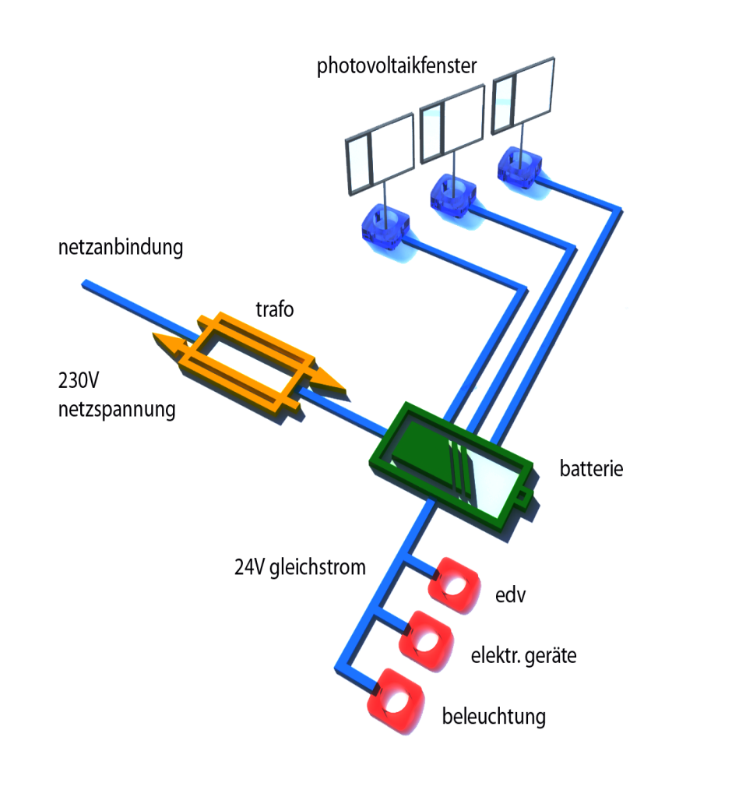


Science-tower
for companies and research facilities
with landmark function will be finished in 2016
new building technologies
Science
© Architekt Markus Pernthaler ZT GmbH

Slide 26
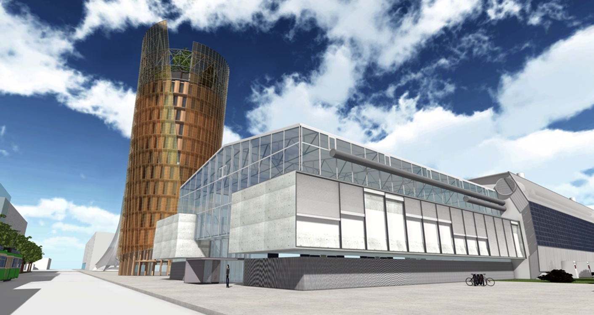
Visualisierung © uwalkin 2014

Slide 27
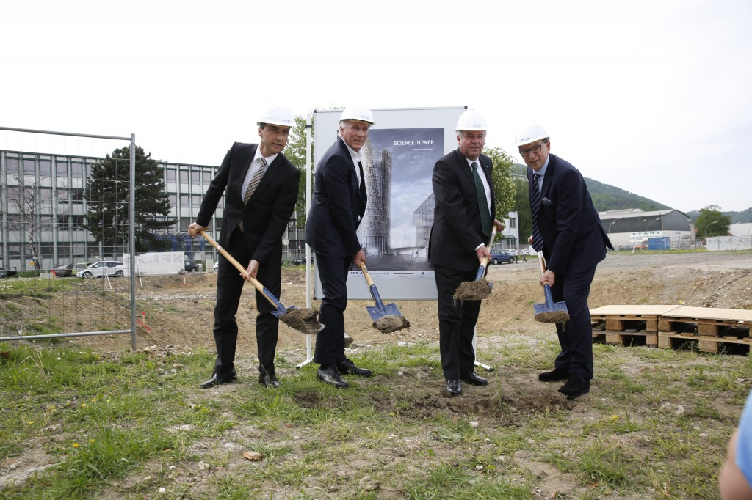
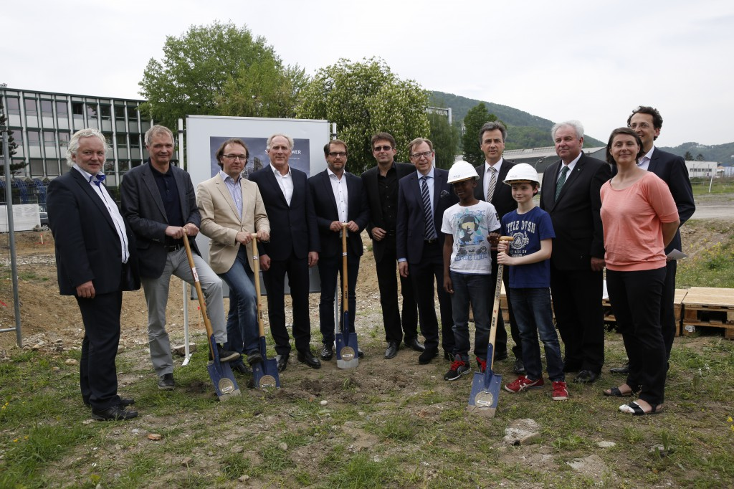
Science-tower
Groundbreaking ceremony
05. May 2015
After 100 years a new city quarter appears
Science Tower as the first landmark
4.600m² floor area space
200 scientific workplaces
Smart City Graz; www.smart citygraz.at

Slide 28
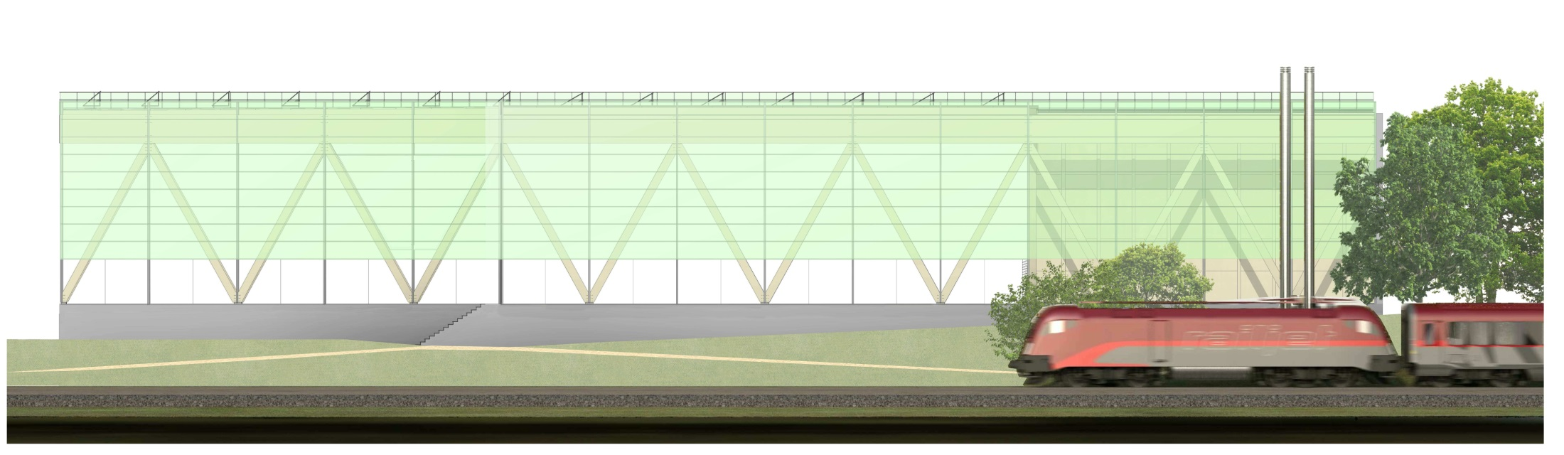
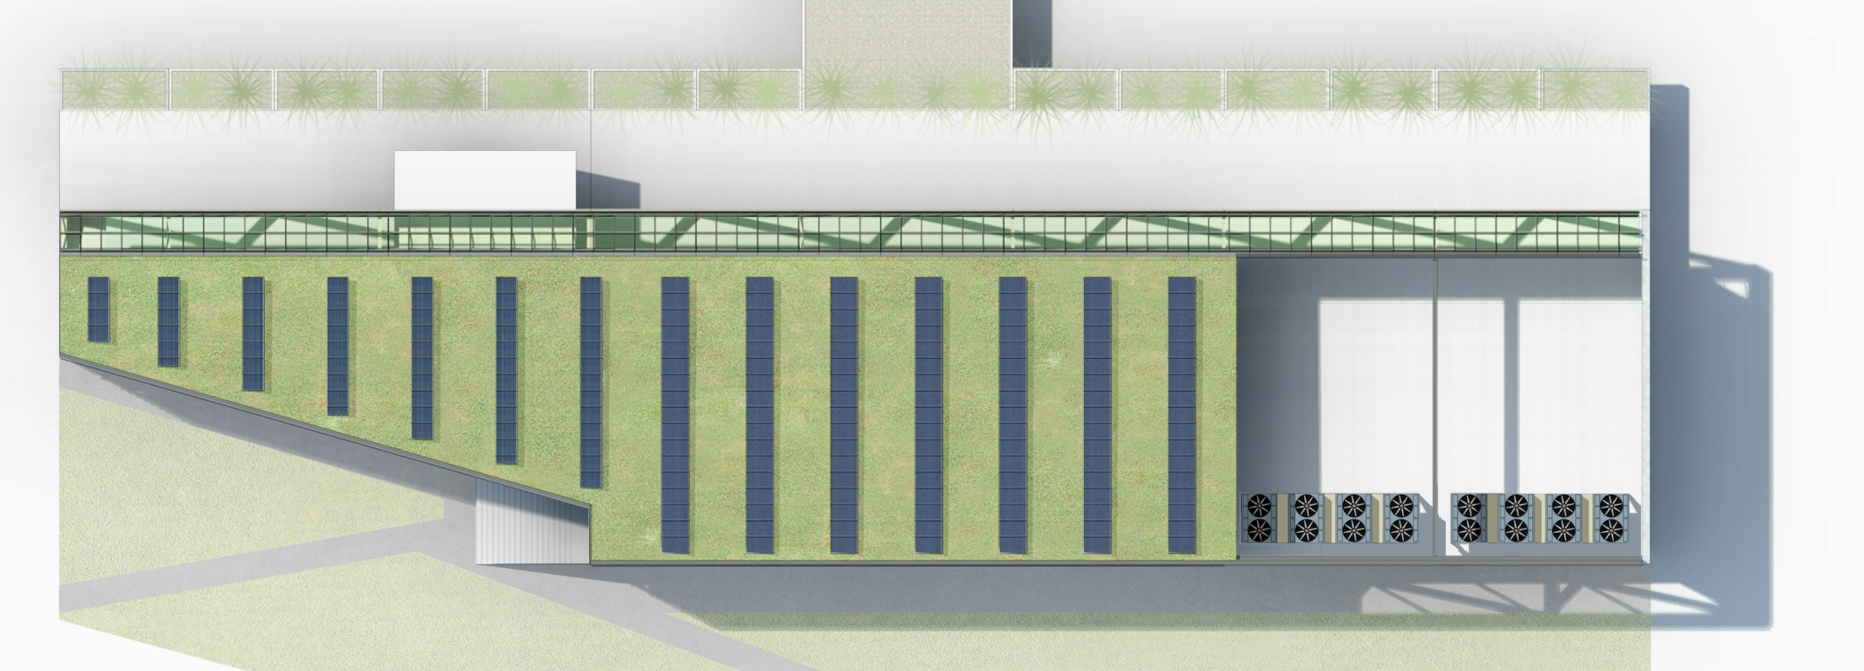
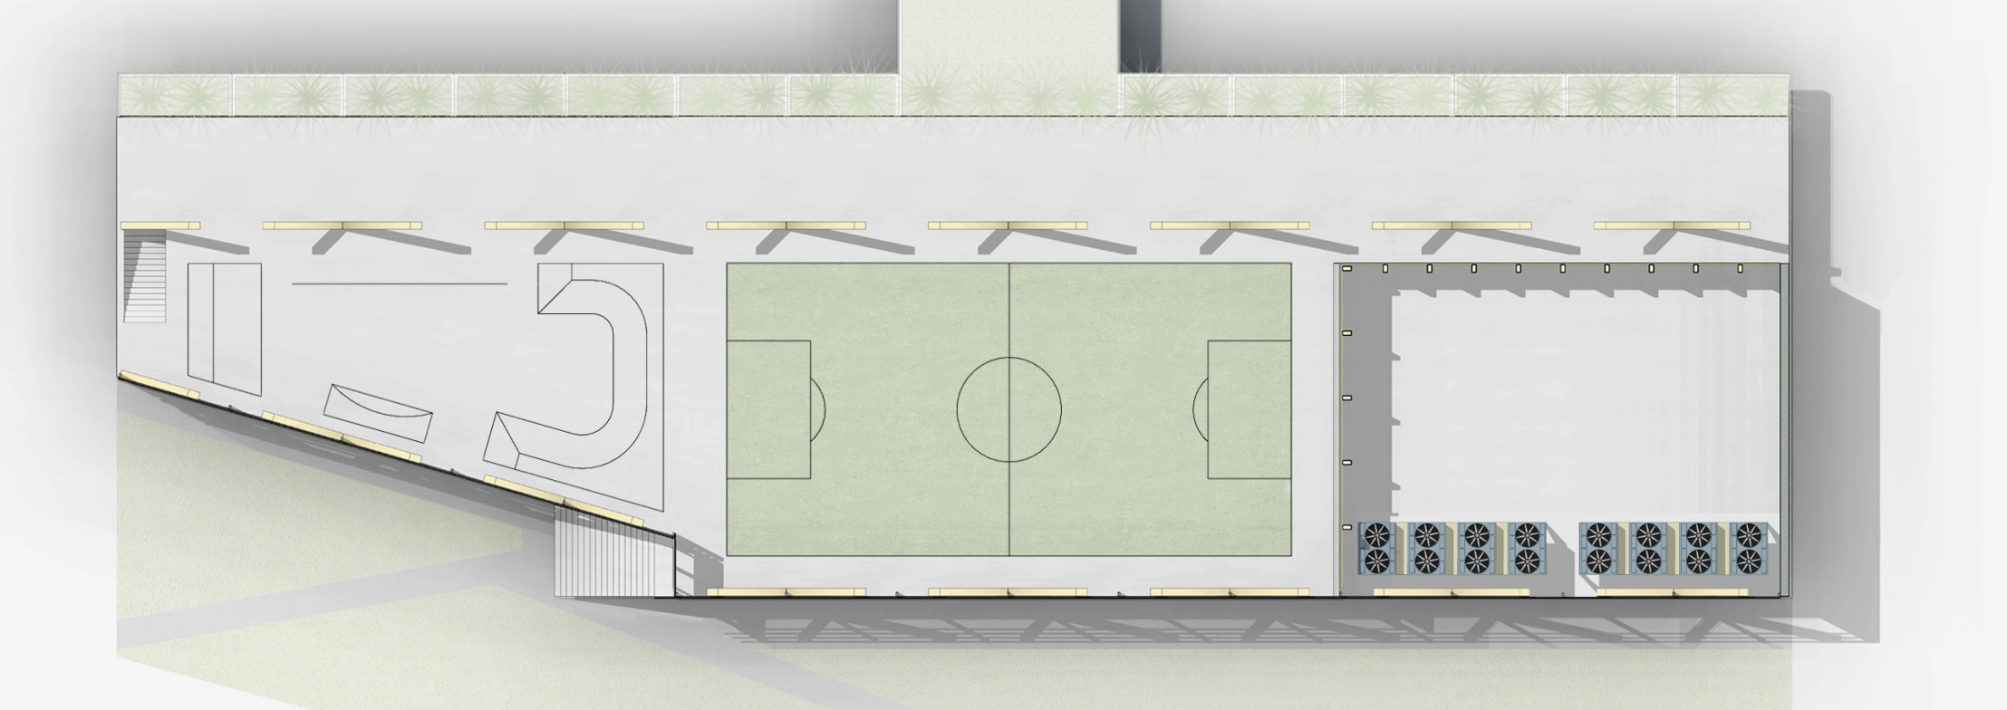
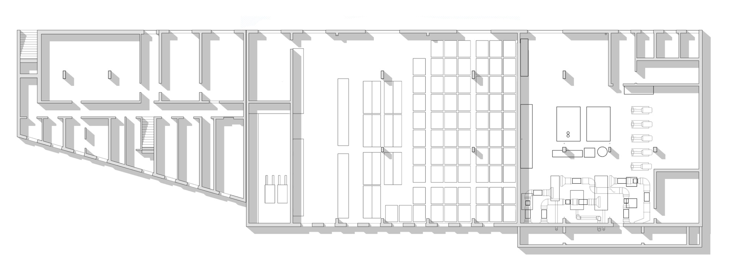

Energy
GREEN POWER PLANT
PERNTHALER ARCHITECTS

Slide 29
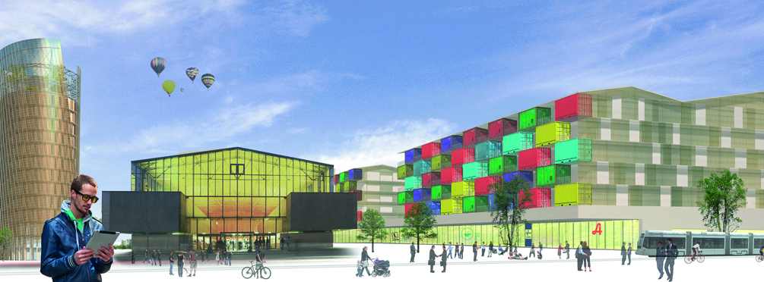

Architekturwettbewerb (Baufeld Süd)
Preis
PENTAPLAN ZT-GmbH Arch. Köck, Graz
Abbildung: PENTAPLAN ZT-GmbH
Culture

Slide 30
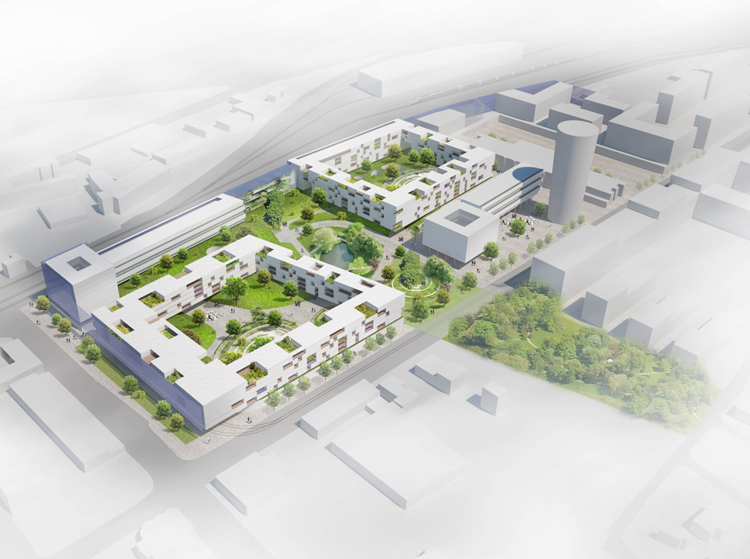

Städtebaulicher Wettbewerb (Mitte + Nord)
Preis:
Nussmüller Architekten ZT GmbH, Graz
Living
Recreation
Abbildung: Nussmüller Architekten ZT GmbH

Slide 31
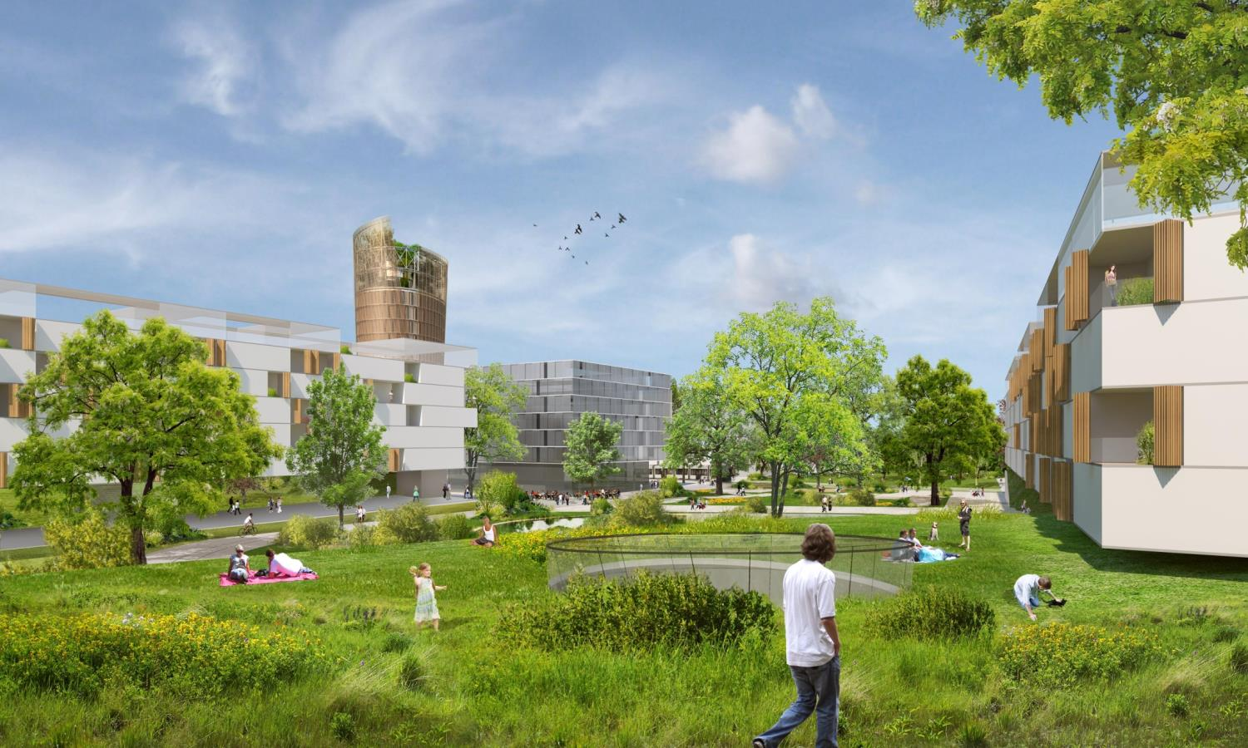
Abbildung: Nussmüller Architekten ZT GmbH

Slide 32
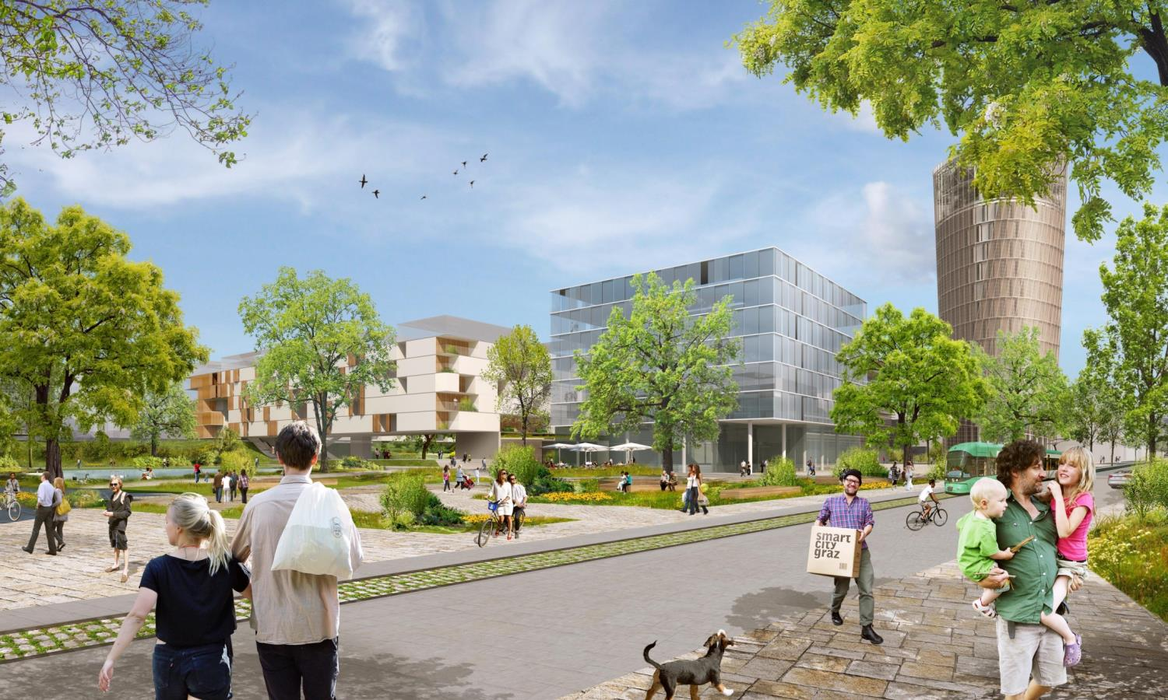
Abbildung: Nussmüller Architekten ZT GmbH

Slide 33









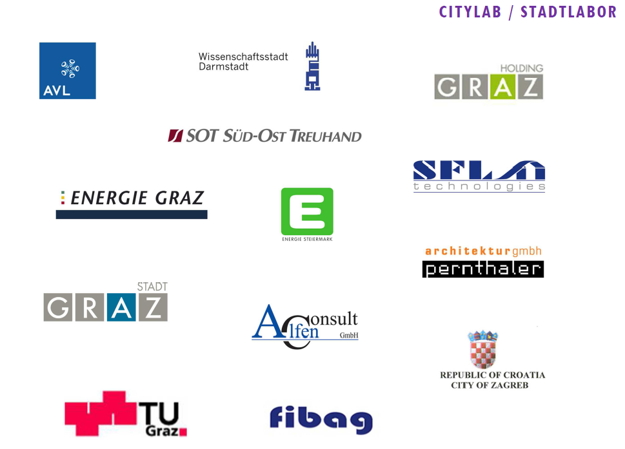




Slide 34
Thank you for your attention

