Slide 1
Evaluation of an urban medium voltage network using reliability indices

Slide 2
Agenda
  Aim of the evaluation
  Reliability assessment
  Restructuring of an urban medium voltage network and results
  Conclusions

Slide 3
Aim of the evaluation
Assessment of reliability indices of a medium voltage network in order to:
  Evaluate restructuring measures in terms of efficiency
  Impartially compare restructuring measures

Slide 4
Reliability assessment
  Input data: interruption behavior of network equipment (cables, overhead lines, switches, ...)
  Reliability datatypes: global input for software
  Datatypes, switching options and switching times
  → reliability values for each network element

Slide 5
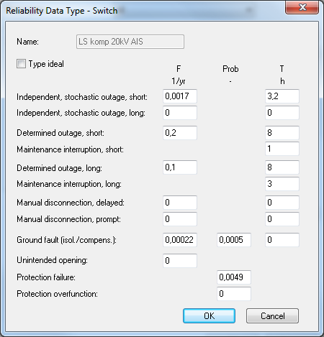
Reliability assessment – reliability datatype

Slide 6
Reliability assessment – reliability values
Acronym | Reliability value | Unit | Description
F | Expected value of interruption frequency | 1/yr | Frequency of expected interruptions per year
Q | Non-availability | min/yr or h/yr | Probability of expected interruptions per year
T | Expected value of duration of interruption | min or h | Expected duration of interruption

Slide 7
Reliability assessment – reliability indices
Input data: interruption
behavior in terms of
Reliability-
Network calculation
datatypes
software NEPLAN®
interruption durations
and frequencies
Reliability values
(F, Q and T) for each node
Transformer capacity
Calculation acc. to
respectively number of
customers
IEEE Std.1366-2012
Reliability indices
SAIDI, SAIFI, etc.

Slide 8
Reliability assessment – reliability indices
  System Average Interruption Duration Index (SAIDI)
  ...total duration of interruption for the average customer
  System Average Interruption Frequency Index (SAIFI)
  ...indicates how often the average customer is affected by an interruption
  Customer Average Interruption Duration Index (CAIDI)
  ...average time required to restore service

Slide 9
Reliability assessment – reliability indices
  Average System Interruption Duration Index (ASIDI)
  ...corresponds to SAIDI but refers to the interrupted load rather than to the average customer
  Average System Interruption Frequency Index (ASIFI)
  ...is based on the load which can't be supplied due to interruptions

Slide 10
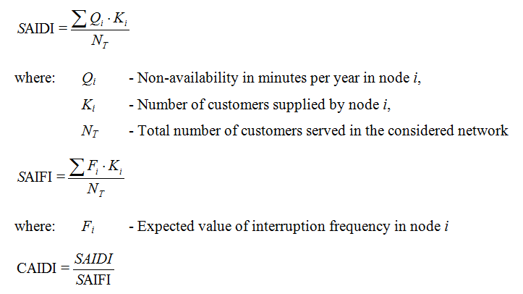
Reliability assessment – reliability indices

Slide 11
Restructuring of an urban medium voltage network
Assumption of heavy load conditions
→ selected cables are loaded with more than 50 % of their capacity
  Change of switching status
  Additional cable connection
  Additional cable with cross connections to existing stations

Slide 12

Measure a – change of switching status
Station x
Improvement of SAIDI by 28 %
initial value: 6,6 min/yr
improved value: 4,8 min/yr
47 %
Busbar
51 %
< 30 %
50 %
< 30 %
22 %
32 %
51 %
< 30 %
33 %
Circuit breaker closed

Slide 13

Measure b – additional cable connection
Station x
Additional cable connection between busbar and station x
→ Initial and additional cable connection are loaded with about 25 % of their capacity
47 %
21 %
24 %
Busbar
51 %
26 %
50 %
24 %
51 %
25 %
Circuit breaker open

Slide 14
Combination of measure a and b
Closed circuit breaker + additional cable connection
  Combines the benefits of measures a and b:
  Lower load and improved SAIDI
  Reduction of SAIDI by 26,7 %
  initial value: 6,6 min/yr
  improved value: 4,8 min/yr

Slide 15
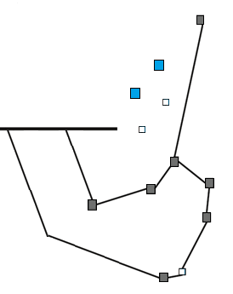
Measure c
Station x
Additional cable + cross-connections with open circuit breakers
  Reduced loadflow
  Improved SAIDI
  by 26,5 %
  initial value: 6,6 min/yr
  improved value: 4,8 min/yr
25 %
Busbar
25 %

Slide 16
Conclusions
By the use of the network calculation software NEPLAN® and data of the »FNN-Interruption-Statistics« an assessment of reliability indices can be accomplished with high accuracy.
By applying restructuring measures the load of the equipment can be reduced and the network reliability is improved.
Including further switching options can have a positive effect on the network reliability.

Slide 17
Conclusions
Simplifying statements regarding the impact of network restructuring measures are difficult to make.
The efficiency of such measures depends on the network structure and has to be calculated and evaluated individually.
Evaluation of restructuring measures using reliability indices before the actual implementation of e.g. new cable connections can be beneficial.

Slide 18
Thank you for your attention

Slide 19
Appendix

Slide 20
