Slide 1

Reflection on Global Earthing Systems
24TH KOMUNALNA ENERGETIKA
May 12TH to 14TH 2015
Dipl.-Ing. Thomas Mallits
Dipl.-Ing. Dr.techn. Ernst Schmautzer
Univ.-Prof. Dipl.-Ing. Dr.techn. Lothar Fickert
Universität Graz
Institut of Electrical Power Systems
www.ifea.tugraz.at
thomas.mallits@tugraz.at

Slide 2
AGENDA
Global Earthing System
Definition
Current distribution
Evaluation
Statistical considerations
People risk
CBA – cost benefit analysis

Slide 3
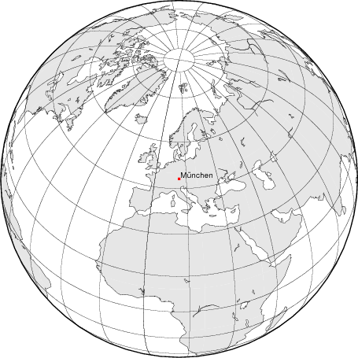
Global Earthing System!

Slide 4
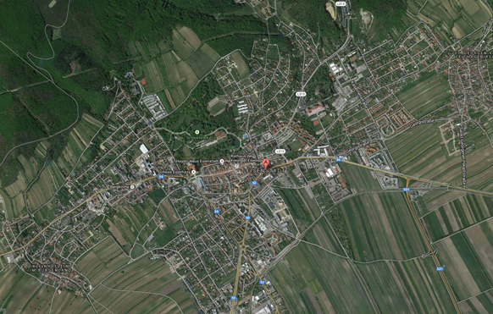
Global Earthing System – Standards (1)
DIN EN 61936-1 (VDE 0101-1):2011-11 / EN 61936-1:2010
Kap. 3.7.19 - Definitions
A combination of local grounding systems, which ensures that through the small mutual distance no dangerous contact voltages can occur.
NOTE 2: The existence of a global grounding system can be detected by pattern-measurements or calculations for typical arrangements. Typical for global earthing systems are city centers, urban or industrial areas with distributed low and high voltage grounding.

Slide 5
Global Earthing System – Standards (2)
DIN EN 61936-1 (VDE 0101-1):2011-11 / EN 61936-1:2010
Annex O (informative) - Global Earthing System
Typical cases
Installation, surrounded by buildings with foundation earth electrodes and connected ground systems
City centers
Suburban areas with many distributed earth electrodes, which are connected by the low-voltage protective conductor
Plant with a specific number and length of outgoing earth electrodes
Systems connected via several cable with earthing function
Extensive industrial areas

Slide 6
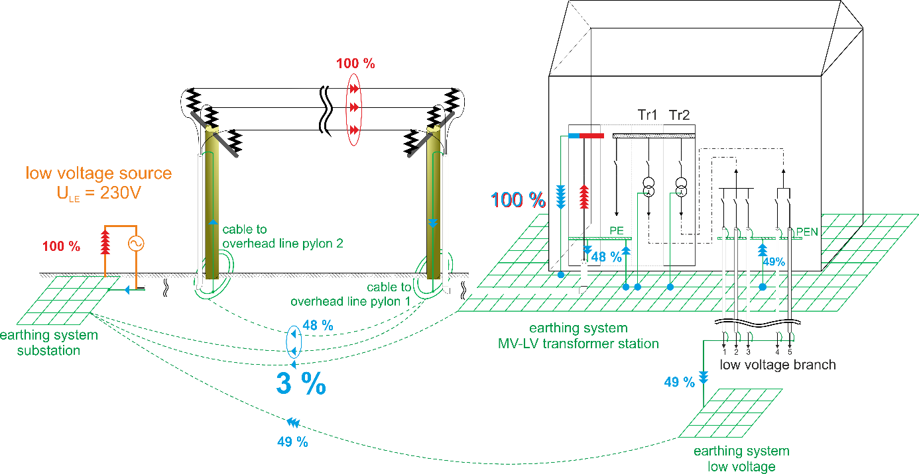
Current distribution in medium voltage grids

Slide 7
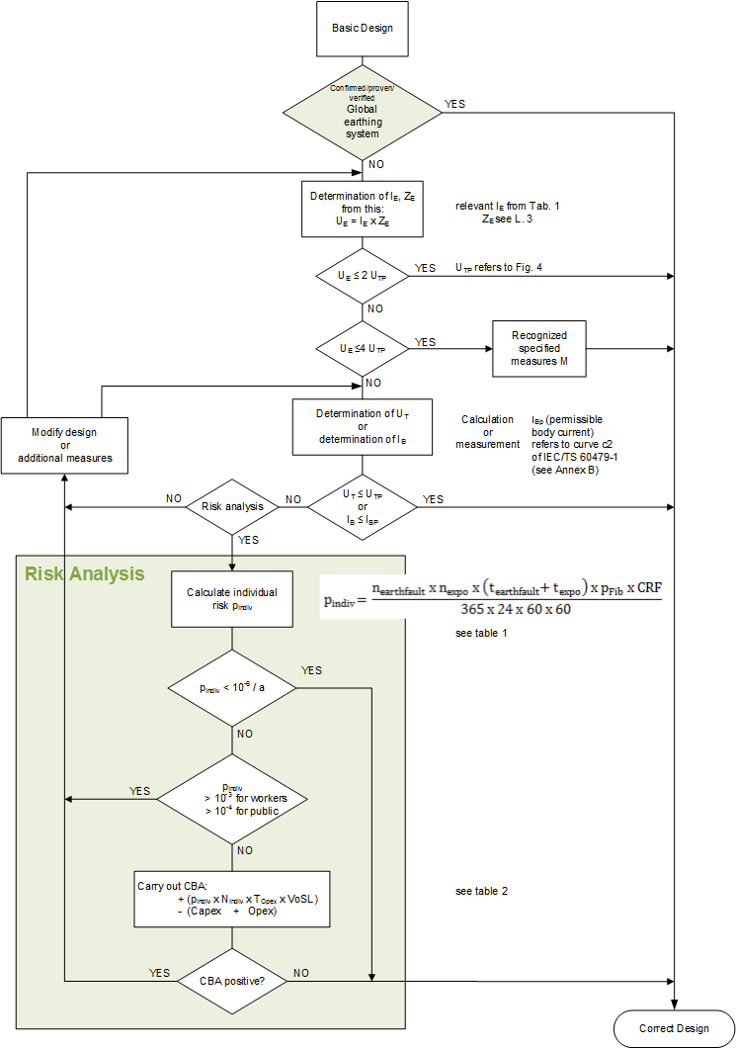
Standard status quo (EN 50522)
80
Zulässige Berührungsspannung U_{T}
touch voltage in V
duration in ms

Slide 8
Typical touch voltages
Planning guideline: traditonal typical
60 A (former “self-extinguishing limit“)
with R_{ES} = 2,5 Ω (planning value of the station resistance)
→ U_{E} = 150 Volt ≤ 2 x 75 V (lt. E 8383) resp. 2 x 80 Volt (lt. EN 50522) ✔
Reality: There is often a global earthing system. In the global earthing system ground fault causes no dangerous contact voltages.
Measurements showed: U_{T} = Z_{Trans} x I_{F} with Z_{Trans} ≤ 30 mΩ
e.g. continuous 100 A → ≤ 3 Volt ✔
e.g. short-term locating auxiliary current 300 A → ≤ 9 Volt ✔

Slide 9
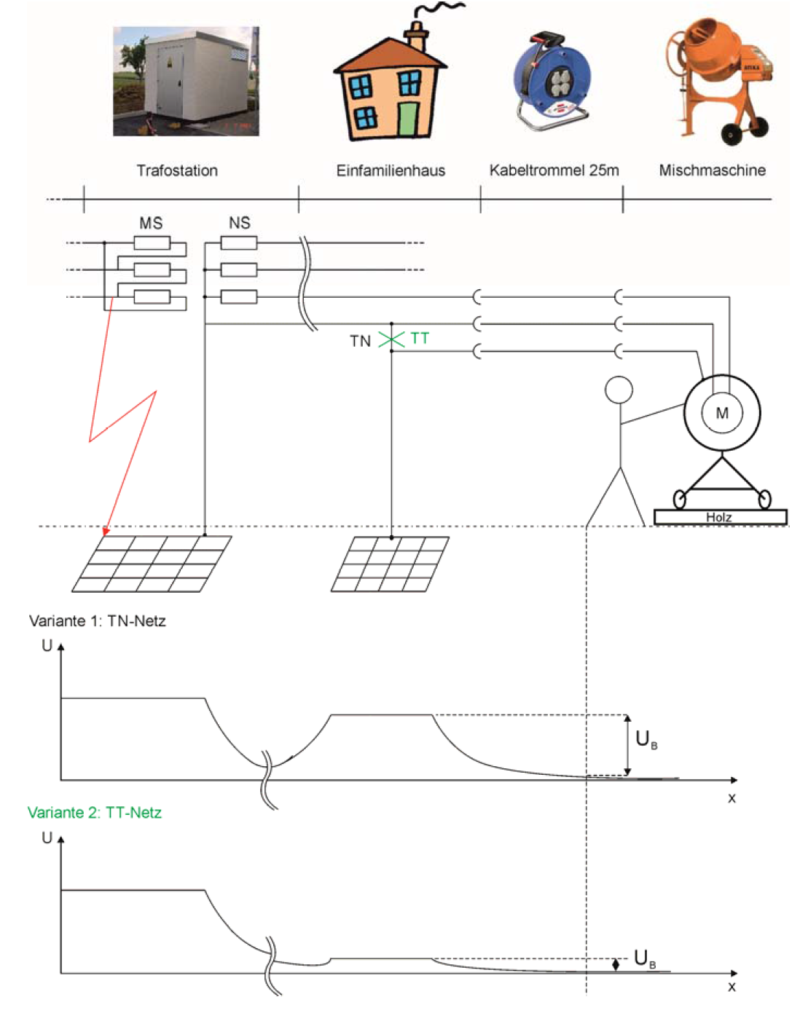
Global Earthing System – Exposed Areas
Examples
Situation at local edges ("Blender")
Outlier
Cable to overhead line poles (MV)
External MV-stations
Exterior building - LV (“snackbar")
installations at the border of global earthing system
Conection of LV-earth (TN) with
MV-earth and voltage transfer
(EPR ≤ F · UTP: “concrete mixer
on extension cord")

Slide 10
Statistical evaluation of human safety

Slide 11
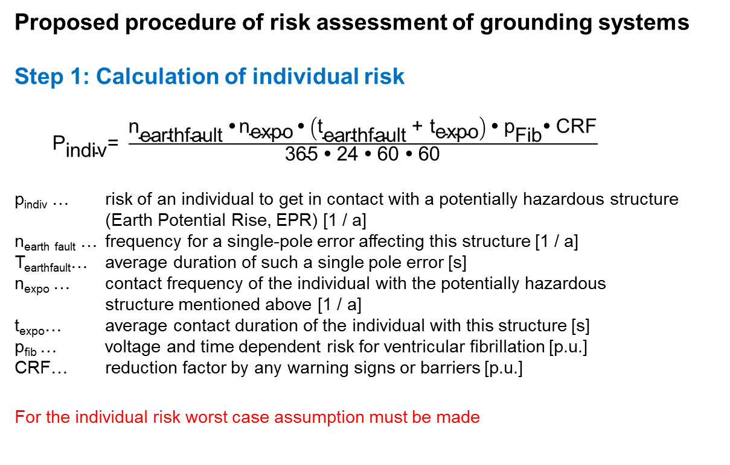
Risk analysis BS EN 50522 (1)
Proposed procedure of risk assessment of grounding systems
Step 1: Calculation of individual risk
${\text{P}}_{\text{indiv}}\text{= }\frac{{\text{n}}_{\text{earthfault}} \text{•} {\text{n}}_{\text{expo}} \text{•} \left({\text{t}}_{\text{earthfault}} \text{+ }{\text{t}}_{\text{expo}}\right) \text{•} {\text{p}}_{\text{Fib}}\text{•} \text{CRF}}{\text{365} \text{•} \text{24} \text{•} \text{60} \text{•} \text{60}}$
p_{indiv} … risk of an individual to get in contact with a potentially hazardous structure (Earth Potential Rise, EPR) [1 / a]
n_{earth fault} … frequency for a single-pole error affecting this structure [1 / a]
T_{earthfault}… average duration of such a single pole error [s]
n_{expo} … contact frequency of the individual with the potentially hazardous structure mentioned above [1 / a]
t_{expo}… average contact duration of the individual with this structure [s]
p_{fib} … voltage and time dependent risk for ventricular fibrillation [p.u.]
CRF… reduction factor by any warning signs or barriers [p.u.]
For the individual risk worst case assumption must be made

Slide 12
Risk analysis BS EN 50522 (2)
Step 2: Compare with the allowable risk 10⁻⁶ p.a.
The basic individual risk of 10⁻⁶ p.a. are general socially accepted.
Step 3: Compare with a permissible limit risk
Step 4: Cost Benefit Analyse (CBA)
Parameter
N_{indiv} total number of potentially affected people [p.a.]
T_{Opex} total period under review [a]
VoSL Value of Statistical Life (economic concept in the economic evaluation of personal injury)
Capex Investment Costs during the operating life
Opex Operations Costs during the operating life
Step 5: Evaluation of the Cost Benefit Analysy (CBA)
Among economic aspects the cost of avoided power accidents are compared the costs of technical remedial

Slide 13
Proposed procedure BS EN 50522

Slide 14
Summary
Global Earthing System
Traditioneller Planungs-Richtwert für I_{F} ist oft gleich der „Löschgrenze“.
Erfahrung zeigt: nur ein kleiner Teil des Erdfehlerstromes fließt i.a. über die lokale Erdungsanlage in das Erdreich
Überprüfung von globalen Erdungssystemen hinsichtlich den normativen Vorgaben oft sehr aufwendig (Aufwand Praxisgerecht!?).
Statistical evaluation of human safety
Future (?): Additionally statistical methods for the of personal safety, with an economic evaluation

Slide 15
Reflection on Global Earthing Systems
Dipl.-Ing. Thomas Mallits
Dipl.-Ing. Dr.techn. Ernst Schmautzer
Univ.-Prof. Dipl.-Ing. Dr.techn. Lothar Fickert
Universität Graz
Institut of Electrical Power Systems
www.ifea.tugraz.at
thomas.mallits@tugraz.at

Slide 16
Bonus Material

Slide 17
Reserve – concrete mixer

Slide 18
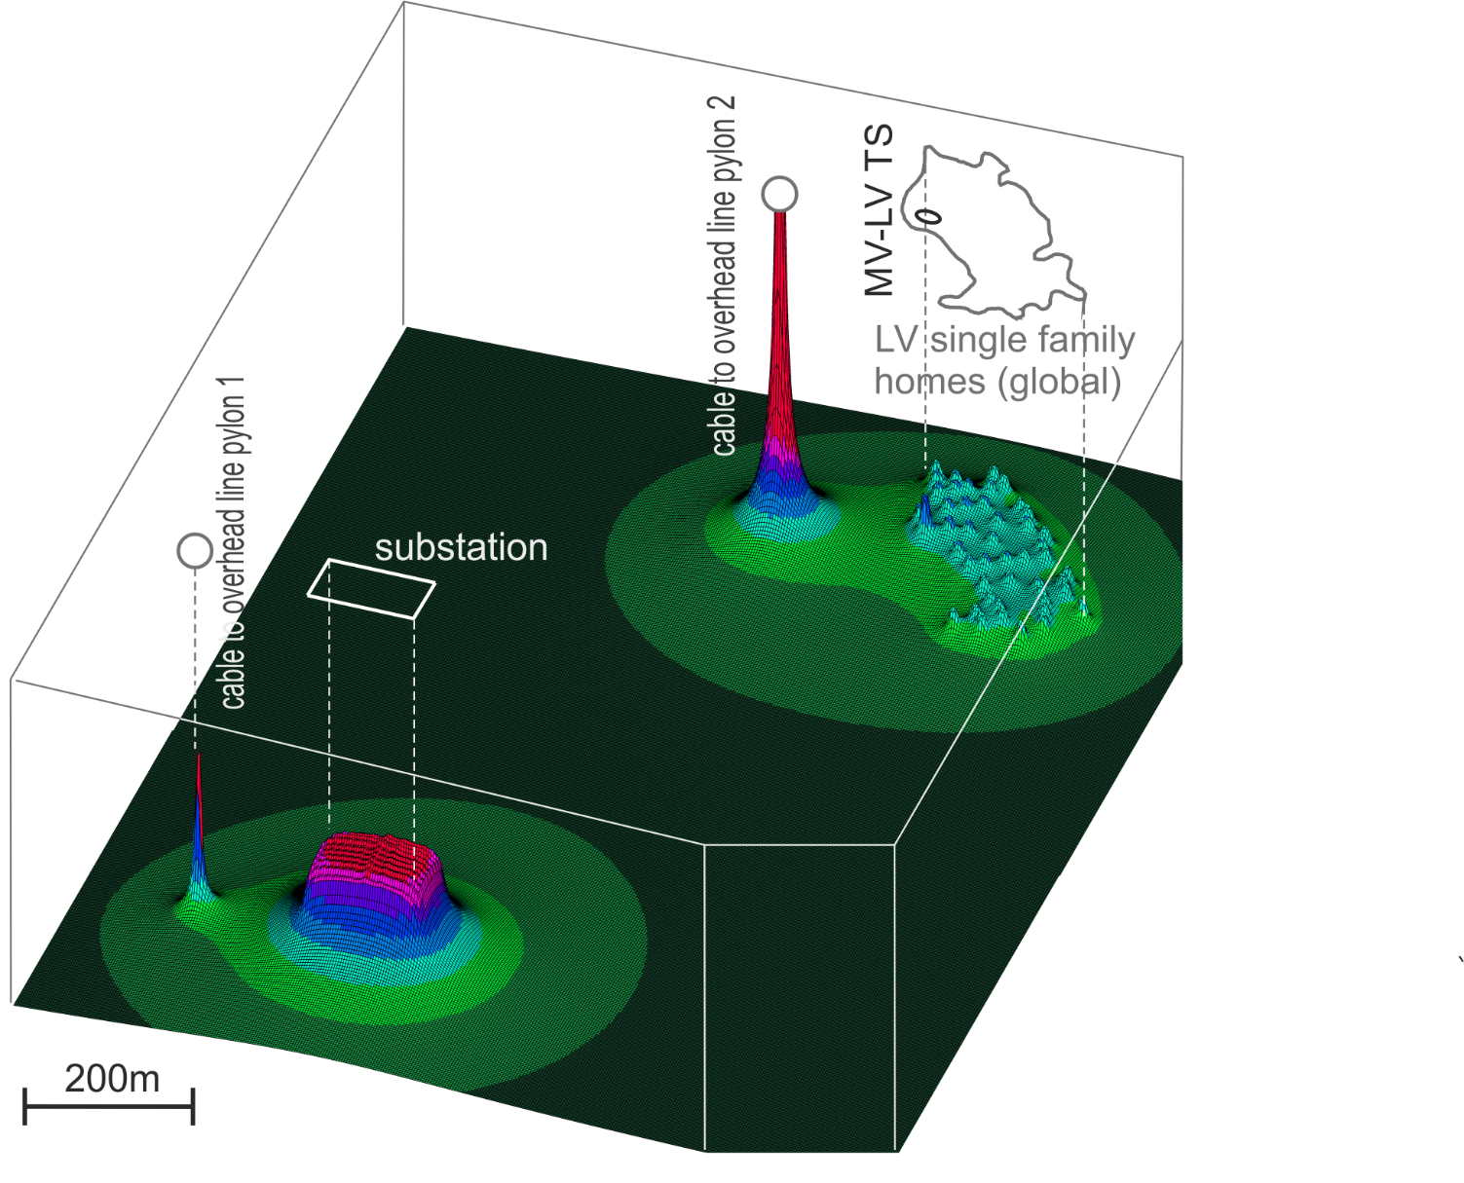
Earth Surface Potential

