Slide 1
What is it worth?
Determining the capital stock of Europe‘s hydropower plants

Slide 2
Motivation
High capital intensities and high lifetimes
Especially for hydropower plants:
  Depreciations are too low to ensure adequate replacement investments
  Real (!) value is not shown in balance sheets
  Nominal price increases have a bigger impact than in other sectors
Notes:
This is especially true for hydropower plants: those power plants have, among all electricity generating technologies, the highest technical lifetimes (up to 80 to 100 years), they require huge investments and the amount of the investment is strongly depending on the geographical location and environmental circumstances.
Therefore, due to the high lifetimes and capital intensities:

Slide 3
Problem
Value of fixed assets important, determination difficult
  Real (!) value cannot be determined based on balance sheets
Alternative: Capital stock
  Difference
  Replacement values Historic acquisition values
  Technical lifetimes Economic useful life
Problem:
  Hydropower plants particular difficult, as not standardized
  Information regarding historic acquisition values and replacement values not available
Gross capital stock
Net capital stock
✓
✗
✓
✗
Notes:
Not possible to get the real value of the fixed assets from the balance sheets, as in other sectors with a high asset turnover, low lifetimes and low capital intensities.

Slide 4
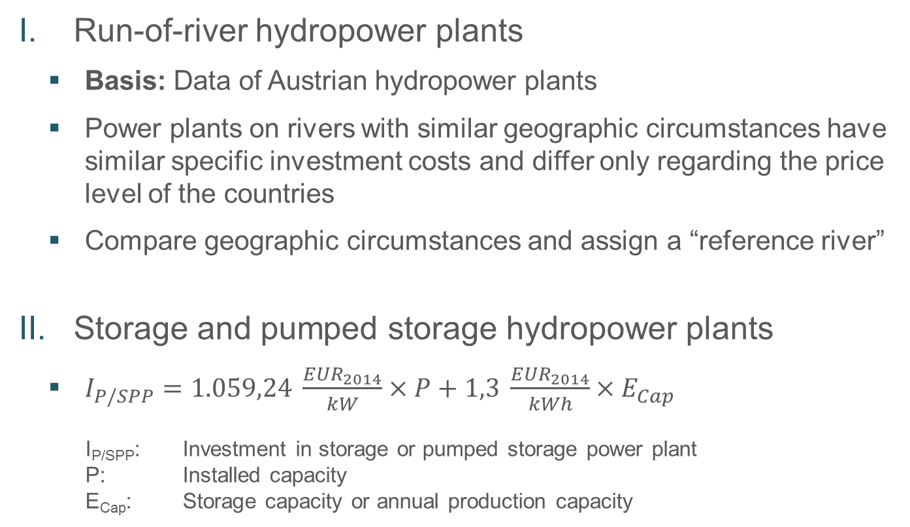
Method (I)
Run-of-river hydropower plants
  Basis: Data of Austrian hydropower plants
  Power plants on rivers with similar geographic circumstances have similar specific investment costs and differ only regarding the price level of the countries
  Compare geographic circumstances and assign a “reference river”
Storage and pumped storage hydropower plants
  $I_{P/SPP}=1.059,24 \frac{{EUR}_{2014}}{kW}×P+1,3 \frac{{EUR}_{2014}}{kWh}×E_{Cap}$
  I_{P/SPP}: Investment in storage or pumped storage power plant
  P: Installed capacity
  E_{Cap}: Storage capacity or annual production capacity
Source: Forschungsstelle für Energiewirtschaft e.V., 2014

Slide 5
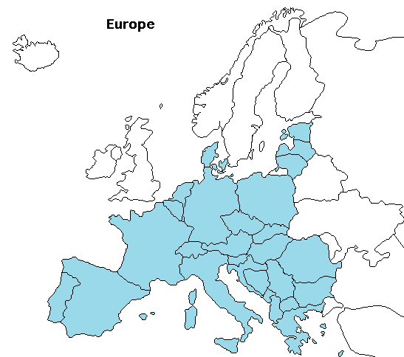
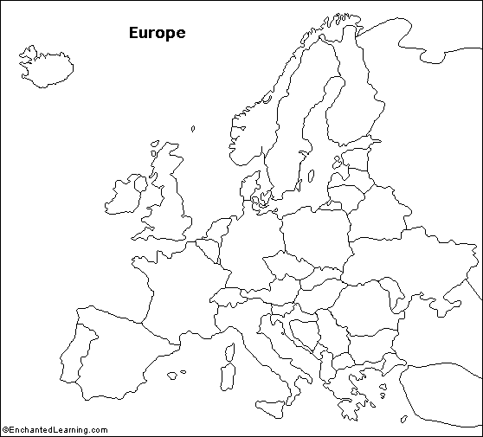
Results (I)
28 European countries
End of 2015:
  ~ 1.600 run-of-river
  hydropower plants, 50 GW
  Aggregates for microgeneration units
  ~ 1.400 storage and pumped
  storage hydropower plants, 105 GW

Slide 6
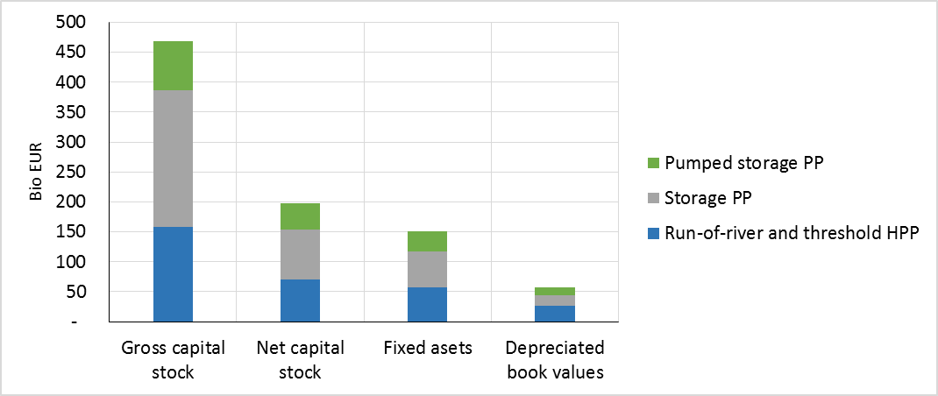
Results (II)
Values in bio EUR
2015 | Gross CS | Net CS | Fixed assets | Net fixed assets
Run-of-river HPP | 158,1 | 70,5 | 56,9 | 26,7
Storage PP | 228,0 | 83,0 | 60,9 | 16,8
Pumped storage PP | 81,9 | 44,7 | 32,4 | 13,5
Total | 468,0 | 198,2 | 150,2 | 57,0
Capital stock (CS):
Replacement values, 80 years
Fixed assets:
Historic acquisition values, 50 years

Slide 7
Results (III)
Young run-of-river HPP on the Sava in Slovenia
Notes:
illustrates the investment costs in absolute numbers of the three youngest large hydropower plants in Slovenia, all of them located on the lower Sava river.
Also these rather young hydropower plants already show some differences between the replacement values and the historical acquisition values due to nominal price increases.
For all three power plants, the depreciated replacement value is higher than the historic acquisition value.
Commissioning year: 2006 – 2009 – 2012
Installed capacity: 33 – 43 – 40

Slide 8
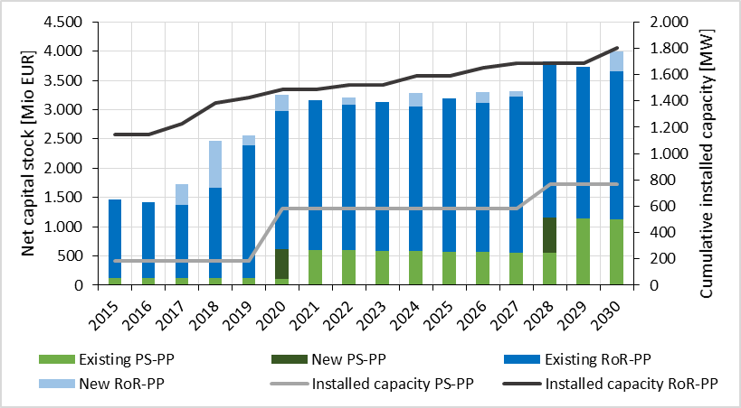
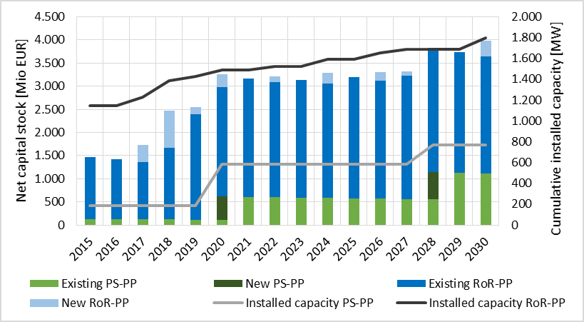
Results (IV)
Net capital stock of hydropower plants in Slovenia
PS-PP = Pumped storage hydropower plant
RoR-PP = Run-of-river hydropower plant
Notes:
Data based on National Energy Programme Slovenia 2011
2009: 1st PSPP, Avce, 185 MW

Slide 9
Summary
Net capital stock 3,5 times higher than depreciated historical acquisition values
Undervalued fixed assets in sectors with low asset turnover, high capital intensities, long-lasting assets
Net capital stock enables a determination of the real value of fixed assets
Notes:
Niedrige Kapitalumschlagshäufigkeit, hohe Kapitalintensität, langlebige Anlagen: AV durch hist. AW nicht der Realität entsprechend in Bilanzen abgebildet.
Tatsächliches AV hat viel höheren Wert als das in den Bilanzen ausgewiesene. Deshalb: Nettokapitalstock zur Ermittlung des tatsächlichen AV
Großer Teil der Kosten für Begleitdämme, Staumauer. Diese zwei Charakteristika hängen stark von geographischen Gegebenheiten (Gefälle, Wassermenge) ab – zulässig für Ermittlung der InvestK
Verschiedene Szenariorechnungen mit institutseigenem Simulationsmodell ATLANTIS liefern je nach Strategie (CO2-Minimierung, Elektromobilität, etc.) unterschiedlichen Kapitalstock – kann ermittelt und miteinander verglichen werden.

Slide 10
Thank you for your attention!

