Slide 1
ON-LINE IDENTIFIABILITY OF A SYNCHRONOUS GENERATOR BY LINEARIZED EQUIVALENT
Gorazd Bone, Urban Rudež and Rafael Mihalič

Slide 2
About dynamical equivalents in general
Let there be a dynamic signal measurement.

Slide 3
About dynamical equivalents in general
Let there be a dynamic signal measurement.

Slide 4
About dynamical equivalents in general
Try to find a dynamical equivalent

Slide 5
About dynamical equivalents in general
Try to find a dynamical equivalent

Slide 6
About dynamical equivalents in general
Quality – how to measure?

Slide 7
About dynamical equivalents in general
Quality – how to measure?

Slide 8
About dynamical equivalents in general
Quality – distance between signals

Slide 9
About dynamical equivalents in general
Quality – distance between signals

Slide 10
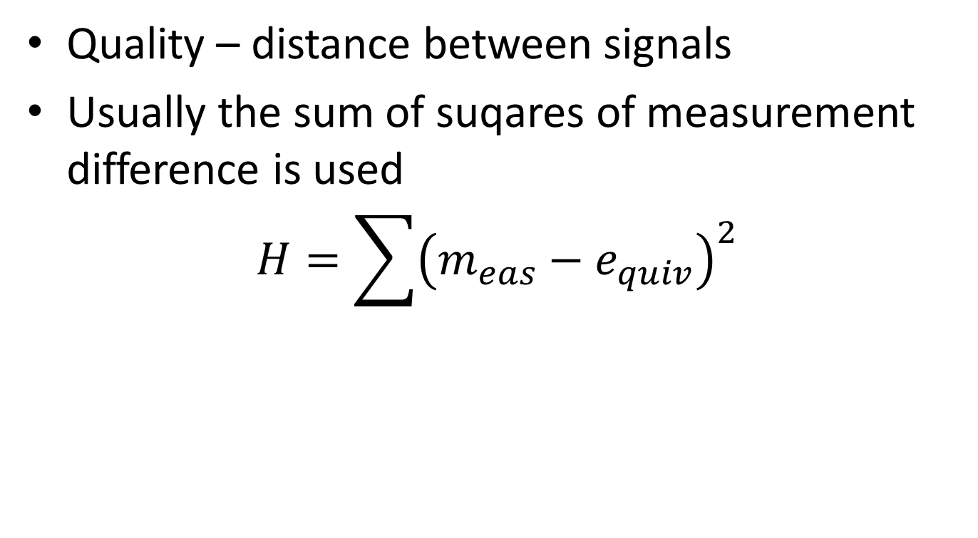
About dynamical equivalents in general
Quality – distance between signals
Usually the sum of suqares of measurement difference is used
$$H=\sum{{\left(m_{eas}−e_{quiv}\right)}^{2}}$$

Slide 11
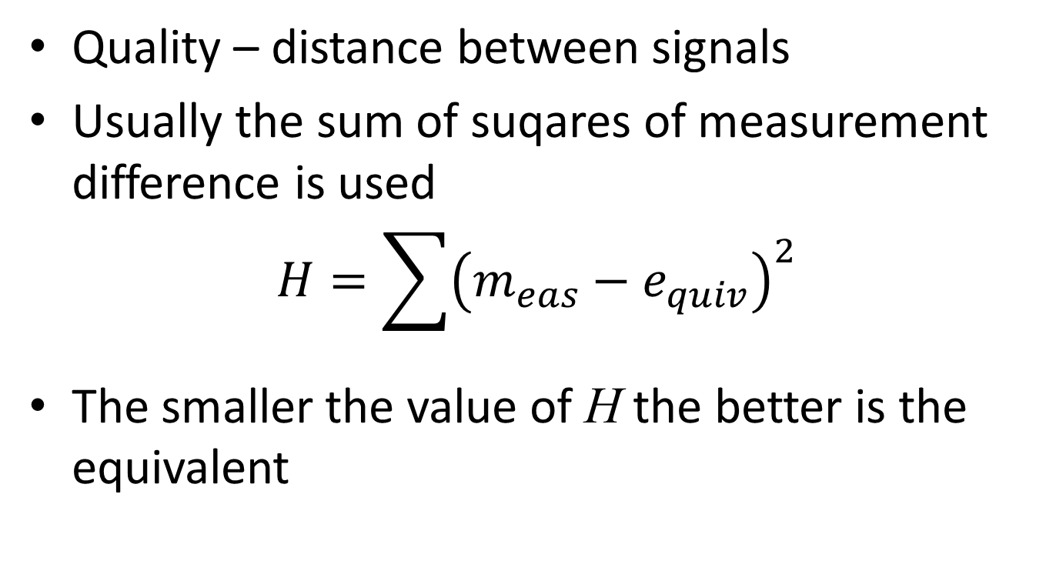
About dynamical equivalents in general
Quality – distance between signals
Usually the sum of suqares of measurement difference is used
$$H=\sum{{\left(m_{eas}−e_{quiv}\right)}^{2}}$$
The smaller the value of H the better is the equivalent

Slide 12
Synchronous generator dynamical equivalent

Slide 13
Synchronous generator dynamical equivalent
Measured signal at terminals – obtained active and reactive power dynamics

Slide 14
Synchronous generator dynamical equivalent
Measured signal at terminals – obtained active and reactive power dynamics
Use exhaustive, brute force search

Slide 15
Synchronous generator dynamical equivalent
Measured signal at terminals – obtained active and reactive power dynamics
Use exhaustive, brute force search
  Perform simulation, compare the signals, if close, save parameters

Slide 16
Synchronous generator dynamical equivalent
Measured signal at terminals – obtained active and reactive power dynamics
Use exhaustive, brute force search
  Perform simulation, compare the signals, if close, save parameters
  Decoupled. Some signals not influenced by some parameters

Slide 17
Synchronous generator dynamical equivalent
Measured signal at terminals – obtained active and reactive power dynamics
Use exhaustive, brute force search
  Perform simulation, compare the signals, if close, save parameters
  Decoupled. Some signals not influenced by some parameters
The results show that different parameter sets may produce the same dynamics

Slide 18
Identifiablity issue – active power for all parameters

Slide 19
Identifiablity issue – reactive power for all parameters

Slide 20
Noticeable difference between physical and simulated (modeling fidelity)

Slide 21
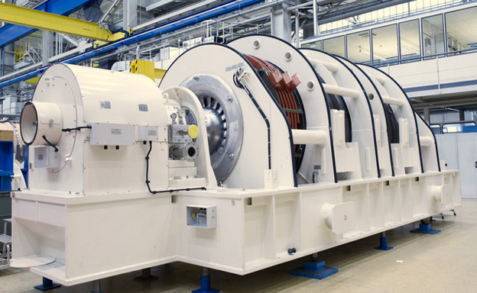
Intrinsic issue with synchronous generator
*https://www.tonex.com/fundamentals-of-synchronous-machines/

Slide 22
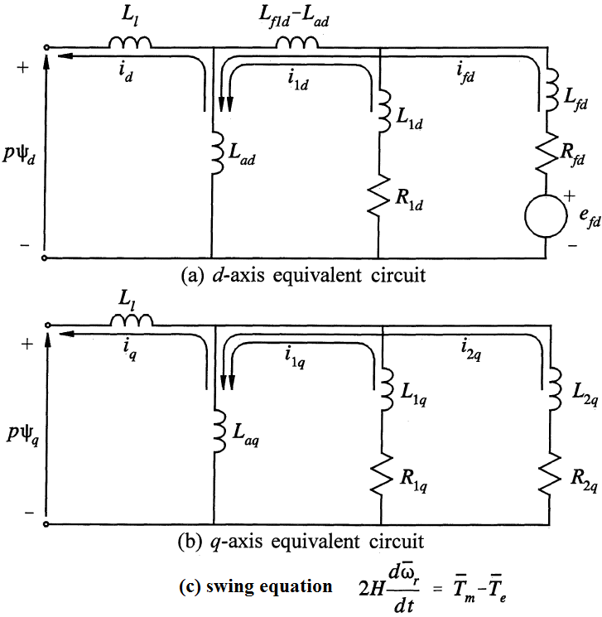
Intrinsic issue with synchronous generator
*https://www.tonex.com/fundamentals-of-synchronous-machines/
**Prabhashankar Kundur: „Power System Stability and Control“, McGrawHill Inc.

Slide 23
Thank you for your attention
Gorazd Bone, Urban Rudež and Rafael Mihalič

