Slide 1
Impact of considered SVC implementation in the Slovenian power system on inter-area
ENTSO-E oscillation damping
International Expert Meeting
„Komunalna energetika 2017“
10. May 2017, Maribor, Slovenia
Urban Rudež, Rafael Mihalič
University of Ljubljana, Faculty of Electrical Engineering
urban.rudez@fe.uni-lj.si, rafael.mihalic@fe.uni-lj.si

Slide 2
Introduction
Komunalna energetika 2017
Future investments into the Slovenian power system
EU funding for solving steady-state voltage issues in the region
Smart solutions for wide-area welfare
Static Var Compensator (SVC)
ENTSO-E inter-area oscillation damping
Appropriate modelling:
  Power-system
  SVC device itself
  Triggering and sustaining oscillations

Slide 3
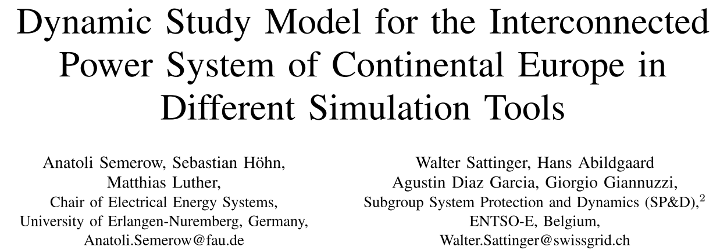
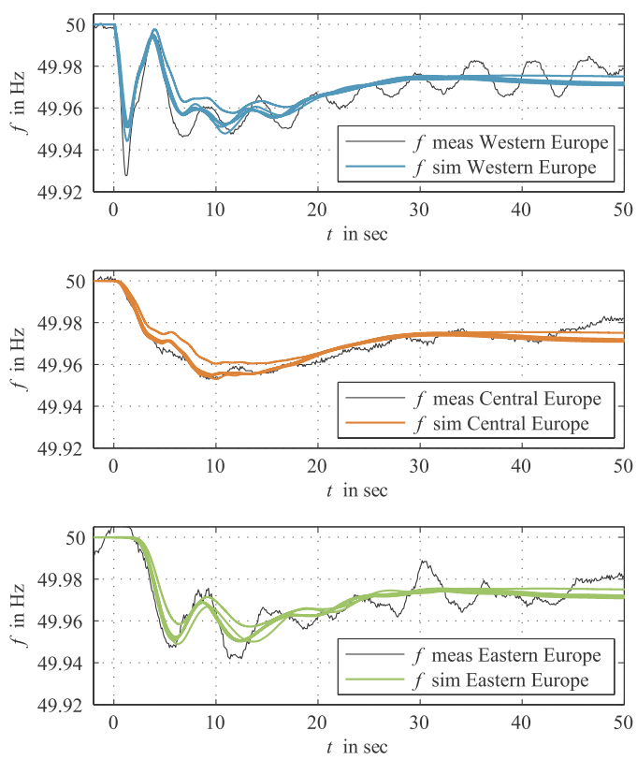
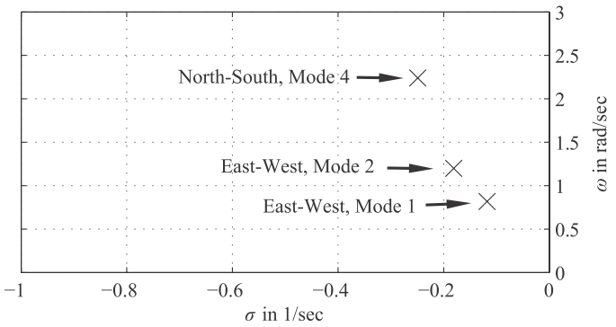
Dynamic Study Model
Komunalna energetika 2017
mean frequency transients
general oscillatory behavior
SEVERAL MODEL SPECIFICS
replacement of national
power-system model
0.35 Hz → 0.40 Hz
0.13 Hz → 0.09 Hz

Slide 4
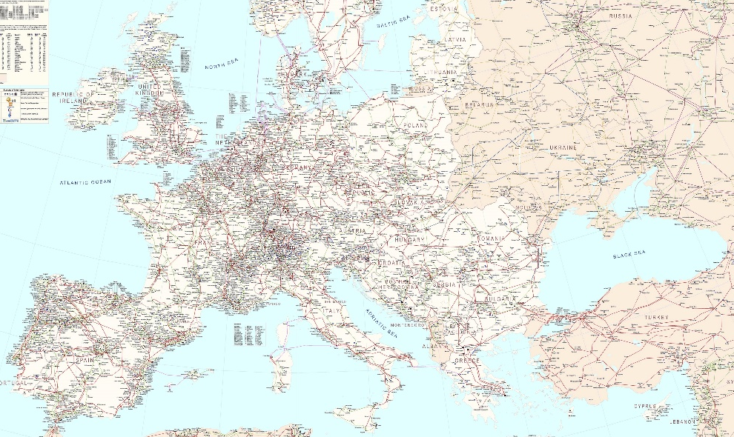
Slovenian power-system dynamic model
Komunalna energetika 2017
Model build for Slovenian TSO
Detailed 400kV, 220 kV and 110 kV network
Two simulation tools (NEPLAN, PSS Netomac)
Verified by PMU measurements
Slovenian portion
of the model used

Slide 5
SVC equivalent model
Komunalna energetika 2017
Stability calculation mode
Equivalent model, not detailed
Variable admittance (VAR-Y) element
for Thyristor Controlled Reactor (TCR)
POWER-OSCILLATION DAMPING
CONTROL
VOLTAGE CONTROL

Slide 6
Stimulation of oscillations
Komunalna energetika 2017
free oscillations (or negative-damping oscillations)
forced oscillations
changes in excitation-control parameters
sine-shaped active-power injection
brief oscillation-source presence
sustained oscillation
180° phase-shift

Slide 7
SVC impact (1)
Komunalna energetika 2017
West-east oscillation
center

Slide 8
SVC impact (2)
Komunalna energetika 2017
center
North-south oscillation

Slide 9
Conclusions
Komunalna energetika 2017
Models are appropriate
West-east and north-south inter-area oscillations
Electrical location of the SVC for specific oscillations
SVC in Slovenian power system contributes to damping
Influence of Slovenia-Italy interconnections

Slide 10
Komunalna energetika 2017
Urban Rudež
University of Ljubljana
Faculty of Electrical Engineering
Tržaška 25
1000 Ljubljana
Slovenia
Email: urban.rudez@fe.uni-lj.si
Web: lpee.fe.uni-lj.si
Skype: urban.rudez
Mobile: +386-41-756-735

