Slide 1


POSSIBILITIES OF VIRTUAL POWER PLANT PARTICIPATION IN THE SLOVAKIAN ELECTRICITY MARKET
22. Mednarodno posvetovanje Komunalna Energetika
Ján Ivanecký*, Klemen Deželak, Gorazd Štumberger
*University of Žilina, Department of Power Electrical Systems
Maribor, 15. maj 2013

Slide 2
Previous situation in Slovakia
Regulation of EU- “20-20-20“ by the 2020
Ministry of economy of the SR – issued the law 309 Z.z. about RES
Subject of settlement – power plant.
Main drawback in law 309 Z.z.- P_{inst} < 4MW – no responsibility for deviation = Rapid penetration of PV plants into 22 kV voltage level, July 2011 (around total P_{inst} = 480MW)
Present state – P_{inst} < 100kW – stopped furher penetration of PV into medium voltage level.

Slide 3
Consequences
Direction of power flow.
Necessity for building backup power plants (conventional).
Bottlenecks in some power lines.
Voltage fluctuations in power system nodes.

Slide 4
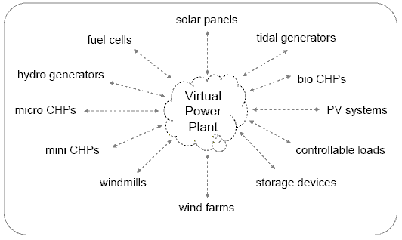
Solution to this? Virtual Power Plant concept (VPP):

Slide 5
Modelling of single sources
Biomass power plant.
Run-of-river power plant.
Pumped hydro storage power plant.
Non-controllable RES.

Slide 6
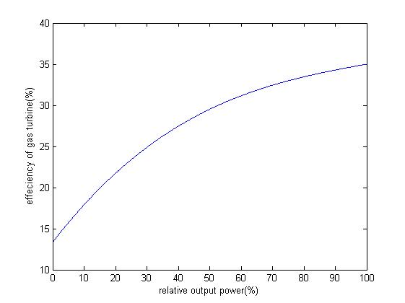
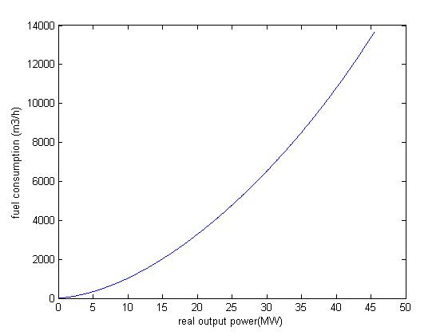
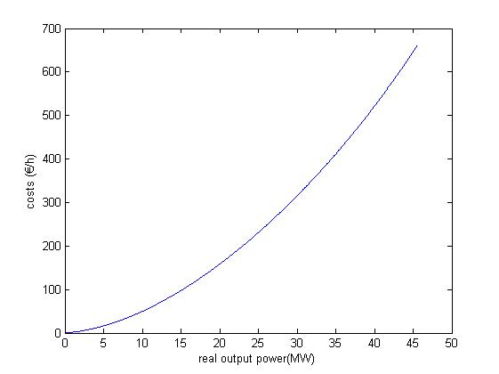
Biomass power plant

Slide 7
Participation of VPP in different markets
Day ahead market,
Ancillary service markets- secondary and tertiary.
Inputs needed:
Day ahead price forecast.
Forecast of output power of non-controllable RES.
Probabilities of calling up to provide individual ancillary service and their prices.
Parameters of sources (cost functions, ramp-rates, minimum up and down times, start-up and shut-down costs,…)

Slide 8
Problem formulation:
Objective function:
Constraints:
Energy balance equations.
Market constraints (day ahead, secondary, tertiary).
Logical status constraints.
Ramp rate constraints.
Minimum up and down time constraints.
Accumulation constraints.

Slide 9
Constraints:
Energy balance equation:
Logical status equations:
Ramp-rate constraints:
Accumulation constraints:

Slide 10
Thank you for your attention

